Slide 1
Git
Michael Backherms

Slide 2
What is Git?
Free Software Development Tool
Speedy tool for distributed revision control and source code management
Designed by Linus Torvalds for Linux kernel development
Git directories feature full revision tracking functionality
Not dependent on network access or central servers

Slide 3
History
2005 - Previous Linux kernel development tool, BitKeeper, revoked free service
Commercial company vs. user disputes
Creator of Linux, Linus Torvalds begins to develop own method, with the following design goals:
Speed
Simple Design
Strong Non-linear Development Support
Fully Distributed
Suport for Large Projects

Slide 4
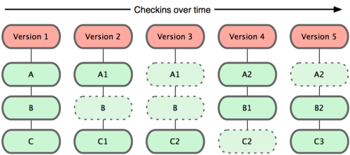
Git Storage
Stores data in a manner similar to snapshotting a mini filesystem
Stores references to file states
If the state hasn't changed, no need to store again

Slide 5
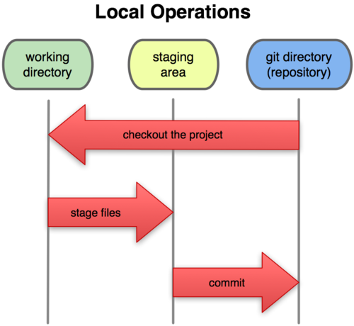
Git States
Three States:
Modified
File changes remain uncommitted
Staged
Modified files ready to be committed
Committed
Data stored in local database
Notes:
The basic Git workflow goes something like this:
You modify files in your working directory.
You stage the files, adding snapshots of them to your staging area.
You do a commit, which takes the files as they are in the staging area and stores that snapshot permanently to your Git directory.

Slide 6
Git Basics
git init
Creates new .git subdirectory with necessary repository files
git clone <url> [myDir]
Get a copy of an existing Git repository, can specify name with optional [myDir] parameter
git add <file>
Stages file, works with wildcards

Slide 7
Git Basics(cont.)
git commit -m "Commit info"
Commits staged files to repository, "-m" flag titles the commit
git commit --amend
If you commit too early, you can alter the staged files and then recommit
git reset HEAD <file>
Unstages a file

Slide 8
Git Basics (cont.)
git status
Views repository information
Current branch
Untracked files (those not present in last snapshot)
Changes to be committed
git diff
Shows the difference between what is in working directory and staging area
git rm <file>
Stages file's removal
git mv <oldFile> <newFile>
Similar to Linux mv command

Slide 9
Git Basics (cont.)
git log
lists commands made, most recent first
git log -p -#
p flag shows the diff introduced in each commit
# limits output (-2 limits to last 2 entries)
git log --stat
prints abbreviated stats, looks nicer

Slide 10
Git Branching
Branches can help go back to previous snapshots
For testing or distributed development
git branch <branch>
Creates a new branch for the current repository named <branch>
git checkout <branch>
Changes current branch to be <branch>
git checkout -b <branch> creates, and then switches to, a new branch <branch>

Slide 11
Installing Git
From source
Install dependencies
$ yum install curl-devel expat-devel gettext-devel \ openssl-devel zlib-devel $ apt-get install libcurl4-gnutls-dev libexpat1-dev gettext \ libz-dev libssl-dev
Grab latest snapshot, compile and install
Grab from http://git-scm.com/download
$ tar -zxf git-1.7.2.2.tar.gz $ cd git-1.7.2.2 $ make prefix=/usr/local all $ sudo make prefix=/usr/local install

Slide 12
Installing Git (cont.)
From binary installer
$ yum install git-core
$ apt-get install git
For OSX
http://code.google.com/p/git-osx-installer
For Windows
http://code.google.com/p/msysgit

Slide 13
Linux Kernel Repos
Git is the primary tool for the Linux kernel development community to use
Repos can be found at:
Kbuild development tree, Sam Ravnborg <sam@ravnborg.org> kernel.org:/pub/scm/linux/kernel/git/sam/kbuild.git
ACPI development tree, Len Brown <len.brown@intel.com> kernel.org:/pub/scm/linux/kernel/git/lenb/linux-acpi-2.6.git
Block development tree, Jens Axboe <axboe@suse.de> kernel.org:/pub/scm/linux/kernel/git/axboe/linux-2.6-block.git
DRM development tree, Dave Airlie <airlied@linux.ie> kernel.org:/pub/scm/linux/kernel/git/airlied/drm-2.6.git
ia64 development tree, Tony Luck <tony.luck@intel.com> kernel.org:/pub/scm/linux/kernel/git/aegl/linux-2.6.git

Slide 14
Linux Kernel Repos(cont.)
ieee1394 development tree, Jody McIntyre <scjody@modernduck.com> kernel.org:/pub/scm/linux/kernel/git/scjody/ieee1394.git
infiniband, Roland Dreier <rolandd@cisco.com> kernel.org:/pub/scm/linux/kernel/git/roland/infiniband.git
libata, Jeff Garzik <jgarzik@pobox.com> kernel.org:/pub/scm/linux/kernel/git/jgarzik/libata-dev.git
network drivers, Jeff Garzik <jgarzik@pobox.com> kernel.org:/pub/scm/linux/kernel/git/jgarzik/netdev-2.6.git
pcmcia, Dominik Brodowski <linux@dominikbrodowski.net> kernel.org:/pub/scm/linux/kernel/git/brodo/pcmcia-2.6.git
SCSI, James Bottomley <James.Bottomley@SteelEye.com> kernel.org:/pub/scm/linux/kernel/git/jejb/scsi-misc-2.6.git

Slide 15
References
Wiki
http://en.wikipedia.org/wiki/Git_(software)
Getting Started with Git
http://git-scm.com/book/en/Getting-Started
Linux Kernel Development with Git
http://lwn.net/Articles/160191/

Slide 16
Demo

Slide 17
Questions?

