Slide 1
Artificial Intelligence in Networking: Ant Colony Optimization
Matthew Guidry

Slide 2
Ant Colony Optimization
Ants have developed a technique for getting from one point to another
this must be efficient
this must have the ability to adapt

Slide 3
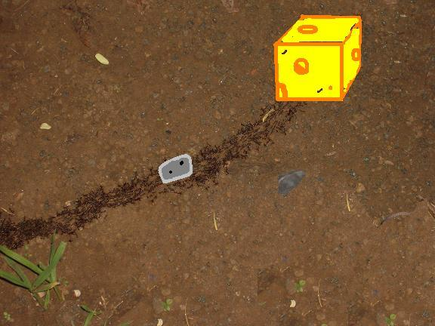
Ants aren’t THAT Dumb
Ants have evolved techniques for getting to a goal quickly and ways to resolves conflicts when a path is blocked.

Slide 4
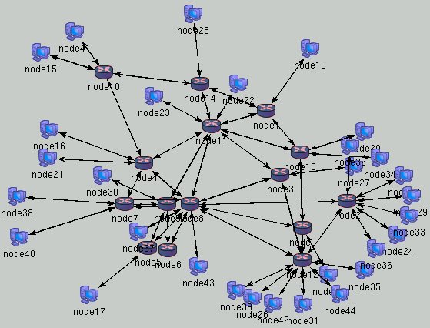
Application in Computer Science
Researchers try to apply this in
Artificial Intelligence to routing the Internet.

Slide 5
Types of Routing in the BGP
Border Gateway Protocol connects the Global Internet
There are types of routing algorithms in the Border Gateway Protocol
Circuit Switching
Packet Switching

Slide 6
Circuit Switching
Comparable to a telephone call:
Make call
Receiver picks up
Transmission is made
(no one else can talk to you that time)
It is agreed to end the call
Both parties hang up

Slide 7
Packet Switching
Much less organized
Packets are not forced to follow the same path
- The next node for a packet is determined at each hop
Packets are not guaranteed to arrive in a particular order

Slide 8
Application
Circuit Switching
Must have knowledge of the layout of the entire network
Determines a path before packets are sent, and then sends all packets along that path
Packet Switching
Does not need knowledge of the entire network
Packets determine next hop at each stop
A.C.O. is most effective in enhancing Packet Switching but is effective for both

Slide 9
Ant Colony Optimization
Uses very little state and computations
Piggy-backs an ant upon a packet that travels the network
There are two types of ants in this system
Regular Ant
Uniform Ant

Slide 10
Regular Ants
Use already established forwarding tables when routing
Will take a certain route based on probabilities which increase as a good route is chosen more
Will eventually converge to one path
Direct packets to the most efficient route, only contain a smaller amount of Artificial Intelligence

Slide 11
Uniform Ants
These are the unbiased ants by forwarding probabilities
Explore all paths and report back the times
Uniform ants do not need a destination since they only explore the network and report the times. Not all nodes may be know to the host.

Slide 12
Bad News Travels Fast
“Good news travels slow, bad news travels fast.”
When a line goes down the algorithm quickly finds a new best path. However, if the currently used path is surpassed by another path it takes a bit longer for the probabilities to correct.

Slide 13
A.C.O. vs other Algorithms
The 2 main Algorithms used by the B.G.P. are Link State (Circuit Switching) and Distance Vector (Packet Switching)
A.C.O. requires much less state to be held at each router
Ants can be piggy-backed on top of other packets, so this required much less bandwidth than other strategies.

Slide 14
Citations
Ants and reinforcement learning: A case study in routing in dynamic networks (1997) by Devika Subramanian,Peter Druschel,Johnny Chen Proceedings of the Fifteenth International Joint Conf. on Arti Intelligence
Website:
” http://www.codeproject.com/KB/recipes/Ant_Colony_Optimisation.aspx”
Lawrence Botley, 2008
Website: ” http://www.sciencedirect.com/science?_ob=ArticleURL “
Sara Morin, Caroline Gagné, and Marc Gravel, 2008

Slide 15
Fin. Any Questions?
~ Matthew Guidry

