Slide 1
Browser Engine
How it works….

Slide 2
Browser
Software application for retrieving, presenting and traversing information resources on the World Wide Web.
An information resource is identified by a Uniform Resource Identifier.
May be a web page, image, video or other piece of content.

Slide 3
Fetching a page
User inputs URL.
The interpretation of the URL depends on the prefix.
The server is contacted to retrieve the page.
The page is rendered by the browser’s layout engine.

Slide 4
Browser Components
All web (non-mobile) and most mobile browsers have 2 components
Host Application: The basic user interface.
Layout Engine: Program that “draws” the content.

Slide 5
Host Application
Provides the menu bar, address bar, status bar, bookmark manager, history and preferences functionality…
Serves as an interface between the user, the engine, and the underlying operating system.

Slide 6
Layout Engine
Takes a URL and a set of window content-area rectangle coordinates as arguments.
It then retrieves the document corresponding to the URL and paints a graphical representation of it in the given rectangle.
It also handles links, forms, cookies, client-side scripting, plug-in loading, and other matters.

Slide 7
Popular Layout Engines
Chrome: Blink
Firefox: Gecko
Internet Explorer: Trident
Safari: Webkit
Opera: Blink

Slide 8
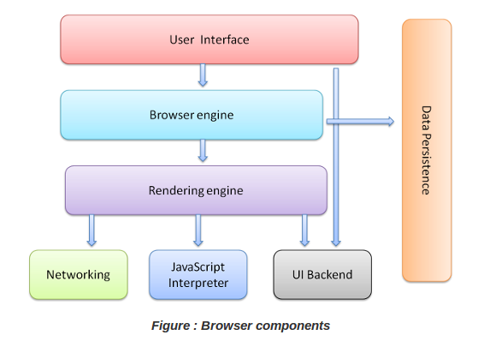
Browser Components

Slide 9
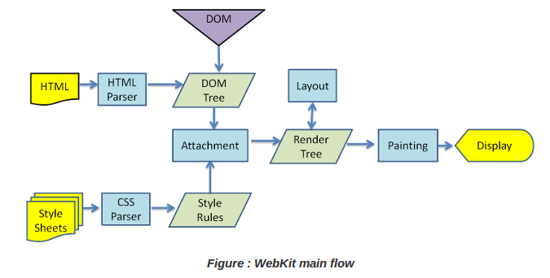
Rendering Engine Flow

Slide 10
More info
More info at : http://www.html5rocks.com/en/tutorials/internals/howbrowserswork/

