Slide 1
JavaScript
an introduction

Slide 2
JavaScript
Dynamic programming language.
Program the behavior of web pages.
Client-side scripts to interact with the user.
Communicates asynchronously and alters document content.
Used with Node.js in server side scripting, game development, mobile applications, etc.

Slide 3
JavaScript ≠ Java
Java is a full-fledged object-oriented programming language.
Java is popular for developing large-scale distributed enterprise applications and web applications.
JavaScript is a browser-based scripting language developed by Netscape and implemented in all major browsers.
JavaScript is executed by the browsers on the client side.

Slide 4
JavaScript and other languages
JavaScript borrows the elements from a variety of languages.
Object orientation from Java.
Syntax from C.
Semantics from Self and Scheme.

Slide 5
What’s a script?
A program written for a special runtime environment.
Interpreted (as opposed to compiled).
Used to automate tasks.
Operates at very high levels of abstraction.

Slide 6
What’s JavaScript?
Developed at Netscape to perform client side validation.
Adopted by Microsoft in IE 3.0 (1996).
Standardized in 1996. Current standard is ECMAScript 5.1 (2011).
CommonJS used for development outside the browser.

Slide 7
JavaScript uses
JavaScript has an insanely large API and library.
It is possible to do almost anything with JavaScript.
Write small scripts/apps for your webpage.
Write REALLY big apps for EVERYONE (gmail).
But...

Slide 9
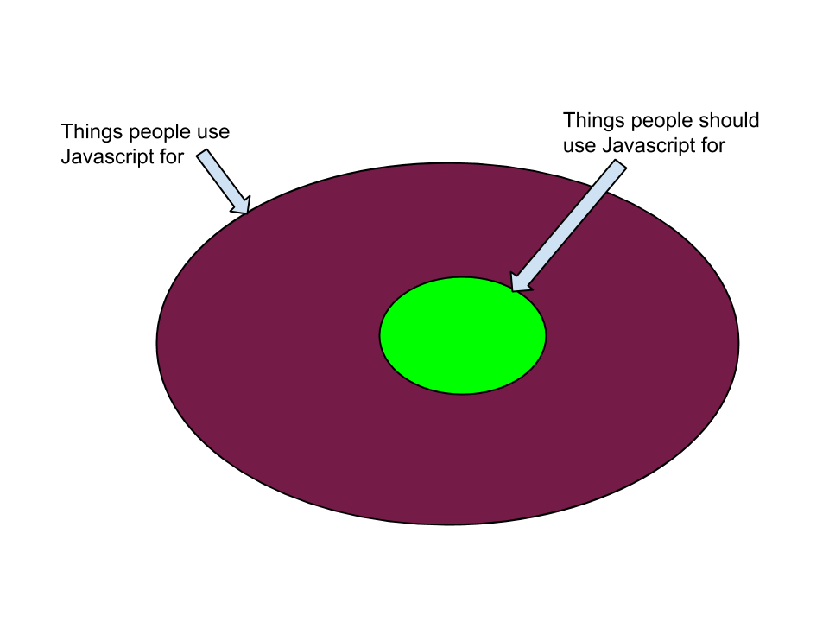

Slide 10
JavaScript can be used to
JavaScript Can Change HTML Elements.
JavaScript Can Change HTML Attributes.
JavaScript Can Change HTML Styles (CSS).
JavaScript Can Validate Data.

Slide 11
Where to add JavaScript?
JavaScripts can be put in the <body> and in the <head> section of an HTML page.
In HTML, JavaScripts must be inserted between <script> and </script> tags.
The lines between <script> and </script> contain the JavaScript code.

Slide 12
External JavaScript
External scripts are practical when the same code is used in many different web pages.
JavaScript files have the file extension “.js”.
To use an external script, put the name of the script file in the source (src) attribute of the <script> tag.
<!DOCTYPE html>
<html> <body>
<script src="myScript.js"></script>
</body> </html>

Slide 13
JavaScript Comments
JavaScript uses C-style comments.
Single line comments:
//This is a comment
Multiline comments:
/*
* This is a comment.
*/

Slide 14
JavaScript Syntax
JavaScript syntax is the rules, how JavaScript programs are constructed.
JavaScript statements are separated by semicolon.
JavaScript statements are composed of:
Values, Operators, Expressions, Keywords, and Comments.
JavaScript uses the Unicode character set.
All JavaScript identifiers are case sensitive.

Slide 15
JavaScript Syntax
Number literals can be written with or without decimals. eg 3.14, 2001, 12e5.
String literals can be written with single or double quotes.
Expression literals evaluate to a value.

Slide 16
JavaScript syntax
Array literals define an array.
[40, 100, 1, 5, 25, 10]
Object literals define an object.
{firstName:"John", lastName:"Doe", age:50, eyeColor:"blue"}
Function literals define a function.
function myFunction(a, b) { return a * b;}

Slide 17
JavaScript Variables
Named variables are used to store data values.
The “var” keyword is used to define variables.
“=” is used to define values to variables.
var length;
length = 6;

Slide 18
JavaScript Operators
JavaScript offers a variety of operators.
Arithmetic: +, -, *, /, %, ++, --
Assignment: =, +=, -=, *=, /=, %=
Comparison: <, >, <=, >=, ==,===, !=
Logical: &&, ||, !
String: concatenation (+, +=)

Slide 19
JavaScript Data Types
JavaScript provides a variety of data types.
Integers
Floating point numbers
Strings
Booleans
Arrays
Objects
Empty
Undefined

Slide 20
JavaScript Data Types
You can use the JavaScript typeof operator to find the type of a JavaScript variable.
JavaScript has dynamic types.
This means that the same variable can be used as different types

