Slide 1
Securing Systems by Threat Mitigation and Adaptive Live Patching
CIS 5935 Introductory Seminar on Research
Yue Chen
http://YueChen.me

Slide 2
Outline
Hack your PC
Hack your phone
Hack your server
And how to protect them…
and win cash.

Slide 3
Hack your PC physically

Slide 4
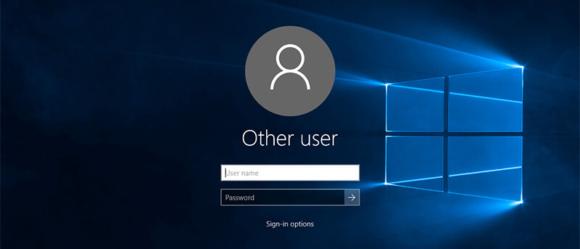
Screen Locked
Stole a PC
Disk Encrypted

Slide 5
Has a Bitcoin wallet inside
with the BTC amount that can buy two pizzas on
May 22, 2010

Slide 6
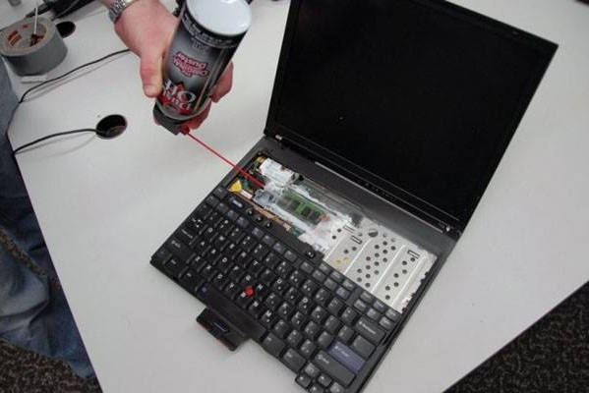
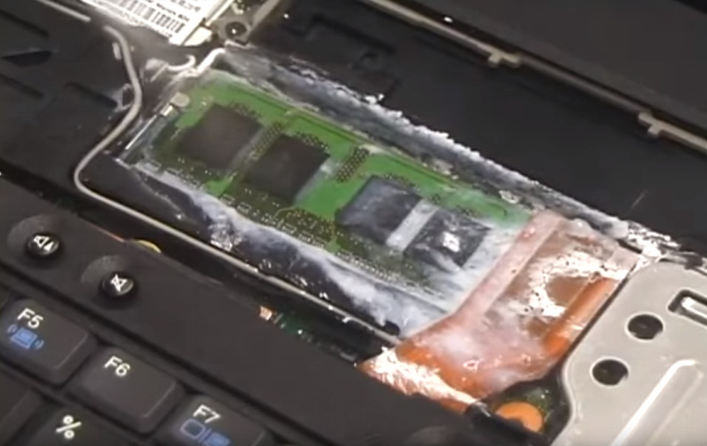
Cold Boot Attack
Freeze the memory

Slide 7
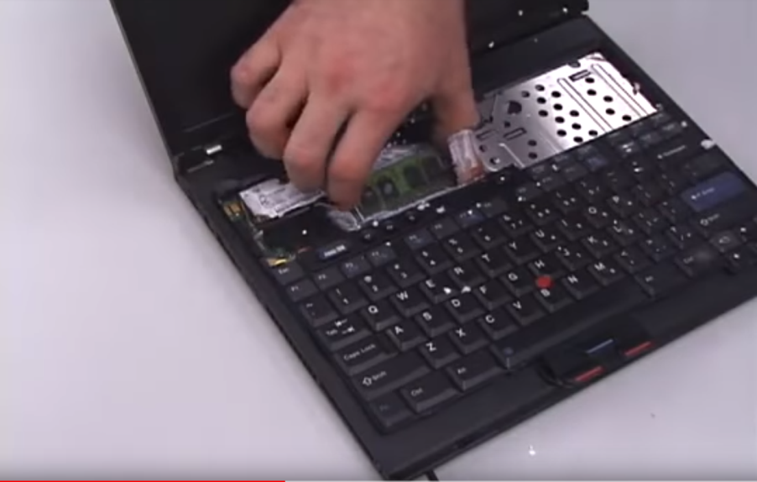
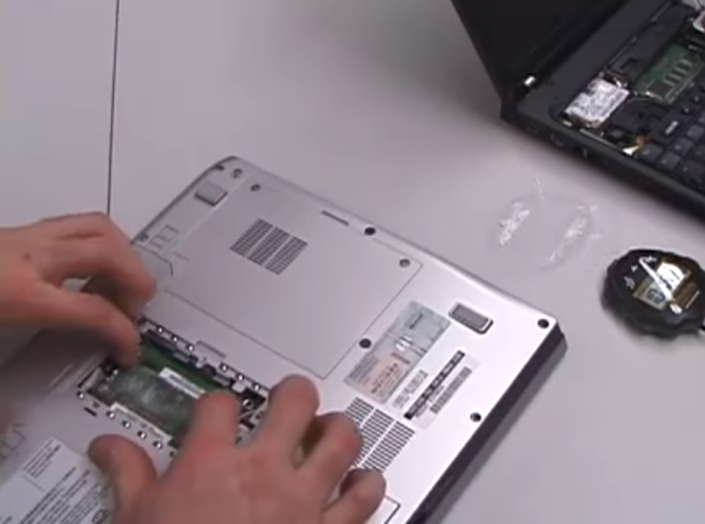
Cold Boot Attack
Transplant the memory

Slide 8
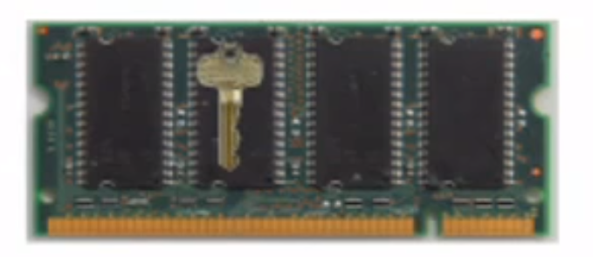
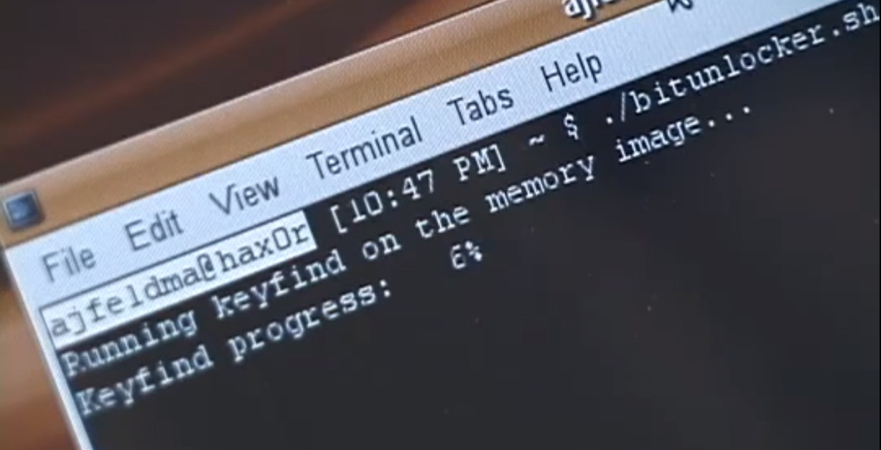
Cold Boot Attack
Extract the disk decryption key
from the memory
Decrypt the disk
Get the Bitcoins

Slide 10
Protect your PC technically

Slide 11
Cold Boot Attack – Protection
Sensitive memory content in plaintext can be extracted easily
“Secret Message”
Memory
“Secret Message”
Notes:
One cause of the attack is that the sensitive memory content is stored as plaintext.
If an attacker transplants the memory to another machine, he can extract the sensitive information directly.

Slide 12
Our Solution – EncExec
Sensitive memory content cannot be read with encryption
? ? ?
Memory
“XXXXXXXXXXXX”
Notes:
However, if we encrypt the memory content, even if the memory is transplanted to another machine, the attacker still CANNOT read it.

Slide 13
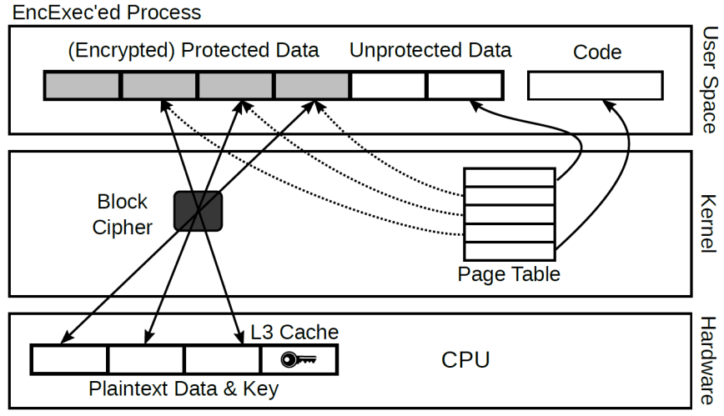
EncExec – Overview
Data in memory always encrypted
Decrypted into the cache only when accessed
Use reserved cache as a window over protected data
Use L3 (instead of L1 or L2) cache to minimize performance impact

Slide 14
EncExec – Overview
Decrypted data will never be evicted to memory (no cache conflict)
Extend kernel’s virtual memory management to strictly control access
Only data in the window are mapped in the address space
If more data than window size -> page replacement

Slide 15
Design: Key Techniques
Spatial cache reservation
Reserves a small part of the L3 cache for its use
Secure in-cache execution
Data encrypted in memory, plaintext view only in cache

Slide 16
CPU Cache
Intel Core i7 4790 cache architecture

Slide 17
CPU Cache
2-way set-associative cache, 8 cache lines in 4 sets. Each cache line has 16 bytes.

Slide 18
Design: Spatial Cache Reservation
Cache
*0
*0
*4
*4
*8
*8
*C
*C
Set 0
Set 1
Set 2
Set 3
00
04
08
0C
10
14
18
1C
20
24
28
2C
30
34
38
3C
40
44
48
4C
Memory

Slide 19
Design: Spatial Cache Reservation
Cache
*0
*0
*4
*4
*8
*8
*C
*C
: Needs to be reserved
Set 0
Set 1
Set 2
Set 3
00
04
08
0C
10
14
18
1C
20
24
28
2C
30
34
38
3C
40
44
48
4C
Memory

Slide 20
Design: Spatial Cache Reservation
Cache
*0
*0
*4
*4
*8
*8
*C
*C
: Needs to be reserved
Set 0
Set 1
Set 2
Set 3
00
04
08
0C
10
14
18
1C
20
24
28
2C
30
34
38
3C
40
44
48
4C
Memory

Slide 21
Design: Spatial Cache Reservation
Cache
*0
*0
*4
*4
*8
*8
*C
*C
: Needs to be reserved
Set 0
Set 1
Set 2
Set 3
00
04
08
0C
10
14
18
1C
20
24
28
2C
30
34
38
3C
40
44
48
4C
Memory

Slide 22
Design: Secure In-Cache Execution
Desynchronize memory (encrypted) and cache (plaintext)
Cache in write-back mode
Guaranteed by hardware and existing kernels (in most OS’es)
L3 cache is inclusive of L1 and L2 caches
Guaranteed by hardware and existing kernels
No conflict in the reserved cache
No more protected data at a time than the reserved cache size

Slide 23
Design: Secure In-Cache Execution
More data to protect?
Demand paging
Access unmapped data -> page fault
Allocate a plaintext page (for securing data)
If no page available, select one for replacement
Encrypt the plaintext page, copy it back
Decrypt faulting page into plaintext, update page table if necessary

Slide 24
Performance Evaluation
Mode 1: Choose data to encrypt
Mode 2: Encrypt all the data
Test with 15 or 31 plaintext pages
Overhead of common cryptographic algorithms

Slide 25
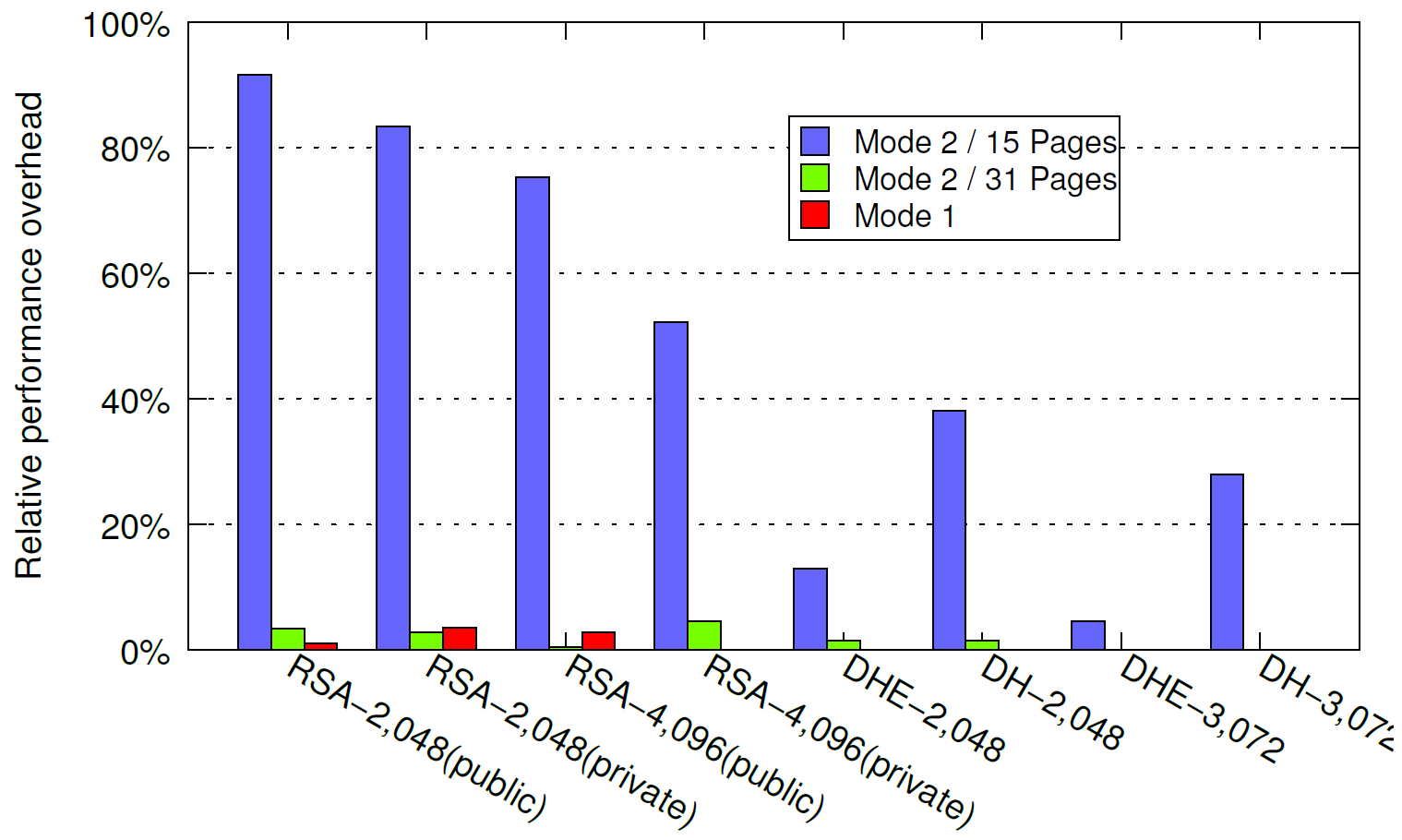
Performance Evaluation
Mode 1: Choose data to encrypt
Mode 2: Encrypt all the data
Test with 15 or 31 plaintext pages
Overhead of RSA and DH handshakes

Slide 26
Hack Protect your phone

Slide 27
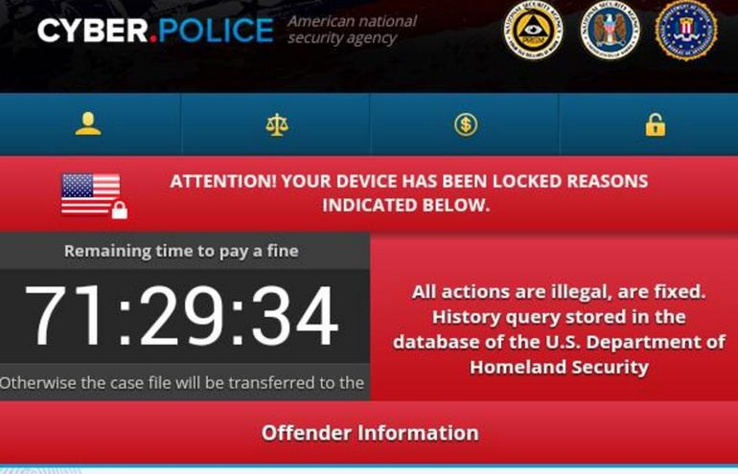
Problem
Dogspectus ransomware reported on April 2016
It contains the code for the futex or Towelroot exploit that was first disclosed at the end of 2014

Slide 28
Problem
Ghost Push malware still a major threat in October 2016
Over 600,000 Android user affected per day
Affected 14,847 phone types and 3,658 brands
Known to use VROOT (CVE-2013-6282) and Towelroot (CVE-2014-3153)

Slide 29
Why?

Slide 30
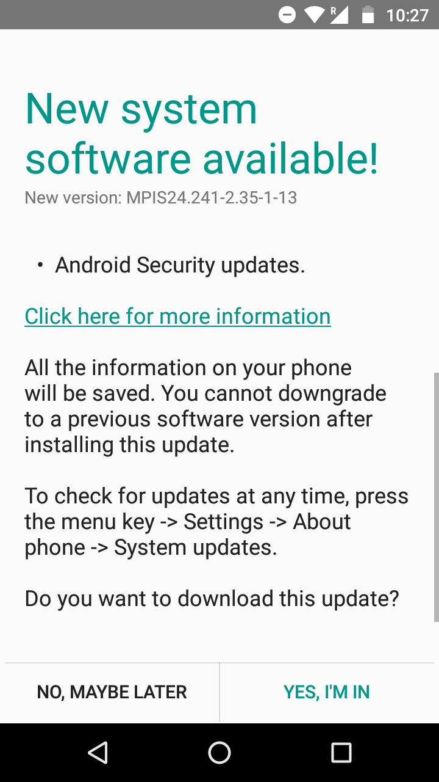

Slide 31
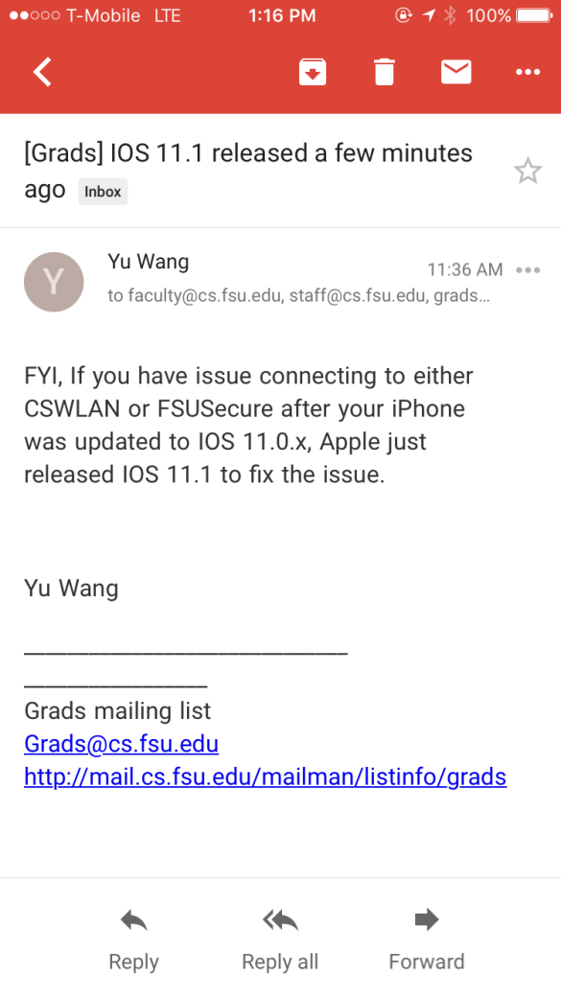

Slide 32
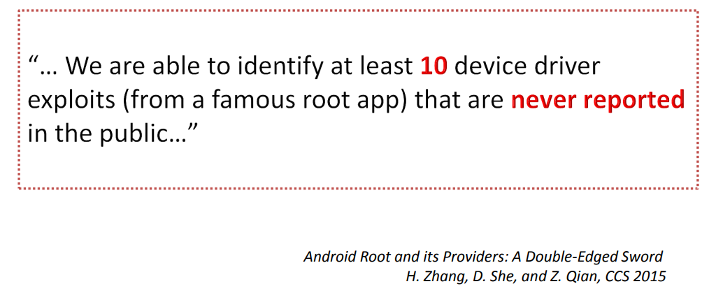
Exploits made public but not reported

Slide 33
Exploits disclosed but not timely patched
Note that this patch was not applied to all msm branches at the time of the patch release (July 2015) and no security bulletin was issued, so the majority of Android kernels based on 3.4 or 3.10 are still affected despite the patch being available for 6 months.
https://bugs.chromium.org/p/project-zero/issues/detail?id=734

Slide 34
Exploits patched but delayed by carriers
It’s each carrier’s job to test all the different updates for all their different smartphones, and they may take many months to do so. They may even decline to do the work and never release the update.
https://www.howtogeek.com/163958/why-do-carriers-delay-updates-for-android-but-not-iphone

Slide 35
Monthly disclosed number of Android kernel vulnerabilities

Slide 36
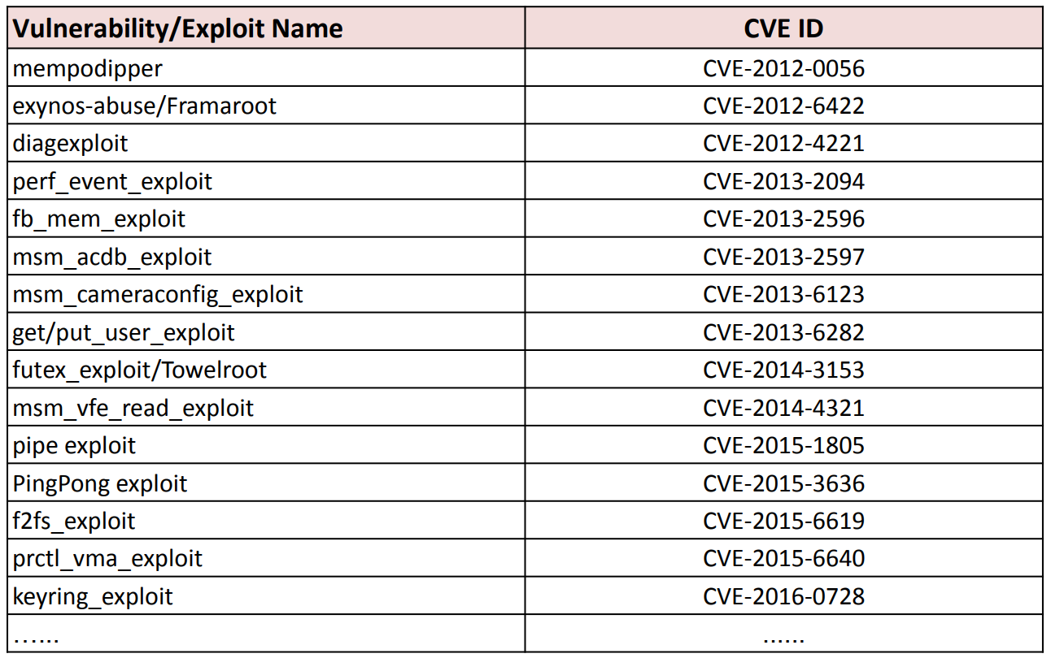
PoC exploits are publicly disclosed

Slide 38
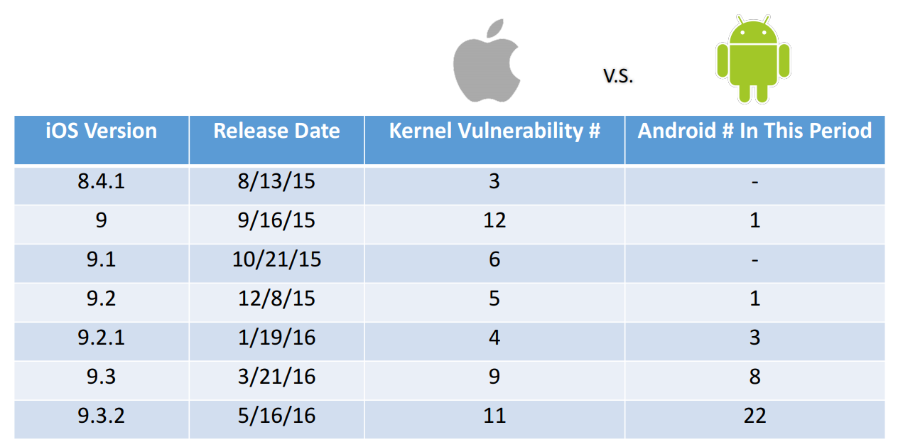

Slide 40
Let’s Start from the Kernel
Apps
TrustZone
Java API Framework
Native C/C++ Libraries
Android Runtime
Hardware Abstraction Layer
Linux Kernel

Slide 41
Let’s Start from the Kernel
Apps
TrustZone
Java API Framework
Native C/C++ Libraries
Android Runtime
Hardware Abstraction Layer
Linux Kernel

Slide 42
Let’s Start from the Kernel
Apps
TrustZone
Java API Framework
Native C/C++ Libraries
Android Runtime
Hardware Abstraction Layer
Linux Kernel

Slide 43
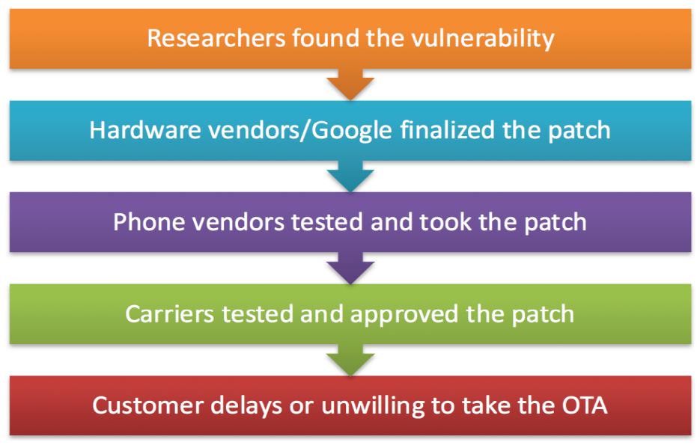
Challenges
Officially patching an Android device is a long process → Third-party
Delayed/non-existing kernel source code → Binary-based

Slide 44
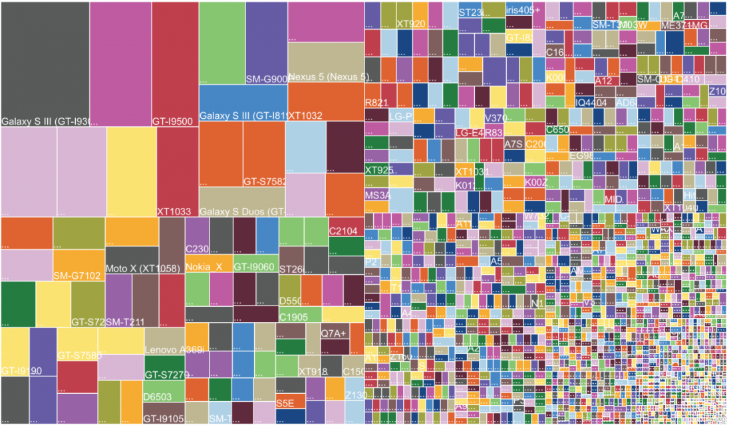
Challenges
Severely fragmented Android ecosystem → Adaptive
http://d.ibtimes.co.uk/en/full/1395443/android-fragmentation-2014.png

Slide 45
Solution
Third-party Binary-based Adaptive Kernel Live Patching
Key requirements:
Adaptiveness
It should be adaptive to various device kernels
Safety
Patches should be easy to audit
Their behaviors must be technically confined
Timeliness
Response time should be short, after disclosed vulnerability or exploit
Performance
The solution should not incur non-trivial performance overhead

Slide 46
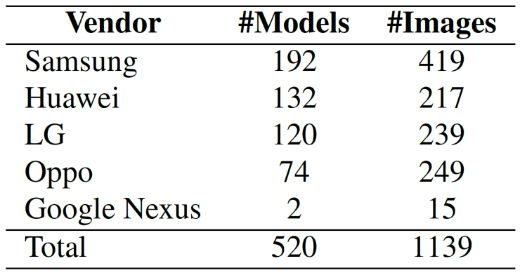
Feasibility Study: Dataset
Studied 1139 Android kernels

Slide 47
Feasibility Study: Observations
Most kernel functions are stable across devices and Android releases
Most vulnerabilities triggered by malicious inputs
Many functions return error codes
Return a pointer → ERR_PTR

Slide 48
Feasibility Study: Observations
Most kernel functions are stable across devices and Android releases
Most vulnerabilities triggered by malicious inputs
Many functions return error codes
Return a pointer → ERR_PTR
Filter them
Gracefully return

Slide 49
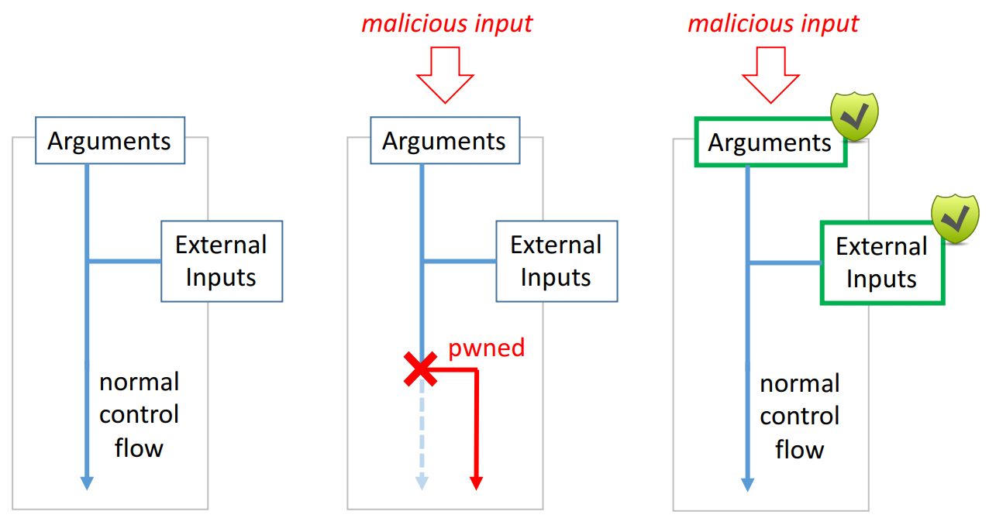
Overall Approach: Input Validation

Slide 50
KARMA
KARMA: Kernel Adaptive Repair for Many Androids
Adaptive – Automatically adapt to various device kernels
Memory-safe – Protect kernel from malicious (misused) patches
Multi-level – Flexible for different vulnerabilities

Slide 51
KARMA Design: Safety
Patches are written in Lua, confined by Lua VM at runtime
A patch can only be placed at designated locations
Patched functions must return error codes or void
Use existing error handling to recover from attacks
A patch can read but not write the kernel memory
Confined by KARMA APIs
Prevent malicious (misused) patches from changing the kernel
Prevent information leakage

Slide 52
KARMA Patch Example
Part of the official patch of CVE-2014-3153 (Towelroot)

Slide 53
KARMA Patch Example
-EINVAL
More complex examples in the paper

Slide 54
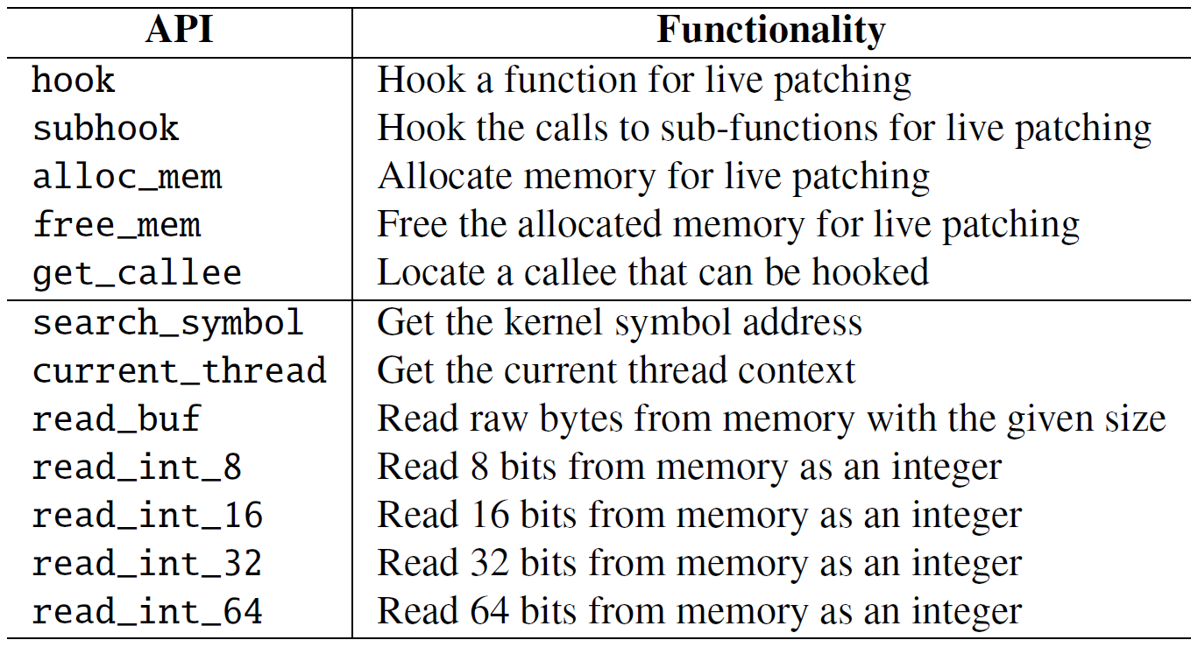
KARMA API

Slide 55
KARMA API
Available to patches

Slide 56
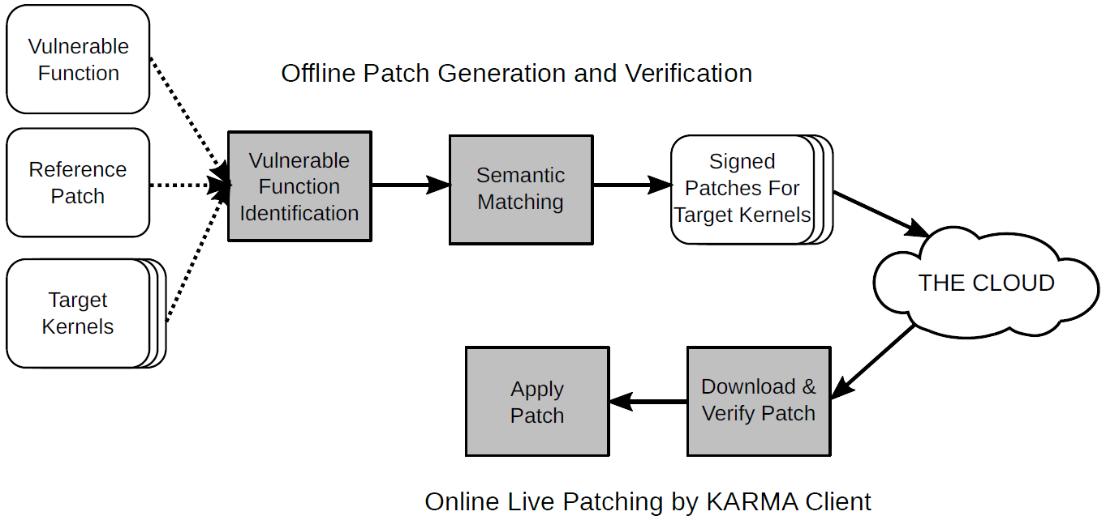
KARMA Architecture
Offline Patch Generation and Verification
Online Live Patching by KARMA Client

Slide 57
Offline Patch Adaptation
Patch A

Slide 58
Offline Patch Adaptation
Three steps:
Identify the vulnerable functions in the target kernel
Same function but different names
Inlined
Check if the reference patch works for the target kernel
Same function but different semantics
Adapt the reference patch for the target kernel

Slide 59
Vulnerable Function Identification Example CVE-2015-3636 (PingPong Root)
Device A: ping_unhash Device B: ping_v4_unhash
Func_A
Func_B
Func_C
Func_A
Func_B
Func_C
ping_unhash
ping_v4_unhash
Func_D
Func_E
Func_D
Func_E
Call graph based similarity comparison

Slide 60
Semantic Matching
Check if two functions are semantically equivalent
If so, adapt the reference patch to the target kernel
Syntactic matching is too strict
Different compilers can generate different code with same semantics
Instruction order, register allocation, instruction selection, code layout

Slide 61
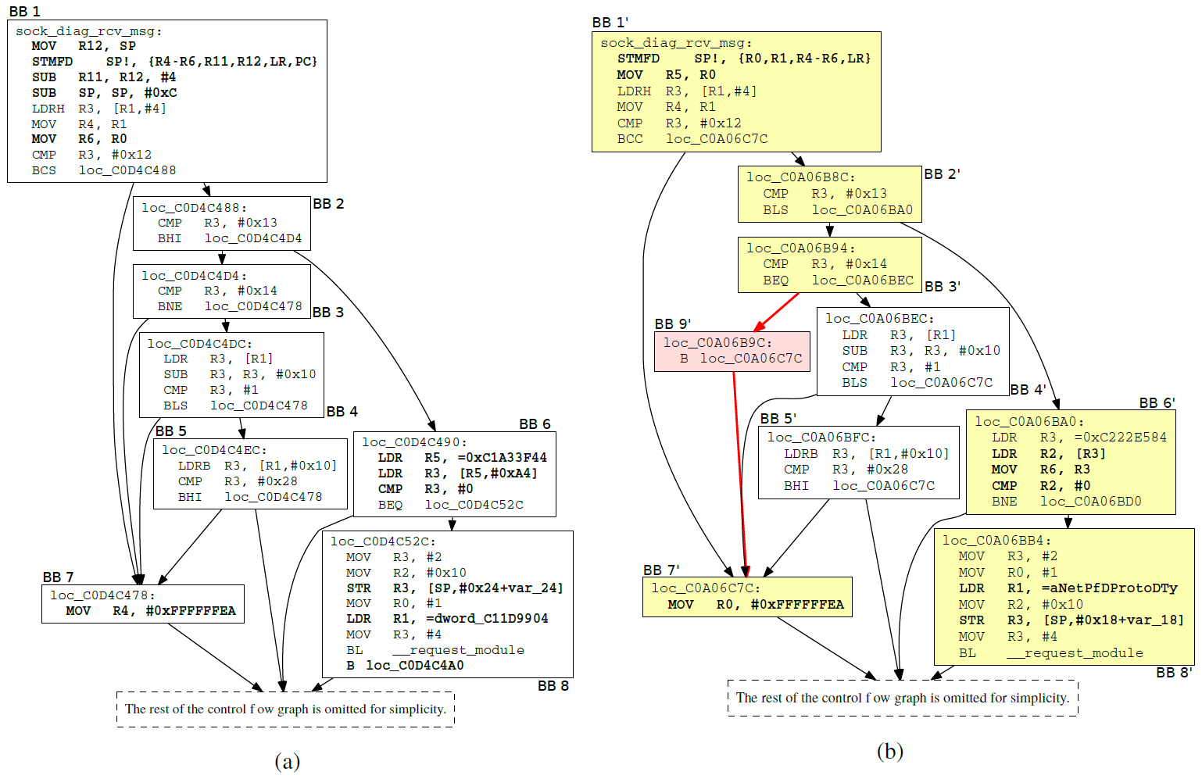
Semantic Matching
Same semantics with different syntax

Slide 62
Semantic Matching
Check if two functions are semantically equivalent
If so, adapt the reference patch to the target kernel
Syntactic matching is too strict
Different compilers can generate different code with same semantics
Instruction order, register allocation, instruction selection, code layout
Use symbolic execution to abstract these differences and adapt patches
Use approximation to improve scalability (details in the paper)

Slide 63
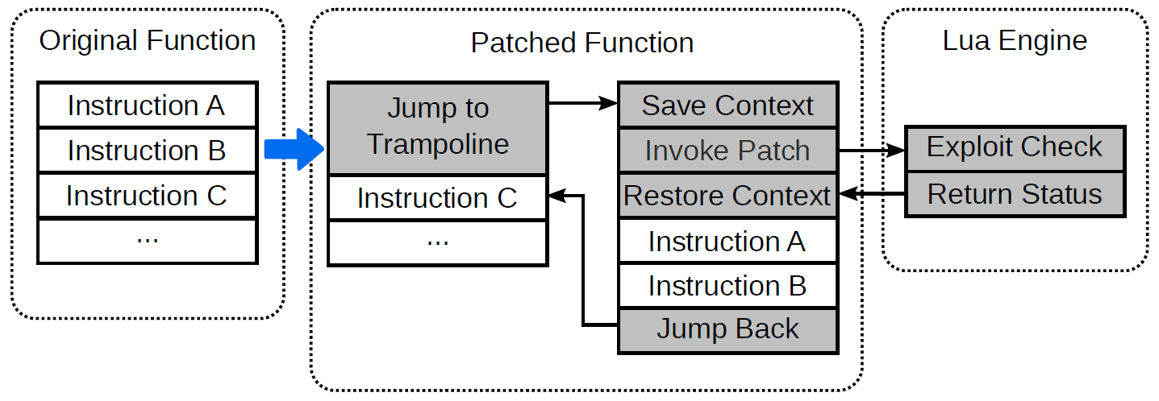
Online Patch Application
Function entry point hooking

Slide 64
Prototype Implementation
Lua engine in kernel (11K SLOC)
Simple
Memory-safe
Easy to embed and extend
24 years of development
Semantic matching
– angr

Slide 65
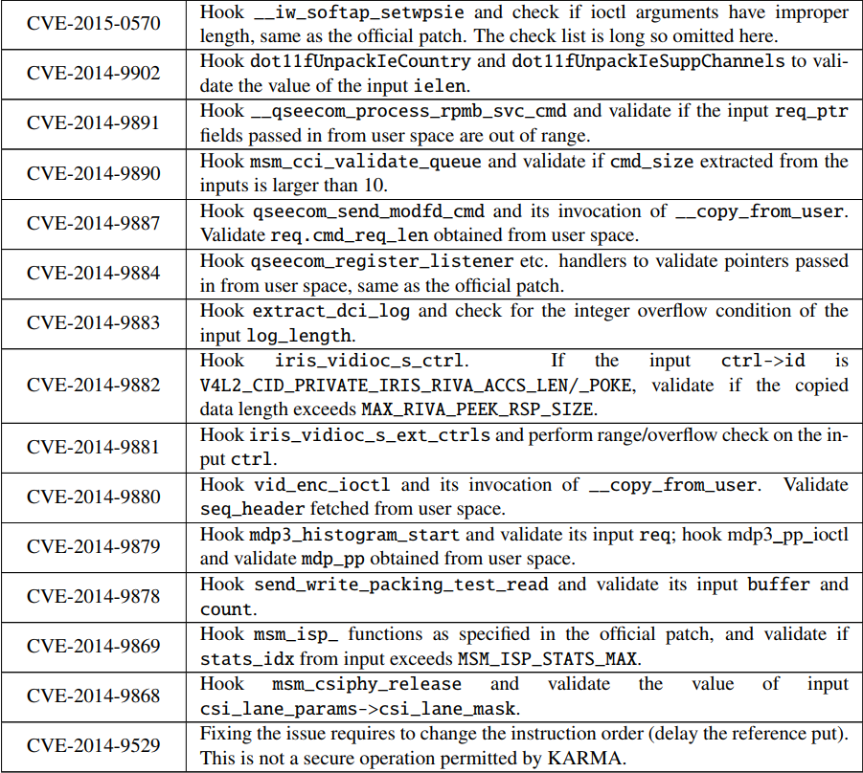
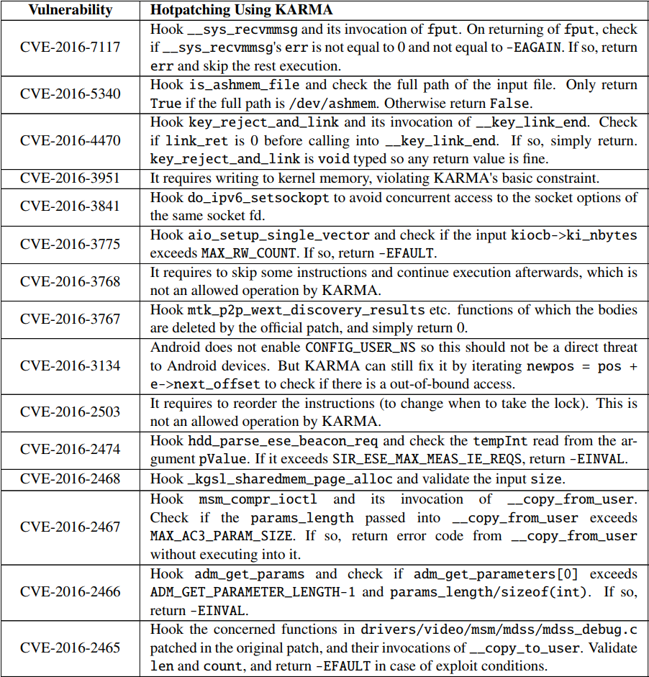
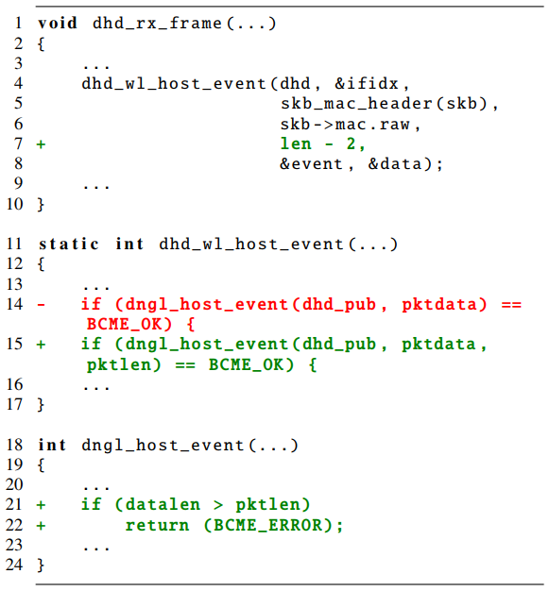
Evaluation: Applicability
Evaluated 76 critical vulnerabilities in the last three years

Slide 66
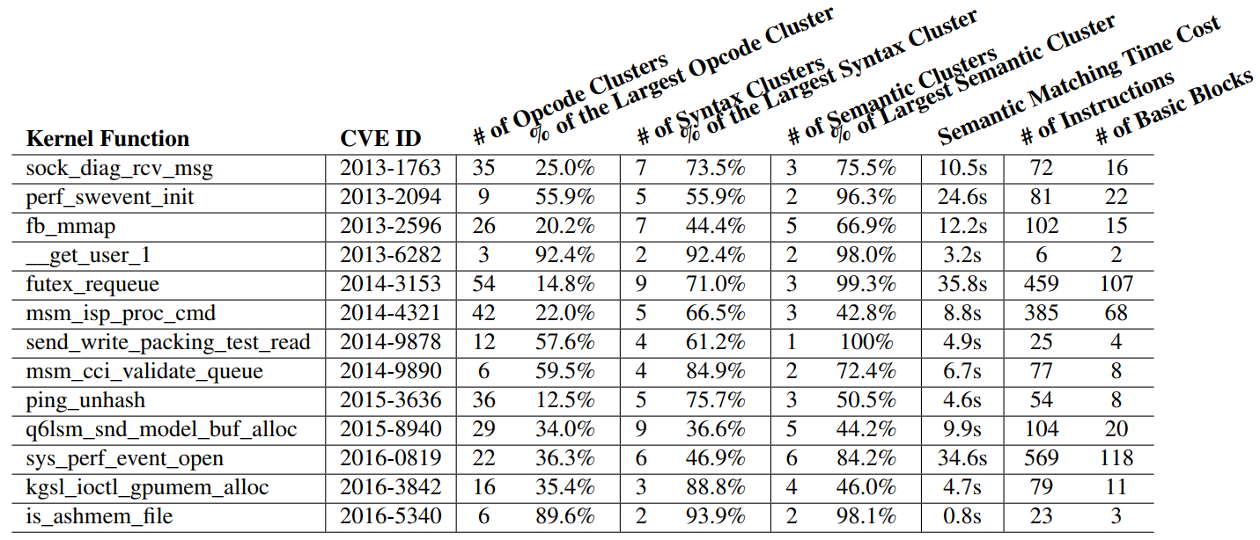
Evaluation: Adaptability

Slide 67
Evaluation: Adaptability
Types and frequencies of instruction opcodes

Slide 68
Evaluation: Adaptability
Number of function calls and conditional branches (to abstract CFG)

Slide 69
Evaluation: Adaptability
KARMA’s semantic matching

Slide 70
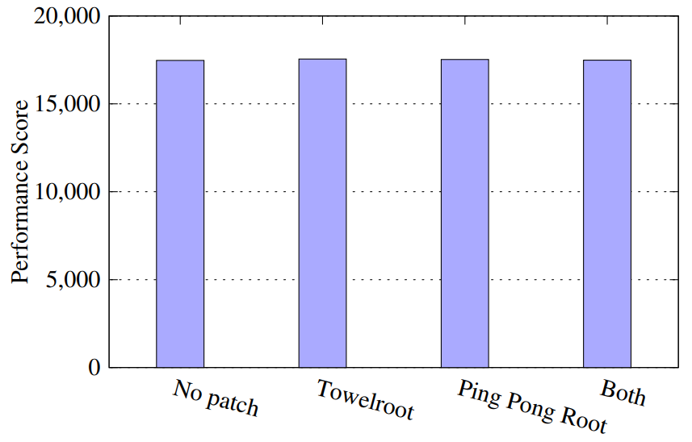
Evaluation: Performance
CF-Bench results with different patches

Slide 71
Hack your server remotely

Slide 72
Attackers have limited information

Slide 73
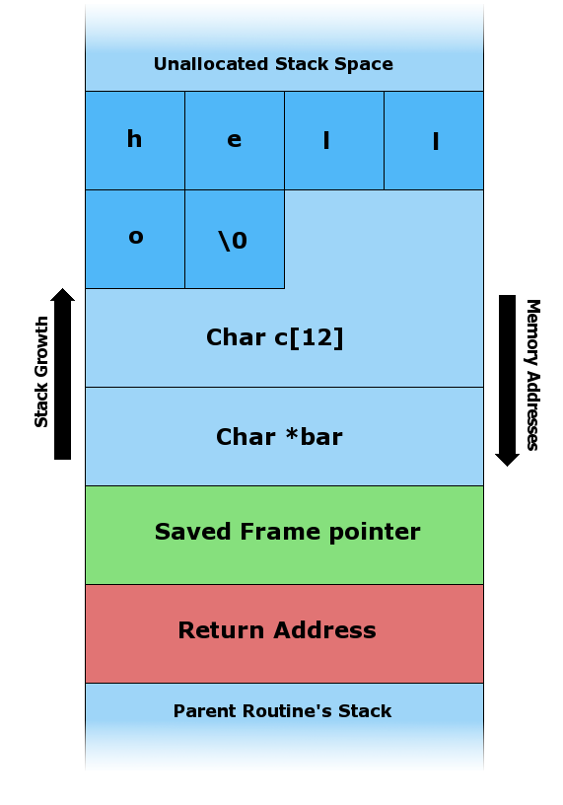
Attack Example: Stack Overflow

Slide 74
Typical Attack Procedure to Take Over the Whole System
Find (memory) vulnerabilities
Exploit them
Run your own code

Slide 75
Data Execution Prevention (DEP)
Previously, attackers inject their own stuff into the process, and run it
Currently, Data Execution Prevention (DEP) is widely deployed.
You cannot run what you inject

Slide 76
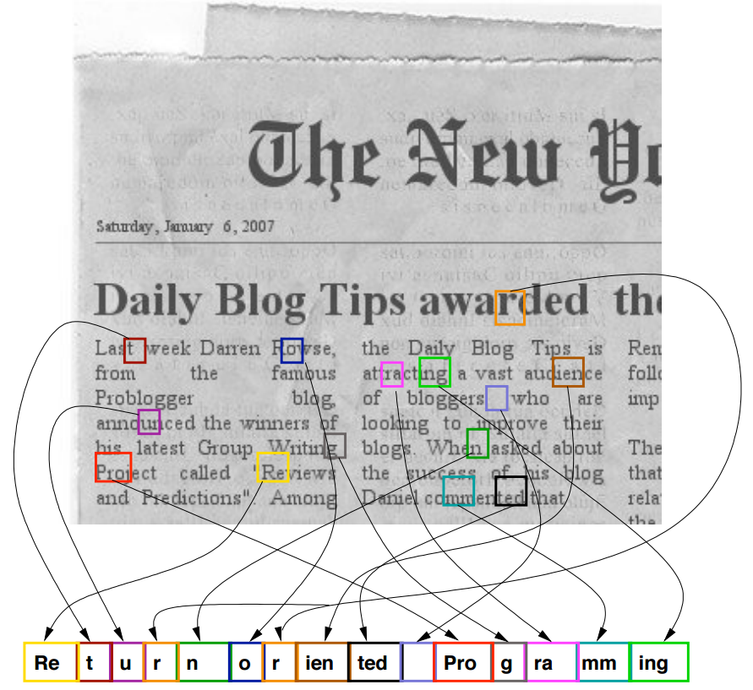
Code Reuse Attack
Example: Return-Oriented Programming
Existing Code
Chained Gadgets

Slide 77
Protect your server magically

Slide 78
Code Reuse Attack
Need to know the code location
Guess the code locations (repeatedly)
Protect?
Make the code locations unpredictable

Slide 79
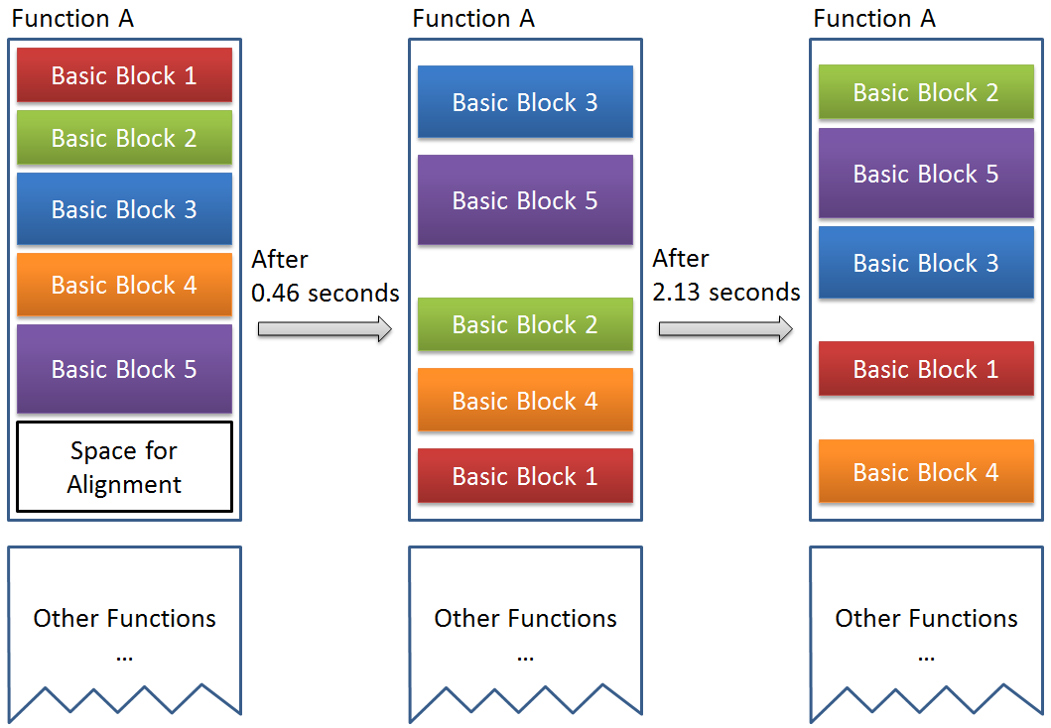
Remix: On-demand Live Randomization

Slide 80
Win cash decently

Slide 82
References
Protect your PC
Secure In-Cache Execution
Protect your phone
Adaptive Android Kernel Live Patching
Protect your server
Remix: On-demand Live Randomization

Slide 83
Thank you
http://YueChen.me

