Slide 1
Adaptive Android Kernel Live Patching
USENIX Security Symposium 2017
Yue Chen¹, Yulong Zhang², Zhi Wang¹, Liangzhao Xia², Chenfu Bao², Tao Wei²
Florida State University¹
Baidu X-Lab²

Slide 2
Android Kernel Vulnerabilities
Apps
TrustZone
Java API Framework
Native C/C++ Libraries
Android Runtime
Hardware Abstraction Layer
Linux Kernel

Slide 3
Android Kernel Vulnerabilities
Apps
TrustZone
Java API Framework
Native C/C++ Libraries
Android Runtime
Hardware Abstraction Layer
Linux Kernel

Slide 4
Android Kernel Vulnerabilities
Apps
TrustZone
Java API Framework
Native C/C++ Libraries
Android Runtime
Hardware Abstraction Layer
Linux Kernel

Slide 5
Number of Disclosed Android Kernel Vulnerabilities

Slide 6
Problem: Old Exploits Remain Effective
Number of devices vulnerable to two root exploits as of Nov. 2016
Android 5.0 released in November 2014
46.3% of devices run an older version in September 2016

Slide 7
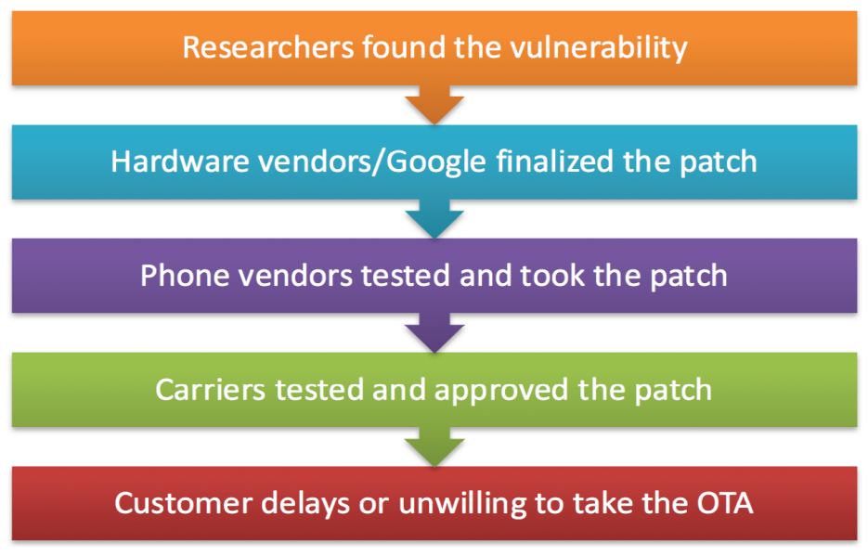
Challenges
Officially patching an Android device is a long process → Third-party
Delayed/non-existing kernel source code → Binary-based

Slide 8
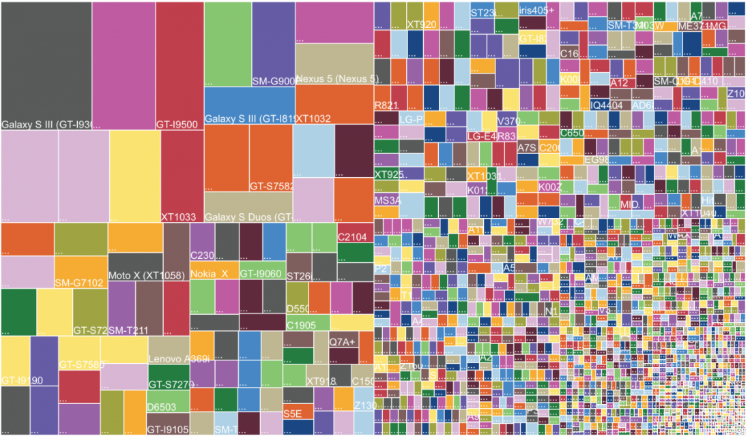
Challenges
Severely fragmented Android ecosystem → Adaptive
http://d.ibtimes.co.uk/en/full/1395443/android-fragmentation-2014.png

Slide 9
Solution
Third-party Binary-based Adaptive Kernel Live Patching
Key requirements:
Adaptiveness
It should be adaptive to various device kernels
Safety
Patches should be easy to audit
Their behaviors must be technically confined
Timeliness
Response time should be short, after disclosed vulnerability or exploit
Performance
The solution should not incur non-trivial performance overhead

Slide 10
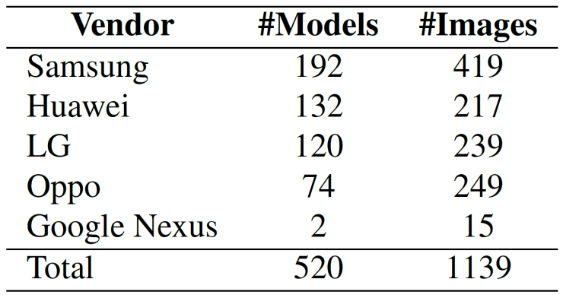
Feasibility Study: Dataset
Studied 1139 Android kernels

Slide 11
Feasibility Study: Observations
Most kernel functions are stable across devices and Android releases
Most vulnerabilities triggered by malicious inputs
Many functions return error codes
Return a pointer → ERR_PTR

Slide 12
Feasibility Study: Observations
Most kernel functions are stable across devices and Android releases
Most vulnerabilities triggered by malicious inputs
Many functions return error codes
Return a pointer → ERR_PTR
Filter them
Gracefully return

Slide 13
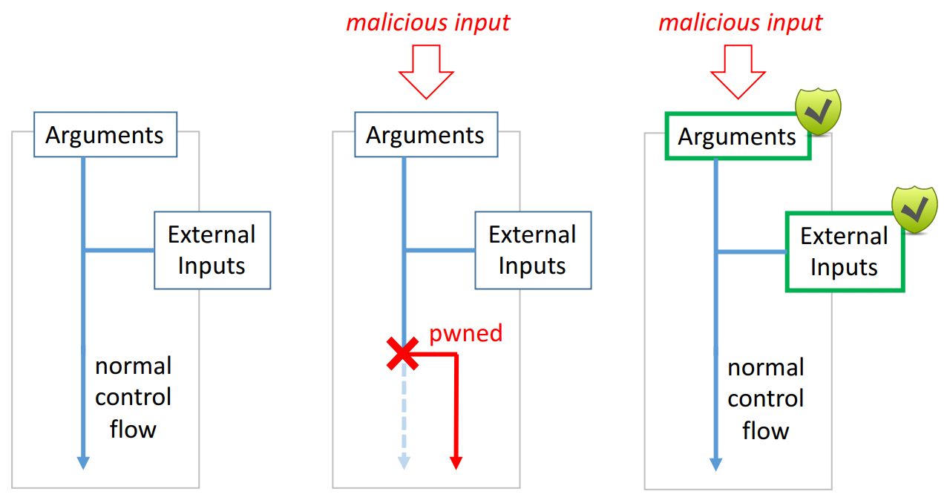
Overall Approach: Input Validation

Slide 14
KARMA
KARMA: Kernel Adaptive Repair for Many Androids
Adaptive – Automatically adapt to various device kernels
Memory-safe – Protect kernel from malicious (misused) patches
Multi-level – Flexible for different vulnerabilities

Slide 15
KARMA Design: Safety
Patches are written in Lua, confined by Lua VM at runtime
A patch can only be placed at designated locations
Patched functions must return error codes or void
Use existing error handling to recover from attacks
A patch can read but not write the kernel memory
Confined by KARMA APIs
Prevent malicious (misused) patches from changing the kernel
Prevent information leakage

Slide 16
KARMA Design: Multi-level Patching
A patch can only be placed at designated locations
Level 1: Entry or return point of a (vulnerable) function
Level 2: Before or after the call site to a callee
e.g., copy_from_user
Level 3: Binary-based patch
76 critical Android kernel vulnerabilities
Level 1: 49/76 (64.5%)
Level 2: 22/76 (28.9%)
Level 3: 5/76 (6.6%)

Slide 17
KARMA Patch Example
Part of the official patch of CVE-2014-3153 (Towelroot)

Slide 18
KARMA Patch Example
-EINVAL
More complex examples in the paper

Slide 19
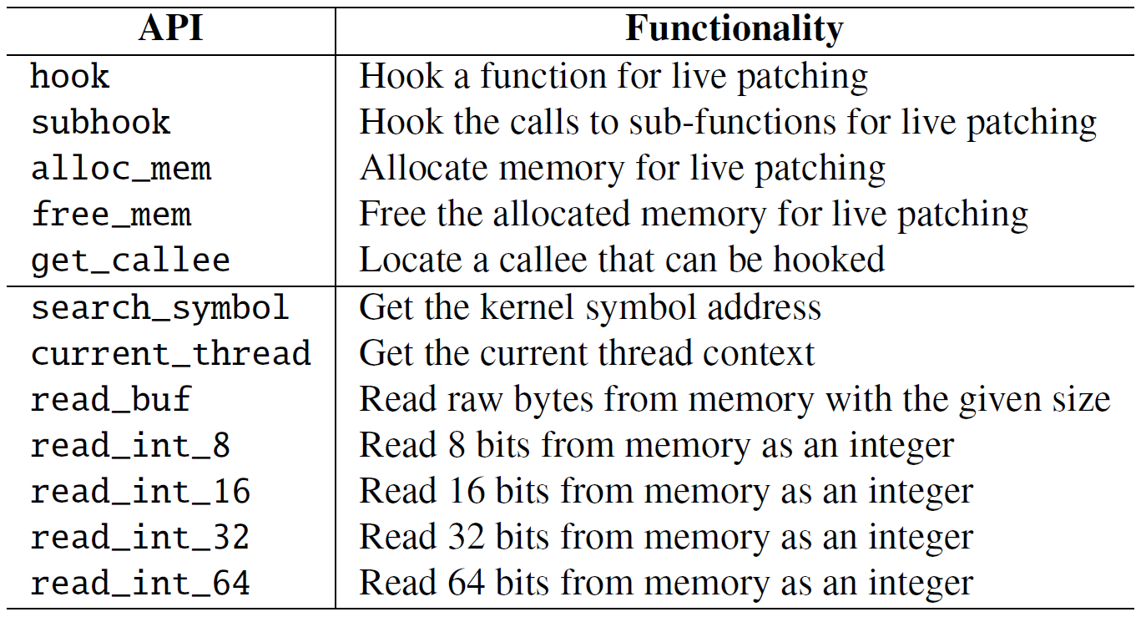
KARMA API

Slide 20
KARMA API
Available to patches

Slide 21
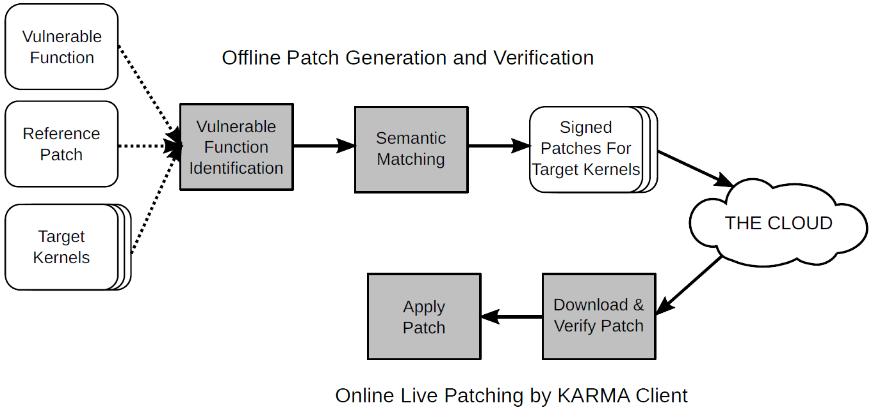
KARMA Architecture
Offline Patch Generation and Verification
Online Live Patching by KARMA Client

Slide 22
Offline Patch Adaptation
Patch A

Slide 23
Offline Patch Adaptation
Three steps:
Identify the vulnerable functions in the target kernel
Same function but different names
Inlined
Check if the reference patch works for the target kernel
Same function but different semantics
Adapt the reference patch for the target kernel

Slide 24
Vulnerable Function Identification Example CVE-2015-3636 (PingPong Root)
Device A: ping_unhash Device B: ping_v4_unhash
Func_A
Func_B
Func_C
Func_A
Func_B
Func_C
ping_unhash
ping_v4_unhash
Func_D
Func_E
Func_D
Func_E
Call graph based similarity comparison

Slide 25
Semantic Matching
Check if two functions are semantically equivalent
If so, adapt the reference patch to the target kernel
Syntactic matching is too strict
Different compilers can generate different code with same semantics
Instruction order, register allocation, instruction selection, code layout

Slide 26
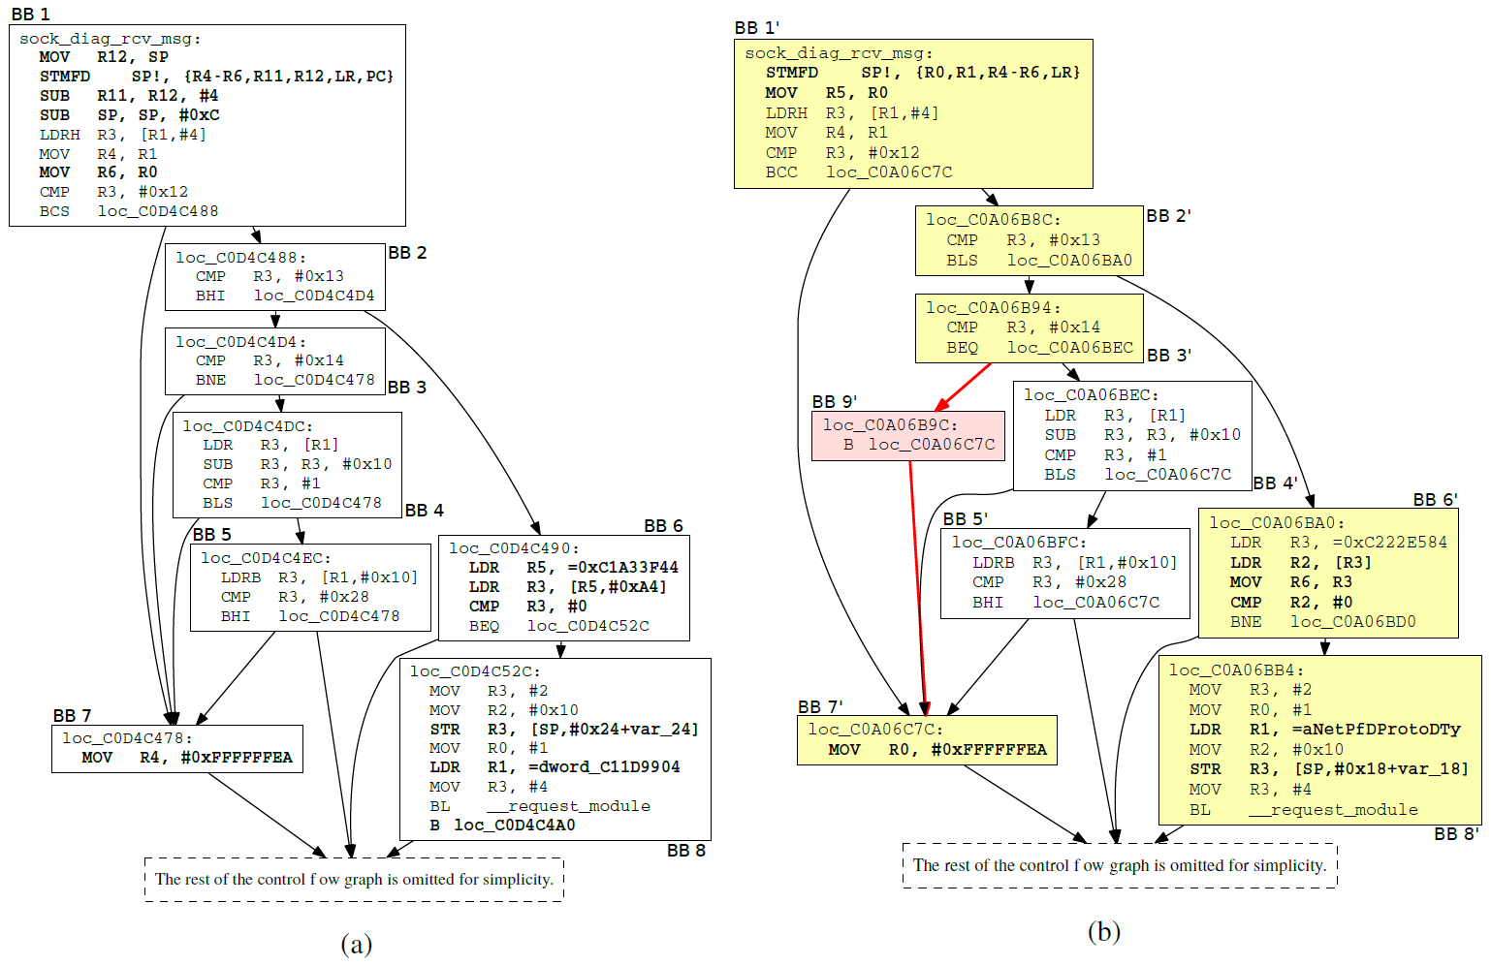
Semantic Matching
Same semantics with different syntax

Slide 27
Semantic Matching
Same semantics with different syntax

Slide 28
Semantic Matching
Same semantics with different syntax

Slide 29
Semantic Matching
Same semantics with different syntax

Slide 30
Semantic Matching
Same semantics with different syntax

Slide 31
Semantic Matching
Check if two functions are semantically equivalent
If so, adapt the reference patch to the target kernel
Syntactic matching is too strict
Different compilers can generate different code with same semantics
Instruction order, register allocation, instruction selection, code layout
Use symbolic execution to abstract these differences and adapt patches
Use approximation to improve scalability (details in the paper)

Slide 32
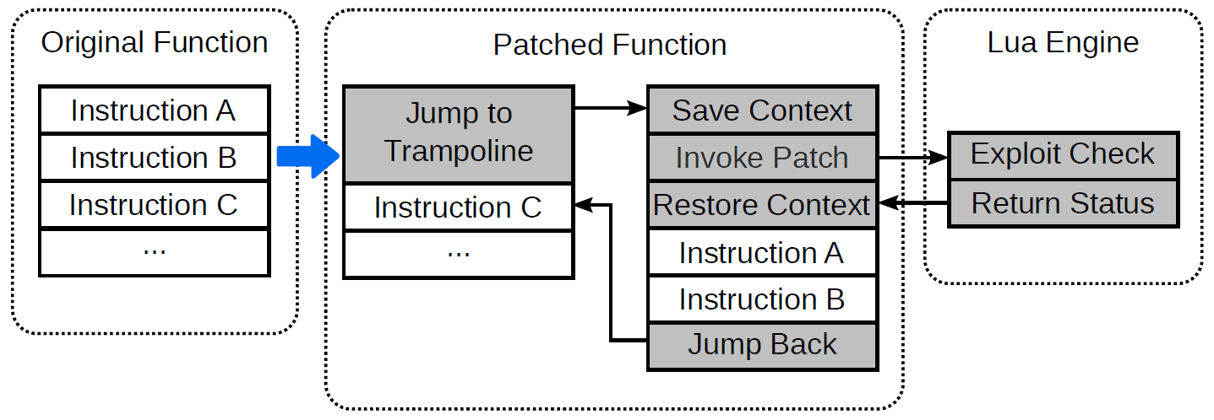
Online Patch Application
Function entry point hooking

Slide 33
Prototype Implementation
Lua engine in kernel (11K SLOC)
Simple
Memory-safe
Easy to embed and extend
24 years of development
Semantic matching
– angr

Slide 34
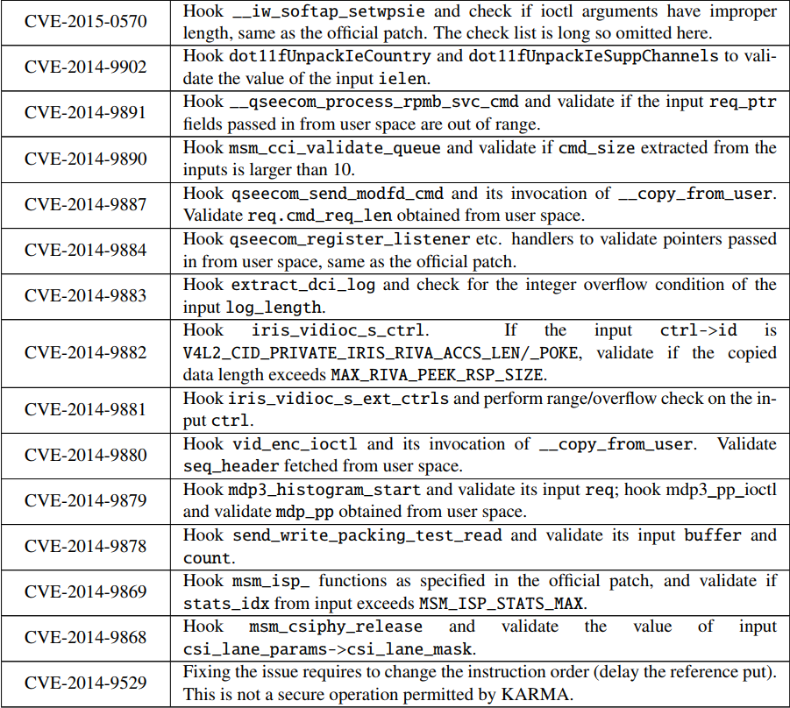
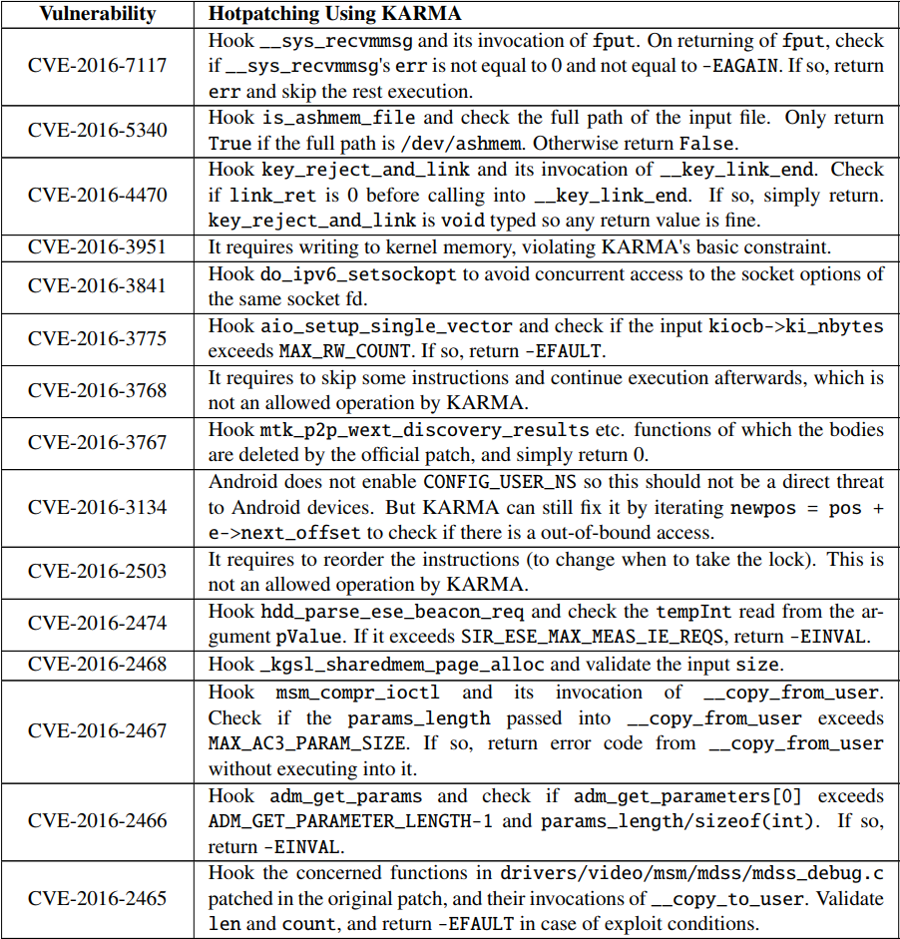
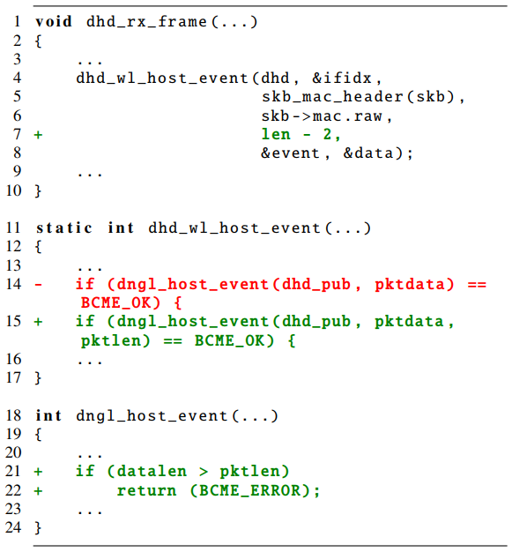
Evaluation: Applicability
Evaluated 76 critical vulnerabilities in the last three years
Patch level:
Level-1: 49
Level-2: 22
Level-3: 5

Slide 35
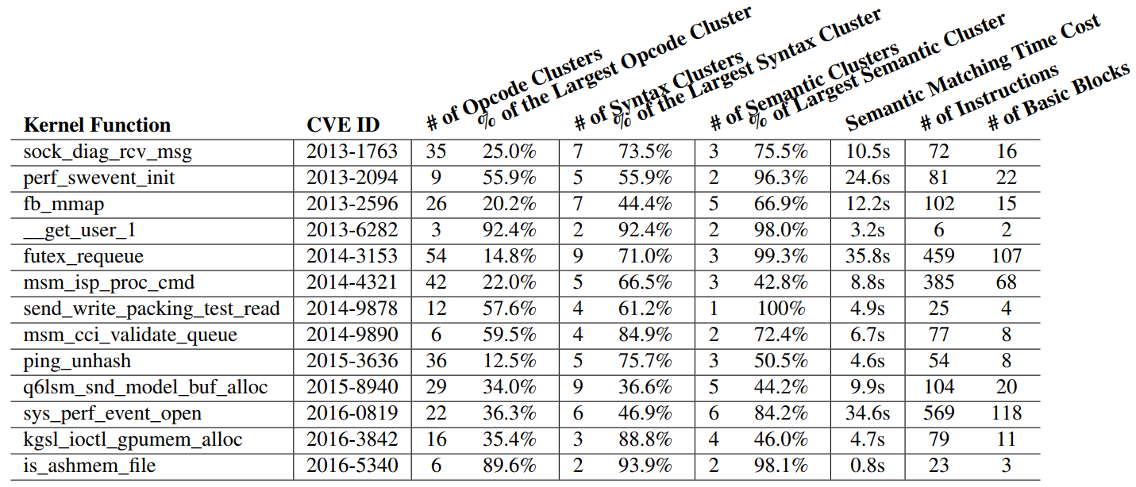
Evaluation: Adaptability

Slide 36
Evaluation: Adaptability
Types and frequencies of instruction opcodes

Slide 37
Evaluation: Adaptability
Number of function calls and conditional branches (to abstract CFG)

Slide 38
Evaluation: Adaptability
KARMA’s semantic matching

Slide 39
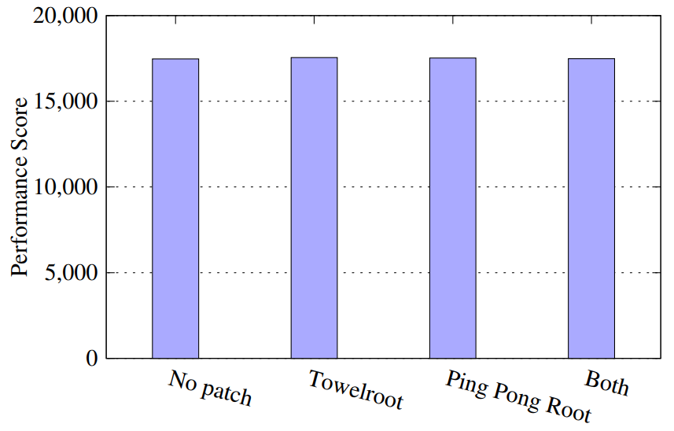
Evaluation: Performance
CF-Bench results with different patches

Slide 40
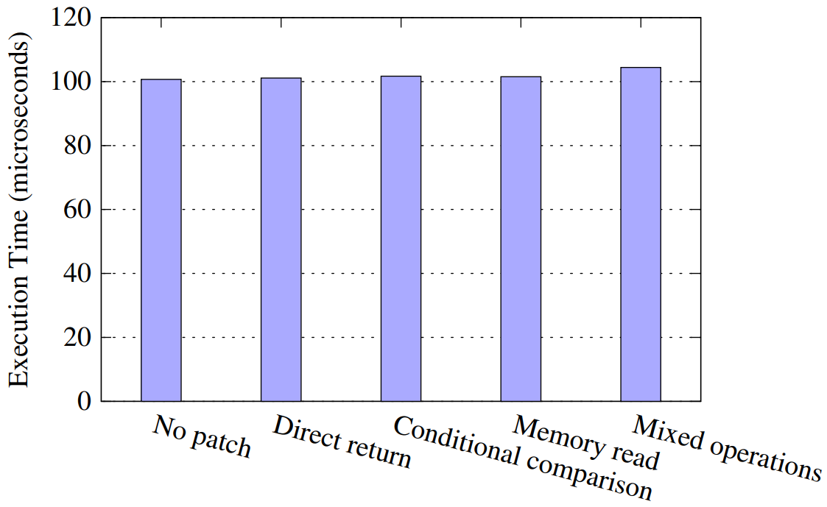
Evaluation: Performance
Execution time of chmod with different patches

Slide 41
Future Work
User-space vulnerability protection
Project Treble → only partially solve the problem
Lua engine in the kernel (11K SLOC)
Alternative execution engines, like BPF or sandboxed binary patches
Error handling code could be vulnerable
Error injection to detect vulnerable error-handling code
Improve semantic matching

Slide 42
Adaptive Android Kernel Live Patching
Q & A
www.YueChen.me

Slide 43
Backup Slides

Slide 44
Attack TrustZone from Kernel
Example:
Downgrade Attack on TrustZone (see its references)

Slide 45
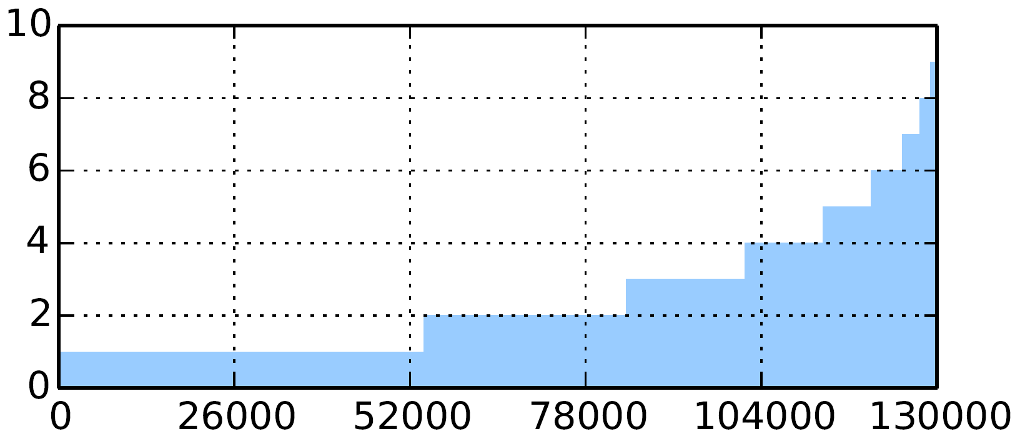
Observations
Most kernel functions are stable across devices and Android releases.
Cluster Number
Kernel Function Number
Number of syntax clusters for each function
About 40% of the shared functions have only one cluster, and about 80% of them have 4 clusters or less.

Slide 46
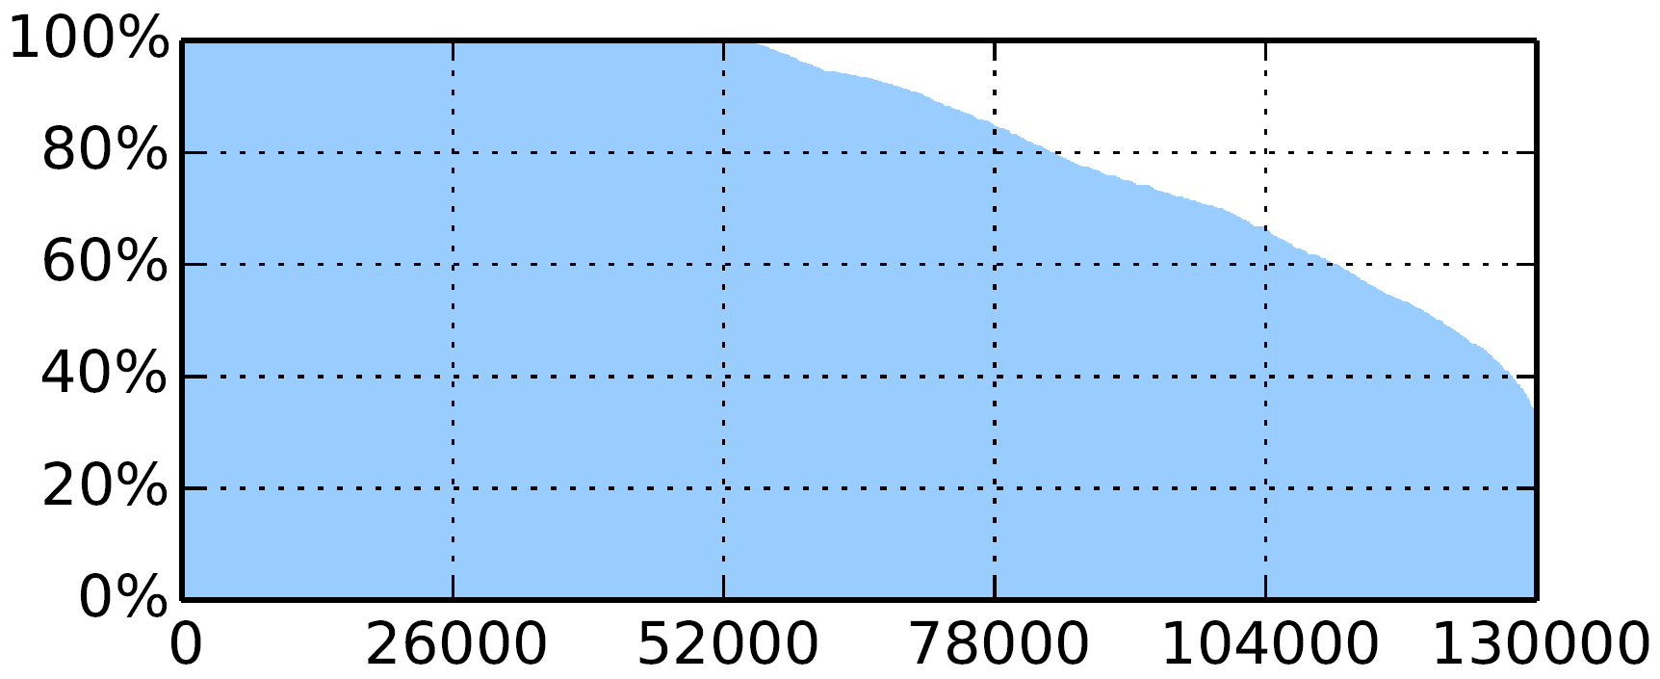
Observations
Most kernel functions are stable across devices and Android releases.
Kernel Function Number
Percentage of kernels in the largest cluster for each function
For about 60% of shared functions, the largest cluster contains more than 80% of all the kernels that have this function.

Slide 47
Symbolic Execution
Challenges
Avoid path explosion
Impact to the environment
Practical Solution
Non-local memory writes
Function calls (and their arguments)
Function return values
Adaptation (e.g., mutate constants or offsets)
foo(symbol_A + 4, 36) foo(symbol_A + 8, 36)

Slide 48
Evaluation: Overall Performance
Complex patch for most frequent syscall (gettimeofday) during web browsing
Overall system performance overhead in this extreme situation: 0.9%

Slide 49
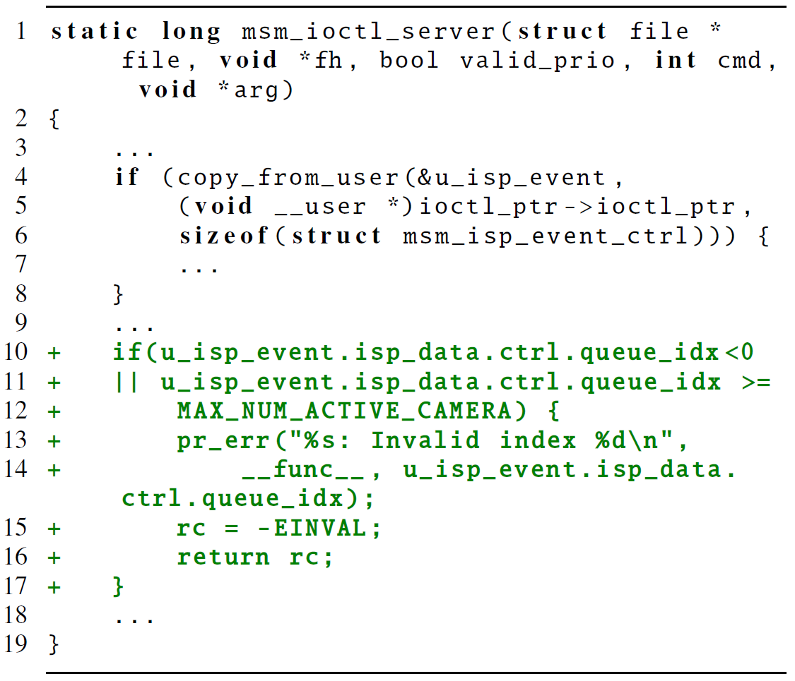
Example: CVE-2013-6123

Slide 50
Example: CVE-2013-6123

Slide 51
Example: CVE-2013-6123

Slide 52
Example: CVE-2013-6123

Slide 53
Example: CVE-2013-6123

Slide 54
Example: CVE-2013-6123

Slide 55
You May Also Like
A time machine to locate vulnerabilities:
Pinpointing Vulnerabilities
Protect your computer by encrypting memory all the time:
Secure In-Cache Execution
Fine-grained dynamic ASLR during runtime:
Remix: On-demand Live Randomization

