Slide 1
Anti-Skew: Single-Key Data Skew Mitigation for MapReduce
Yue Chen
Florida State University
Advanced Database Systems

Slide 2
Outline
Background
Data Skew
Anti-skew Design
Conclusion
Related Work

Slide 3
Background
Skip

Slide 4
Big Data Trend

Slide 5
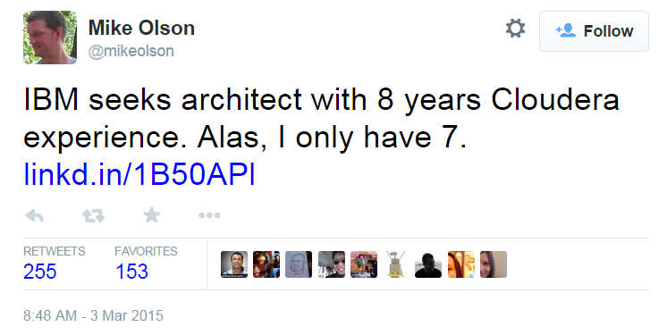
Big Data Trend
Mike Olson is a co-founder and former CEO of Cloudera.

Slide 6
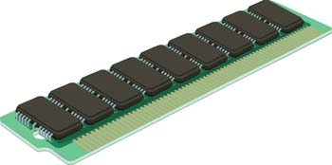
Big Data Trend

Slide 7
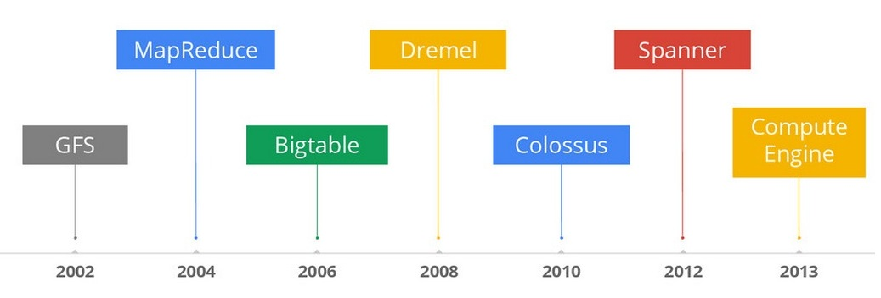
History
Notes:
Give up MapReduce to query database, too slow.
Hawq -> pivotal EMC greenplum

Slide 8
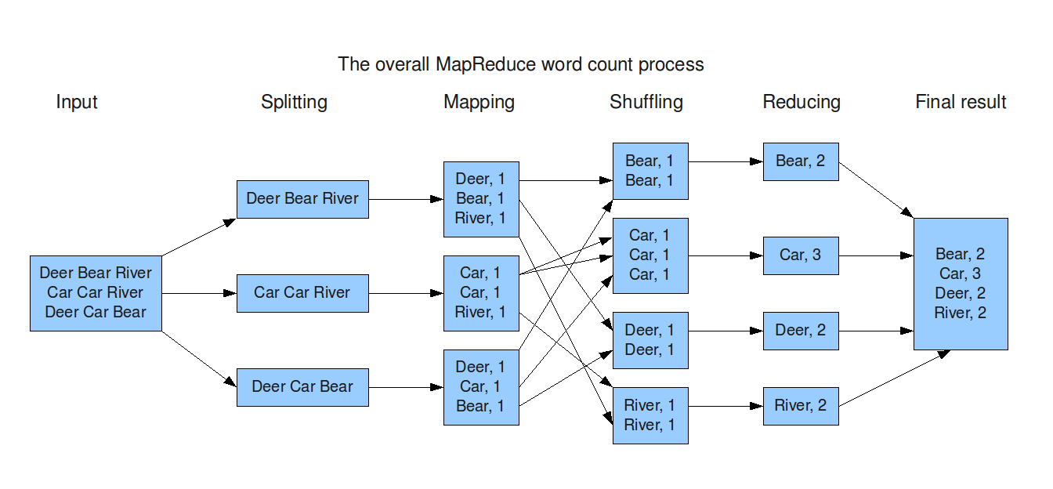
Review of MapReduce Word Count

Slide 9
Data Skew

Slide 10
What is data skew?

Slide 11
What is data skew?

Slide 12
What is data skew?

Slide 13
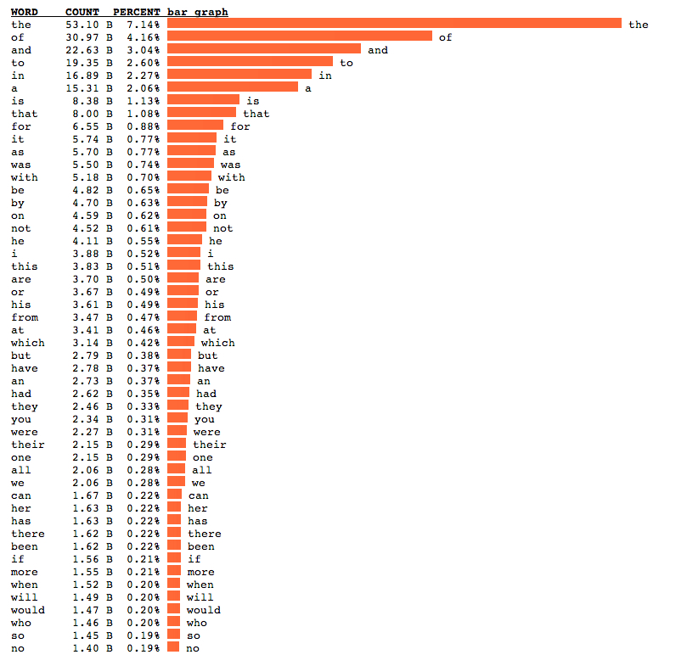

Slide 14
The Most Skewed Key?
NULL
Reported by the data team of

Slide 15
Anti-skew Design

Slide 16
Problem
Reducer1
Key1
Key2
Key3
Reducer2
Key4
Key5
Key6

Slide 17
Problem
Reducer1
Key1
Key2
Key3
Reducer2
Key4
Key5
Key6

Slide 18
Assumption1
The task can be divided into sub-tasks, and can be reassembled back to get the result in an easy way.

Slide 19
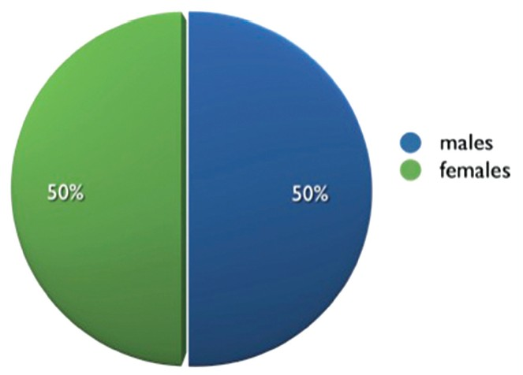
Assumption2
The key-value pairs in input data are near-equally distributed, which means sampling would be effective; although pre-execution sampling is not required.

Slide 20
Basic Idea
Key1
Key1.1
Key1.2
Key1.3
Key1.4
Key1.5
Key1.6

Slide 21
Skew Perception
Needs visualization!
Notes:
Alternative Hadoop distribution observation: Task completion progress remains at 99% (even 100% in practice) for a long time, only one or a relatively very small number of reduce tasks are not completed.

Slide 22
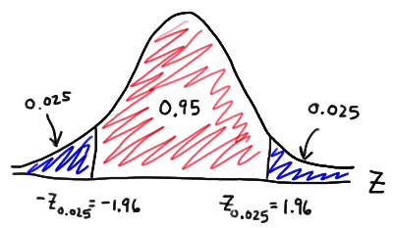
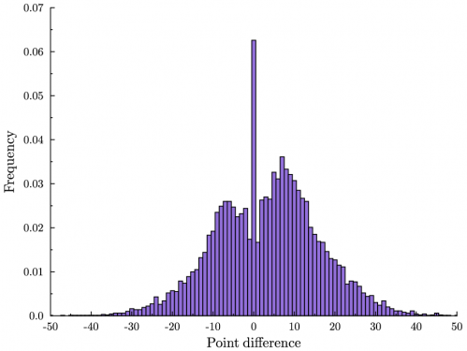
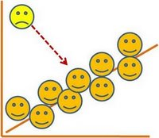
Skew Detection

Slide 23
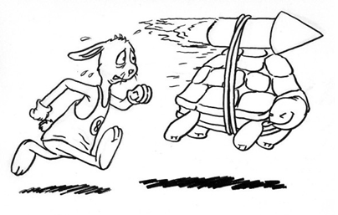
Straggler Identification (tentative)
A certain key’s count is more than 50% (100%? 200%?) of the median one.
Straggler

Slide 24
Straggler Identification (tentative)

Slide 25
Key Splitting
the
Hash
8fc42c6ddf9966db3b09e84365034357
Rehash
6e9b31333e61aad015fa16a3a5fe8e0d
Rehash
2e20bfee9e4486f0ab651fc0bb988ffb

Slide 26
Key Splitting
Special Key
the
8fc42c6ddf9966db3b09e84365034357
6e9b31333e61aad015fa16a3a5fe8e0d
2e20bfee9e4486f0ab651fc0bb988ffb

Slide 27
Load Balancing (tentative)
Can the hashing algorithm combined with the platform’s partition algorithm evenly distribute the keys to reducers?
Partitioner Function

Slide 28
Privacy (if pre-processed)
Name | Net worth (USD)
Bill Gates | $79.2 billion
Carlos Slim | $77.1 billion
Warren Buffett | $72.7 billion
Amancio Ortega | $64.5 billion
Larry Ellison | $54.3 billion
Charles Koch | $42.9 billion
David Koch | $42.9 billion
Christy Walton | $41.7 billion

Slide 29
Privacy (if pre-processed)
Name | Net worth (USD)
8adc1a86f7 | $79.2 billion
8ea0bb9a8f | $77.1 billion
9e640e0fe9 | $72.7 billion
abf803fe43 | $64.5 billion
bce5c74f58 | $54.3 billion
4f589f4867 | $42.9 billion
4867dbd572 | $42.9 billion
e9ca9f808c | $41.7 billion

Slide 30
Conclusion
A simple way to handle single-key skew in the MapReduce programming model
No extra OS-level resources needed
Implement it as a wrapper, no need to modify platforms’ source code, can be used for online platforms (there are so many Hadoop distributions, versions and patches!)

Slide 31
Hadoop Distributions
Notes:
MAPR own file system implementation

Slide 32
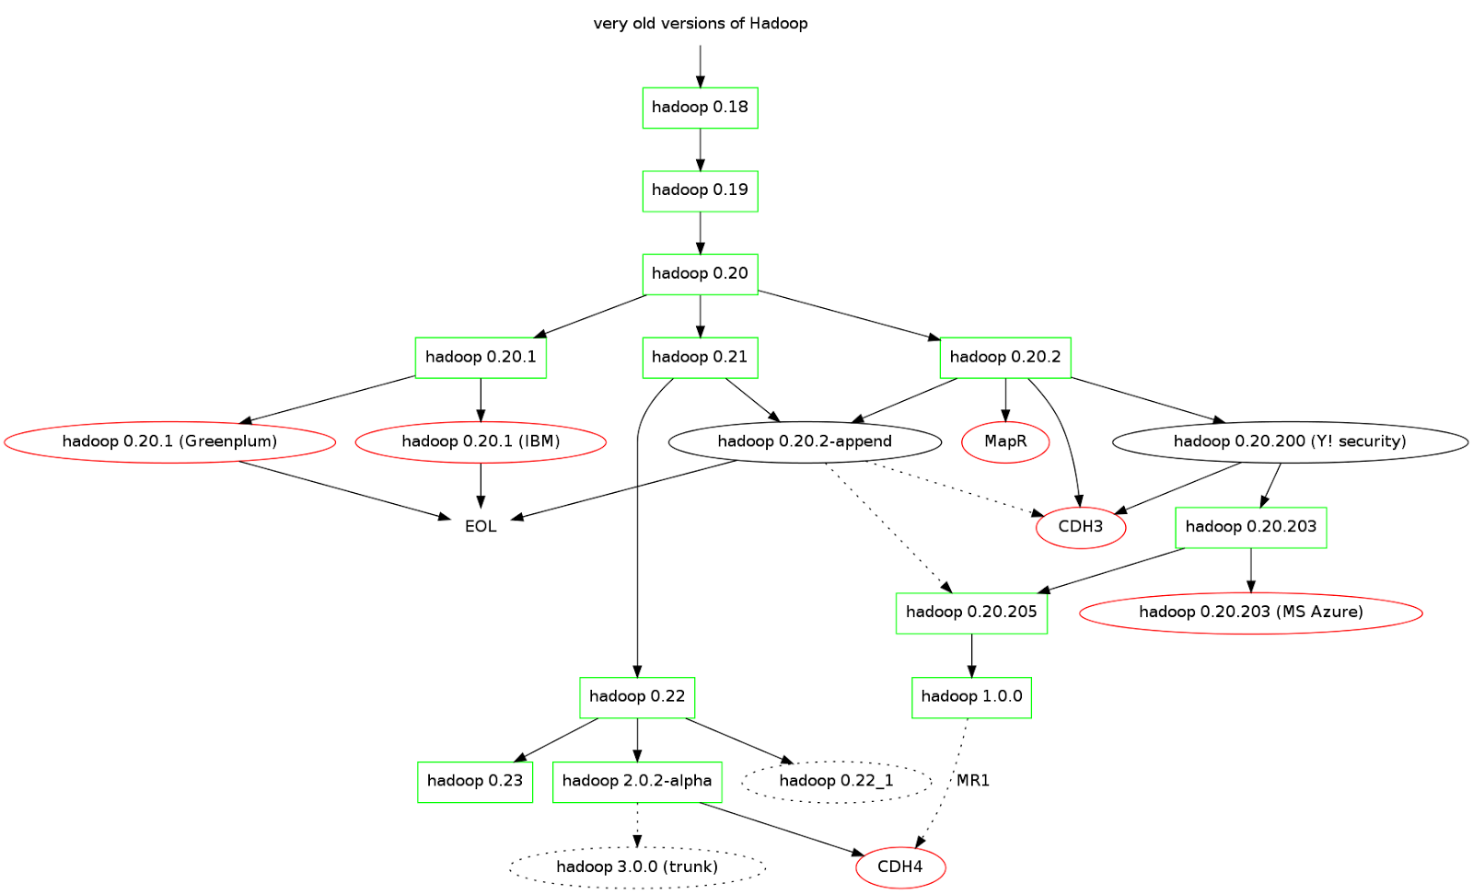

Slide 33
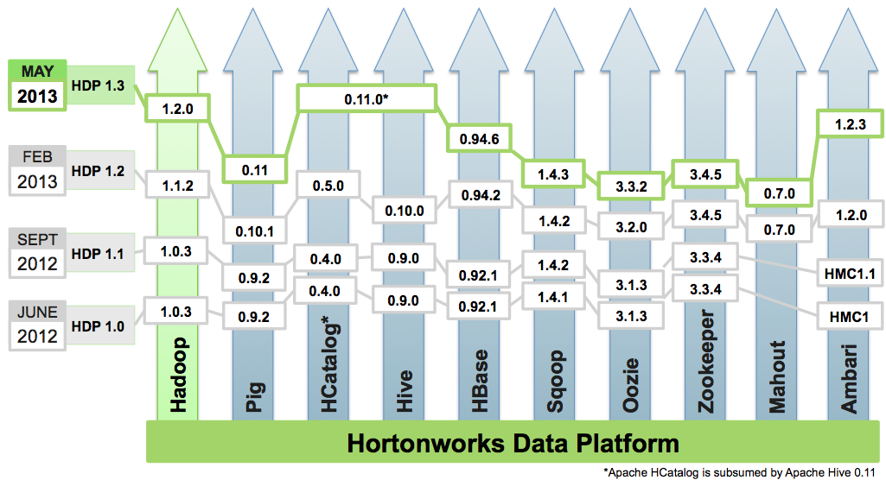

Slide 34
Related Work
Skip

Slide 35
SkewReduce
1
5
9
13
6
11
7
10
8
15
3
12
4
14
2
Varying granularities of partitions
Can we automatically find a good partition plan and schedule?

Slide 36
SkewReduce
1
Sample
SkewReduce
Optimizer
5
9
13
6
11
7
Cost functions
10
8
15
3
Cluster
configuration
12
4
14
2
Goal: minimize expected total runtime

Slide 37
SkewTune
Does what SkewReduce does when the program is running.
Skew detected -> Stop -> Repartition -> Continue

Slide 38
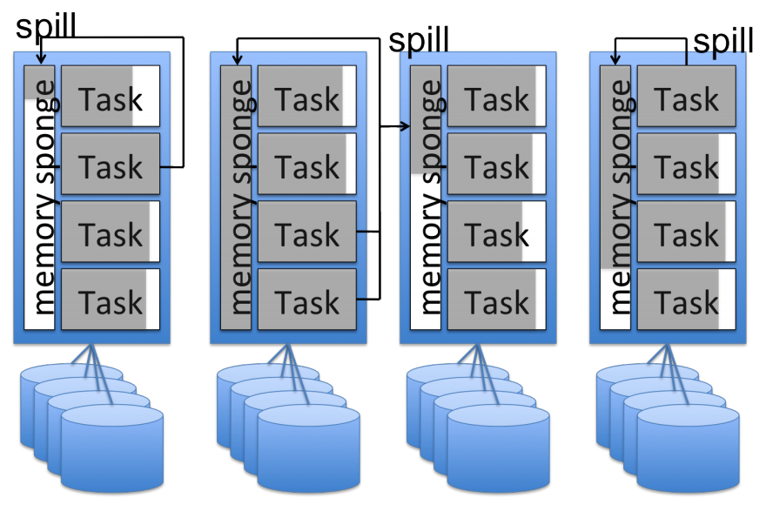
SpongeFiles

Slide 39
Q&A Suggestions?

