Slide 1
Balancing Throughput and Latency to Improve Real-Time I/O Service in Commodity Systems
Mark Stanovich

Slide 2
Outline
Motivation and Problem
Approach
Research Directions
  Multiple worst-case service times
  Preemption coalescing
Conclusion

Slide 3




Overview
Real-time I/O support using
  Commercial-of-the-shelf (COTS) devices
  General purpose operating systems (OS)
Benefits
  Cost effective
  Shorter time-to-market
    Prebuilt components
    Developer familiarity
  Compatibility
Notes:
“Increase” support
- larger number of applications, wider variety of applications
Newer (up-to-date) technology (better performance)
Shorter time-to-market
- prebuilt components
- Developer familiarity
General questions
- “will application set fit on a given system”
- “can we make the application set fit on a system that would otherwise not fit”
What does the OS provide?
- hardware abstraction layer (e.g., device drivers)
- Application isolation (e.g., memory protection)

Slide 4





Example:
Video Surveillance System
How do we know the system works?
  Receive video
  Intrusion detection
  Recording
  Playback
Changes to make the system work?
Local network
Internet
Network
CPU
Notes:
Service order is critical to meet timing constraints
Timing constraints are critical for a properly operating system.
Demonstration for success

Slide 5
Problem with Current I/O in Commodity Systems
Commodity system relies on heuristics
  One size fits all
  Not amenable to RT techniques
RT too conservative
  Considers a missed deadline as catastrophic
  Assumes a single worst case
RT theoretical algorithms ignore practical considerations
  Time on a device ≠ service provided
  Effects of implementation
    Overheads
    Restrictions
Notes:
Theoretical algorithms make too strict assumptions
The effects of the implementation, that if not included in the analysis can cause the analysis to become invalid
Approaching the problem from a with a hard RT mindset.
Commodity devices are not predictable.
Single service profile
Traditional RTOSs have different structures.
Written with RT in mind
Show example of the disconnect
Average throughput vs worst-case
All models wrong
Missing the details of the actual system
Who to attribute time (work) to? Similar to real-world schedule.
Models don’t fit the analysis
Example of unnecessarily over doing it?
Idle time and extra resources is a tradeoff
- Extra resources means less precise scheduling, extra cushion (safety margin)
Watching hulu or netflix, deadline miss is generally expected ☺ not catastrophic at all

Slide 6
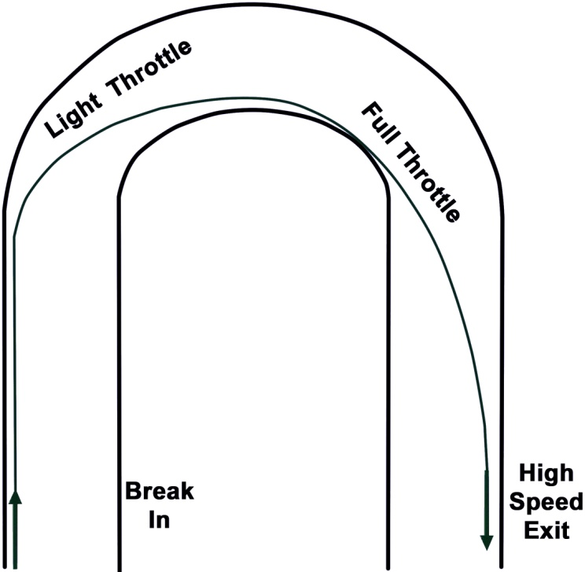
Approach
Balancing throughput and latency
Variability in provided service
  More distant deadlines allow for higher throughput
  Tight deadlines require low latency
Trade-off
  Latency and throughput are not independent
  Maximize throughput while keeping latency low enough to meet deadlines
http://www.wikihow.com/Race-Your-Car
Notes:
The thesis of the dissertation is that properly balancing throughput and latency allows for a broader range of (RT applications) RT I/O guarantees for commodity systems.
What are the things we can do to improve the current state
OS mechanisms that can implement theory but are also implementable
Scheduler as a simple example for mechanisms needed to carryout real-time
What about RT specific OSs?
Analytical vs emperical

Slide 7
Latency and Throughput
Scheduling Windows
Smaller
Larger
time
arrivals
Notes:
Scheduling windows defined by factors such as deadlines and rate of requests defines the number of requests under consideration
Scheduling window
Rate of requests
Smaller window
Smaller number of requests
Fewer permutations

Slide 8
Observation #1:
WCST(1) * N > WCST(N)
Sharing cost of I/O overheads
I/O service overhead examples
  Positioning hard disk head
  Erasures required when writing to flash
Less overhead higher throughput
Notes:
N request (e.g., to a hard disk)

Slide 9

Device Service Profile Too Pessimistic
Service rate workload dependent
  Sequential vs. random
  Fragmented vs. bulk
Variable levels of achievable service by issuing multiple requests
min access size
seek time
rotational latency
Notes:
Higher end movies have video rates up to 42Mbits/sec (blu-ray) 10Mbits/sec (dvd)
Newer higher quality movies are 15-20GB

Slide 10
Overloaded?
RT₁
0
15
25
+
75
50
RT₂
0
15
25
50
75
RT₁+RT₂
0
25
50
75
time
Notes:
Seemingly overloaded with single worst-cases
Tighter bounds, therefore more task sets considered schedulable

Slide 11
Increased System Performance
RT₁
0
15
25
50
RT₂
0
15
25
50
RT₁+RT₂
0
25
50
time
Notes:
Seemingly overloaded with single worst-cases
Tighter bounds, therefore more task sets considered schedulable

Slide 12
Small Variations Complicate Analysis
RT₁
+
0
15
25
50
RT₂
5
deadlines
RT₁+RT₂
0
25
50
time
arrivals

Slide 13
Current Research
Scheduling algorithm to balance latency and throughput
  Sharing the cost of I/O overheads
  RT and NRT
Analyzing amortization effect
  How much improvement?
  Guarantee
    Maximum lateness
    Number of missed deadlines
Effects considering sporadic tasks

Slide 14
Observation #2:
Preemption, a double-edged sword
Reduces latency
  Arrival of work can begin immediately
Reduces throughput
  Consumes time without providing service
  Examples
    Context switches
    Cache/TLB misses
Tradeoff
  Too often reduces throughput
  Not often enough increases latency
Notes:
Use preemption to lower latency
Clearer context switch Disk not preemptable, but other devices

Slide 15
Preemption
deadline
time
arrivals

Slide 16
Cost of Preemption
CPU time for a job

Slide 17
Cost of Preemption
Context switch time
CPU time for a job

Slide 18
Cost of Preemption
Context switch time
Cache misses
CPU time for a job

Slide 19
Current Research:
How much preemption?
time
Network packet arrivals

Slide 20
Current Research:
How much preemption?
time
Network packet arrivals

Slide 21
Current Research:
How much preemption?
time
Network packet arrivals

Slide 22
Current Research:
Coalescing
Without breaking RT analysis
Balancing overhead of preemptions and requests serviced
Interrupts
  Good: services immediately
  Bad: can be costly if occurs too often
Polling
  Good: batches work
  Bad: may unnecessarily delay service

Slide 23
Average Response Time

Slide 24
Average Response Time

Slide 25
Can we get the best of both?
Sporadic Sever
  Light Load
    Low response time
Polling Sever
  Heavy Load
    Low response time
    No dropped pkts

Slide 26
Average Response Time

Slide 27
Conclusion
Implementation effects force a tradeoff between throughput and latency
Existing RT I/O support is artificially limited
  One size fits all approach
  Assumes a single worst-case
Balancing throughput and latency uncovers a broader range of RT I/O capabilities
Several promising directions to explore

Slide 28
Extra Slides

Slide 29
Latency and Throughput
Timeliness depends on min throughput and max latency
Tight timing constraints
  Smaller number requests to consider
  Fewer possible service orders
  Low latency, Low throughput
Relaxed timing constraints
  Larger number of requests
  Larger number of possible service orders
  High throughput, high latency
increase throughput
lengthen latency
resource
(service provided)
time interval
Notes:
Rate-latency curve
Tradeoff typically encountered is the higher rate, higher latency

Slide 30

Observation #3:
RT Interference on Non-RT
Non-real time != not important
Isolating RT from NRT is important
RT can impact NRT throughput
RT
Backup
Anti-virus
Maintenance
System Resources
Notes:
http://www.clker.com/clipart-24887.html
Don’t want to take offline to perform various features
- backup
- SW updates
- Antivirus and other security checks

Slide 31
Current Research:
Improving Throughput of NRT
Pre-allocation
  NRT applications as a single RT entity
Group multiple NRT requests
  Apply throughput techniques to NRT
Interleave NRT requests with RT requests
Mechanism to split RT resource allocation
  POSIX sporadic server (high, low priority)
  Specify low priority to be any priority including NRT
Notes:
Ensure RT timing constraints are not violated

Slide 32
Research
Description
  One real-time application
  Multiple non-real time applications
Limit NRT interference
Provide good throughput for non-real-time
Treat hard disk as black box

Slide 33
Amortization Reducing Expected Completion Time
Higher throughput
(More jobs serviced)
(Queue size increases)
(Queue size decreases)
Lower throughput
(Fewer jobs serviced)

Slide 34
Livelock
All CPU time spent dealing with interrupts
System not performing useful work
First interrupt is useful
  Until packet(s) for interrupt are processed, further interrupts provide no benefit
  Disable interrupts until no more packets (work) available
Provided notification needed for scheduling decisions

Slide 35
Other Approaches
Only account for time on device [Kaldewey 2008]
Group based on deadlines [ScanEDF , G-EDF]
Require device-internal knowledge
  [Cheng 1996]
  [Reuther 2003]
  [Bosch 1999]
vs.

Slide 36
“Amortized” Cost of I/O Operations
WCST(n) << n * WCST(1)
Cost of some ops can be shared amongst requests
  Hard disk seek time
  Parallel access to flash packages
Improved minimum available resource
WCST(5)
5 * WCST(1)
time
Notes:
Idea is that if we can perform better scheduling we can achieve higher levels of throughput
Pizza delivery example
- bulk requests with deadlines taken into account

Slide 37

Amount of CPU Time?
A
B
Sends ping traffic to B
Receive and respond to packets from A
arrival
interrupt
deadline
deadline
Notes:
Previously OS could be generally ignored due to time required being small.

Slide 38
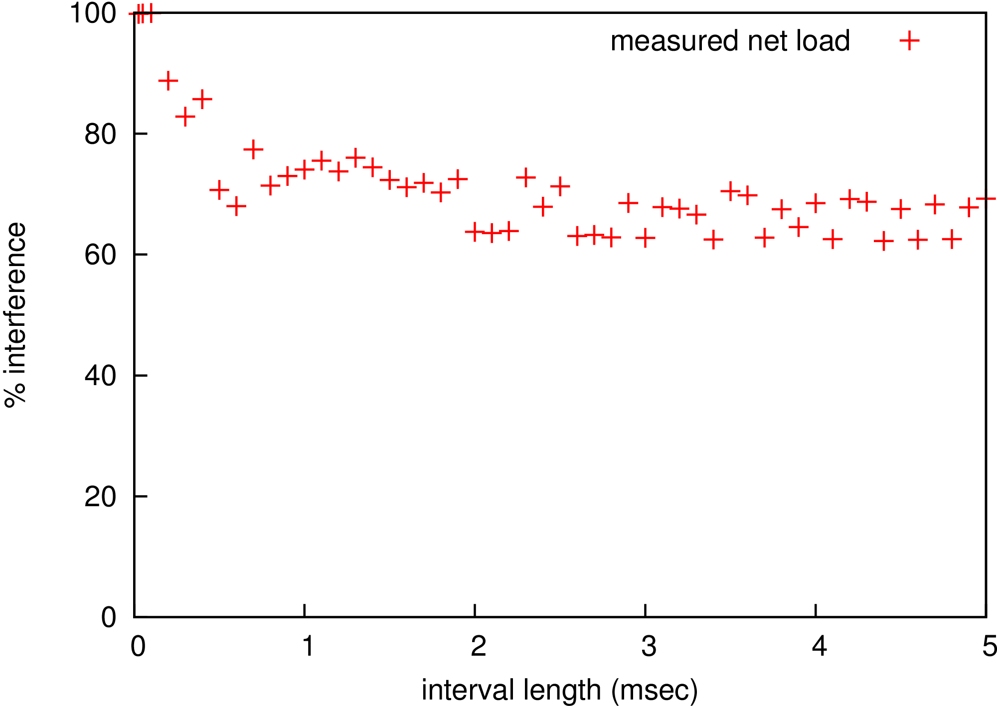
Measured Worst-Case Load
Notes:
Measure different sized intervals for a significant amount of time. Record the maximum of consumed in that time interval (and then take the ratio (divide by the interval length under consideration)).

Slide 39
Some Preliminary Numbers
Experiment
  Send n random read requests simultaneously
  Measure longest time to complete n requests
Amortized cost per request should decrease for larger values of n
  Amortization of seek operation
n random requests
Hard Disk

Slide 40
50 Kbyte Requests

Slide 41
50 Kbyte Requests
Notes:
Why linear and not polynomial looking like other graphs?

Slide 42
Observation #1:
I/O Service Requires CPU Time
Examples
  Device drivers
  Network protocol processing
  Filesystem
RT analysis must consider OS CPU time
Apps
OS
Device
(e.g., Network adapter, HDD)

Slide 43
Example System
Web services
  Multimedia
  Website
Video surveillance
  Receive video
  Intrusion detection
  Recording
  Playback
Local network
All-in-one
server
Network
Internet
CPU
Notes:
Service order is critical to meet timing constraints
Timing constraints are critical for a properly operating system.
Demonstration for success

Slide 44
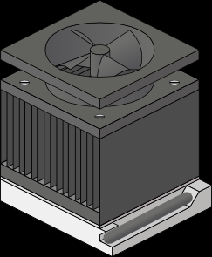
Example
App
arrival
deadline
time
Notes:
Icon that shows where I’m going?
What’s the problem

Slide 45


Example: Network Receive
App
App
OS
OS
arrival
interrupt
deadline
deadline
time
Notes:
Icon that shows where I’m going?
What’s the problem
Envelope:
http://www.clker.com/clipart-16056.html

Slide 46
OS CPU Time
Interrupt mechanism outside control of OS
Make interrupts schedulable threads [Kleiman1995]
  Implemented by RT Linux
Notes:
Why can’t we just disable interrupts? Too coarse grained?
Allow control over when CPU time is consumed rather than have it appear at arbitrary times.
Provides a mechanism to implement RT scheduling algorithms
When the packet arrives we don’t know what application it is for, therefore what priority do we schedule it
Not much work done in this general purpose area
Others
- CPU usage, but not I/O CPU usage
- neglected due to specialized systems
Reference grant
Stronger with multiple state-of-art shortcomings
Start incorporating accounting
Policy to do I/O scheduling
TODO: why not use analysis for priority inheritance
- No bound to put in analysis
Why is this the state of the art? Not many RT systems use GP COTS
I/O inherits priority of process issuing/waiting on I/O
Doesn’t provide policy
Provide mechanism to implement RT theory
Non-unified priority space
Not clear what is schedulable

Slide 47
Example: Network Receive
App
App
OS
OS
arrival
interrupt
deadline
time
Notes:
Network processing not used by RT task => low priority
Everything works out nicely, however, lets look at a slightly more complex example

Slide 48
Other Approaches
Mechanism
  Enable/disable interrupts
  Hardware mechanism (e.g., Motorola 68xxx)
  Schedulable thread [Kleiman1995]
  Aperiodic servers (e.g., sporadic server [Sprunt 1991])
Policies
  Highest priority with budget [Facchinetti 2005]
  Limit number of interrupts [Regehr 2005]
  Priority inheritance [Zhang 2006]
  Switch between interrupts and schedulable thread [Mogul 1997]
Notes:
What do you limit the processing to? Limit interference but also enough for RT I/O

Slide 49
Problems Still Exist
Analysis?
Requires known maximum on the amount of priority inversion
  What is the maximum amount?
Is enforcement of the maximum amount needed?
  How much CPU time?
  Limit using POSIX defined aperiodic server
    Is an aperiodic server sufficient?
    Practical considerations?
      Overhead
      Imprecise control
Can we back-charge an application?
  No priority inversion charge to application
  Priority inversion charge to separate entity
Notes:
Can we use an aperiodic server?
How much time to provide?
Are there any practical considerations?

Slide 50
Concrete Research Tasks
CPU
  I/O workload characterization [RTAS 2007]
  Tunable demand [RTAS 2010, RTLWS 2011]
  Effect of reducing availability on I/O service
Device
  Improved schedulability due to amortization [RTAS 2008]
  Analysis for multiple RT tasks
End-to-end I/O guarantees
  Fit into analyzable framework [RTAS 2007]
  Guarantees including both CPU and device components

Slide 51
Feature Comparison

Slide 52
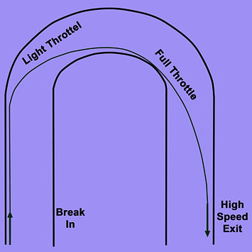
New Approach
Better Model
  Include OS CPU consumption into analysis
  Enhance OS mechanisms to allow better system design
Models built on empirical observations
  Timing information unavailable
  Static analysis not practical and too pessimistic
Resources operate at a variety of service rates
  Tighter deadlines == lower throughput
  Longer deadlines == higher throughput
Notes:
Theory vs implementation
Rather than using the worst-case minimum service rate, consider the workload requirements in order to perform better scheduling and increase the min service rate
http://www.wikihow.com/Race-Your-Car
Implementation is important, so what mechanisms are necessary for system designers to take advantage of this tradeoff between tight deadlines and throughput

Slide 53

Example:
Rate-Latency Curve Convolution
=
rate₁
$$⊗$$
rate₂
Latency₁
Latency₂
rate₁
Latency₁ + Latency₂
Notes:
Rate-latency curves

Slide 54
A Useful Tool: Real-Time Calculus
Based on network calculus, derived from queueing theory
  Provides an analytical framework to compose system
More precise analysis (bounds) especially for end-to-end analysis
Can be used with existing models (e.g., periodic)
Provides a very general representation for modeling systems

Slide 55
End-to-End Analysis
I/O service time includes multiple components
Analysis must consider all components
  Worst-case delay for each?
  Is this bound tight?
Framework to “compose” individual resources
Tx
Device
Rx
request
response
Notes:
How do we add e.g., a filesystem component in a systematic manner

Slide 56
Real-Time Calculus
β
(min service curve)
α
(max arrival curve)
Maximum horizontal distance
is the worst-case response time
Δ
Notes:
Visually and analytically describe the system.

Slide 57








Real-Time Calculus [Thiele 2000]
resources
$$β1$$
$β$₂
workload
(arrivals)
$$α1$$
$$α1′$$
$$β1′$$
$α$₂
$$α2′$$
$$β1′′$$

Slide 58
Composing RT I/O Service
Apps
Tx
Device
Rx

Slide 59
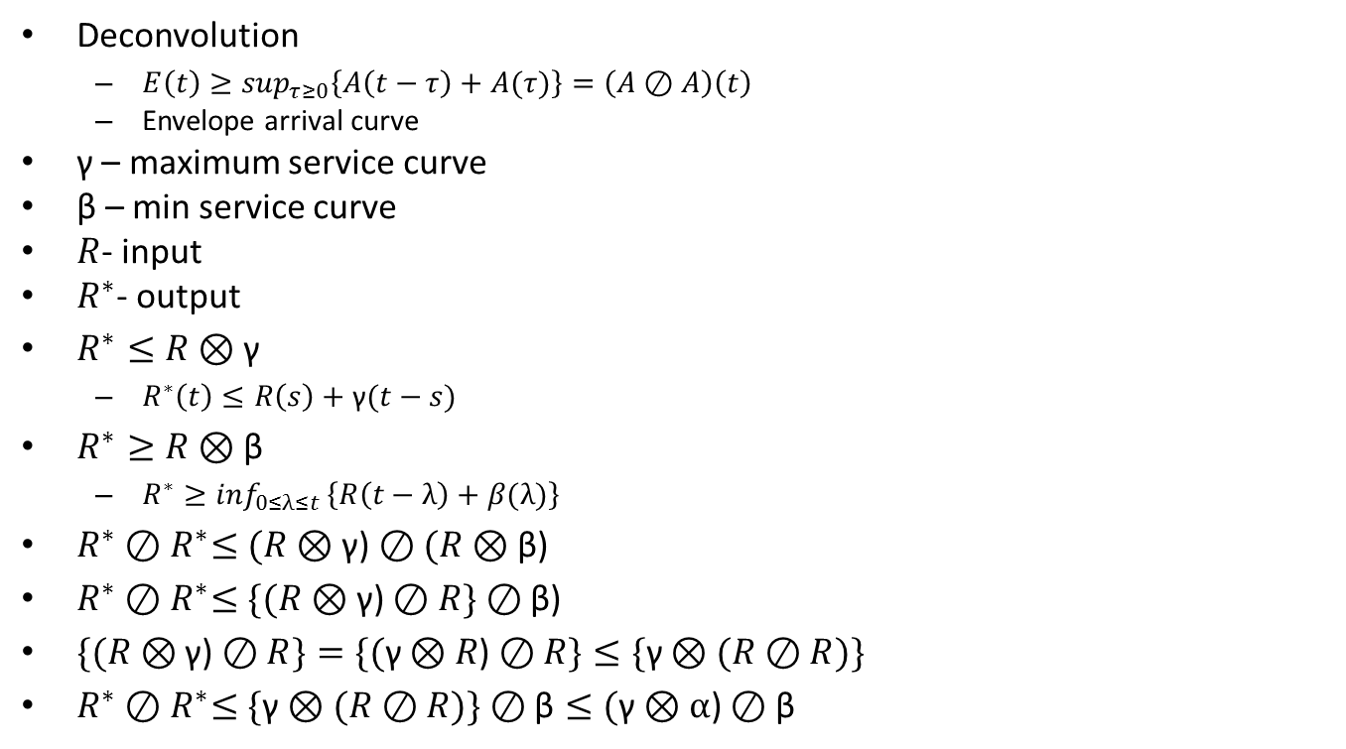
Constraint on Output Arrival
Deconvolution
  $E\left(t\right)≥\sup_{τ≥0}\left\{A\left(t−τ\right)+A(τ)\right\}=\left(A⊘A\right)\left(t\right)$
  Envelope arrival curve
γ – maximum service curve
β – min service curve
$R$- input
$R^{∗}$- output
$R^{∗}≤R⊗\text{γ}$
  $R^{∗}\left(t\right)≤R\left(s\right)+\text{γ}(t−s)$
$R^{∗}≥R⊗\text{β}$
  $R^{∗}≥\inf_{0≤λ≤t }\left\{R\left(t−λ\right)+β(λ)\right\}$
$R^{∗}{⊘R}^{∗}≤(R⊗\text{γ}\text{)}⊘(R⊗\text{β}\text{)}$
$R^{∗}{⊘R}^{∗}≤\{(R⊗\text{γ}\text{)}⊘R\}⊘\text{β}\text{)}$
$\{(R⊗\text{γ}\text{)}⊘R\}=\{(\text{γ}⊗R\text{)}⊘R\}≤\{\text{γ}⊗(R⊘R)\}$
$R^{∗}{⊘R}^{∗}≤\{\text{γ}⊗(R⊘R)\}⊘\text{β}≤(\text{γ}⊗α\text{)}⊘\text{β}$

Slide 60
Timing Bounds
observable
upper-bound
analytical
upper-bound
empirical
upper-bound
actual
upper-bound
frequency
possible
measured
0
response
time
Notes:
Observable – what can be invoked based on how the device is being used
Calculated – analytical determination of upper-bound
REF: The Worst-Case Execution-Time Problem-Overview of Methods and Survey of Tools

Slide 61
Job
Notes:
Model encapsulates the necessary information to perform the calculation as to whether or not deadlines will be missed.
You have these single finite units of work.
Guarantee that for all jobs on the system they will meet their deadlines.
Don’t want to list all job due to it potentially being infinite
Computation of an algorithm
Read data from a disk
Task is potentially infinite number of jobs

Slide 62
Task
Inter-arrival Time
time
Worst-case Execution
Time (WCET)
deadline
Notes:
Describes the generation of a set of potentially infinite sequence of jobs
Arrival time will be in relation to the previous arrival

Slide 63
Theoretical Analysis
Non-preemptive job scheduling reduces to bin packing (NP-hard)

Slide 64



Real-Time Calculus [Thiele 2000]
Resource availability in the time interval [s,t) is C[s,t)
  $$βl\left(t−s\right)≤C\left[s,t\right)≤βl\left(t−s\right), ∀s<t$$
  $$β\left(∆\right)=\min_{u≥0}\left\{C\left(∆+u\right)−C(u)\right\}$$
$$s$$
$$t$$
time

Slide 65













Real-Time Calculus [Thiele 2000]
$$β1$$
$β$₂
$$α1$$
$$α1′$$
$$β1′$$
$$α^{′}u=min\left\{\left(αu⊗βu\right)⊘ βl,βu\right\}$$
$$α^{′}l=min\left\{\left(αl⊘ βu\right)⊗βl,βl\right\}$$
$$β^{′}u\left(t\right)= \inf_{λ≥0}\left\{βu\left(λ\right)−αl\left(λ\right)\right\}$$
$α$₂
$$α2′$$
$$β^{′}l\left(t\right)= \sup_{0≤λ≤t}\left\{βl\left(λ\right)−αu\left(λ\right)\right\}$$
$$β1′′$$
$$\left(f⊗g\right)\left(t\right)=\inf_{0≤λ≤t }\left\{f\left(t−λ\right)+g(λ)\right\}$$
$$\left(f⊘ g\right)\left(t\right)=\sup_{λ≥t }\left\{f\left(t+λ\right)−g(λ)\right\}$$

Slide 66

Real-Time Calculus
β
(service curve)
α
(arrival curve)
$$dmax≤\sup_{λ≥0}\left\{inf\left\{τ≥0:αu(λ)≤βl(λ+τ)\right\}\right\}$$
Maximum horizontal distance
is the worst-case response time
Δ
$$bufmax≤\sup_{λ≥0}\left\{αu(λ)≤βl(λ+τ)\right\}$$
Maximum vertical distance
is maximum queue length

Slide 67








Network Calculus
$$x(t)$$
$$σ(t)$$
$$y(t)$$
$$y\left(t\right)=\left(σ⊗x\right)\left(t\right)=\inf_{0≤λ≤t }\left\{σ\left(t−λ\right)+x(λ)\right\}$$
$$x(t)$$
$$σ1(t)$$
$$σ2(t)$$
$$y(t)$$
$$σc=σ1⊗σ2$$
Notes:
Similar to signal processing
Infimum (greatest lower bound) is essentially the minimum but is well defined over the real numbers.
X e R: 0 < x < 1
Tandem of routers

Slide 68
Apps
Apps
Apps
CPU
CPU
CPU

Slide 69
Real-Time Background
Explicit timing constraints
  Finish computation before a deadline
  Retrieve sensor reading every 5 msecs
  Display image every 1/30th of a second
Schedule (online) access to resources to meet timing constraints
Schedulability analysis (offline)
  Abstract models
    Workloads
    Resources
  Scheduling algorithm
App₂
App₁
App_{n}
Notes:
TODO: explain worst-case. Needed since worst-case is not always constant. That is, the minimum amount of service can vary depending on the type of workload. (e.g., number of sequential sectors on hard disk)
Pizza delivery example, multiple pizzas delivered can be guaranteed faster, but pizzas may be cold!
For average-case typically looking at arbitrarily long time intervals.
Side-note that some real-time analysis does look at probabilistic guarantees, but this research will not extend into that realm.

Slide 70
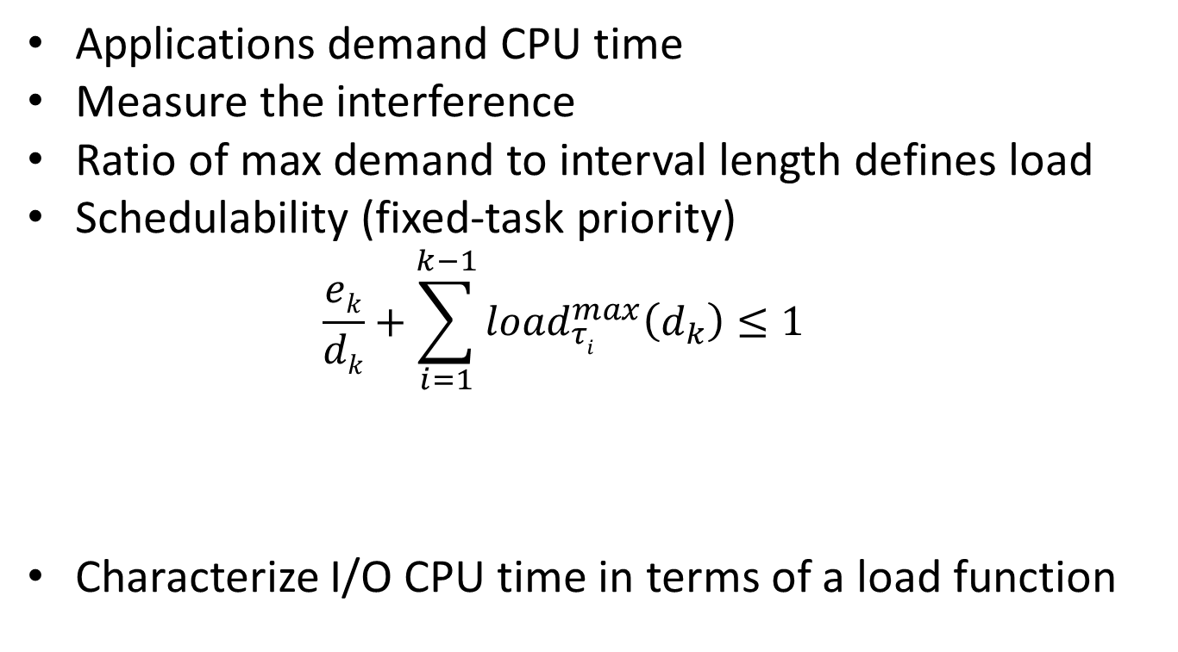
Current Research:
Analyzing CPU Time for IOs
Applications demand CPU time
Measure the interference
Ratio of max demand to interval length defines load
Schedulability (fixed-task priority)
  $$\frac{ek}{dk}+\sum_{i=1}^{k−1}{{load}_{τi}^{max}\left(d_{k}\right)≤1}$$
Characterize I/O CPU time in terms of a load function
Task under
consideration
Interference from
higher priority tasks
Notes:
Preliminary characterization
Only mention curly brace stuff
Load is ratio of demand to interval length
Uniprocessor
Provide a model for the resource.
Try to instantiate the worst-case.
Look at workload isolated and build the model
With the idea that we will encounter the worst-case profile.

Slide 71
How to measure load
I/O CPU component at high priority
Measurement task at low priority
time
Notes:
Empirical, but only for a portion. Analytical techniques (schedulability analysis) is still used. For example, interaction between other tasks still uses powerful analytical techniques to ensure that all permutations are considered and no timing constraints are violated.
Provide a model for the resource.
Try to invoke and measure the worst-case.
Look at workload isolated and build the model
With the idea that we will encounter the worst-case profile.

Slide 72
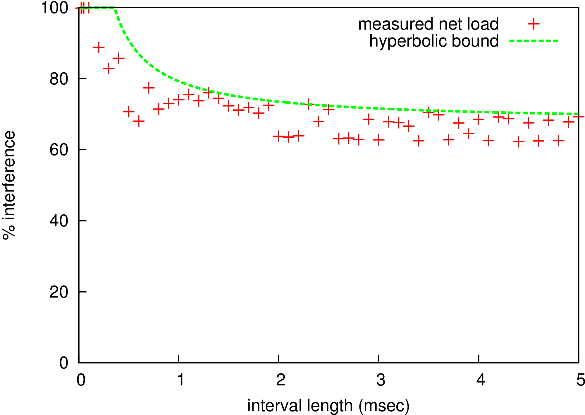
Measured Worst-Case Load
Notes:
TODO: Curve color should match the next graphs
Measure different sized intervals for a significant amount of time. Record the maximum of consumed in that time interval (and then take the ratio (divide by the interval length under consideration)).

Slide 73
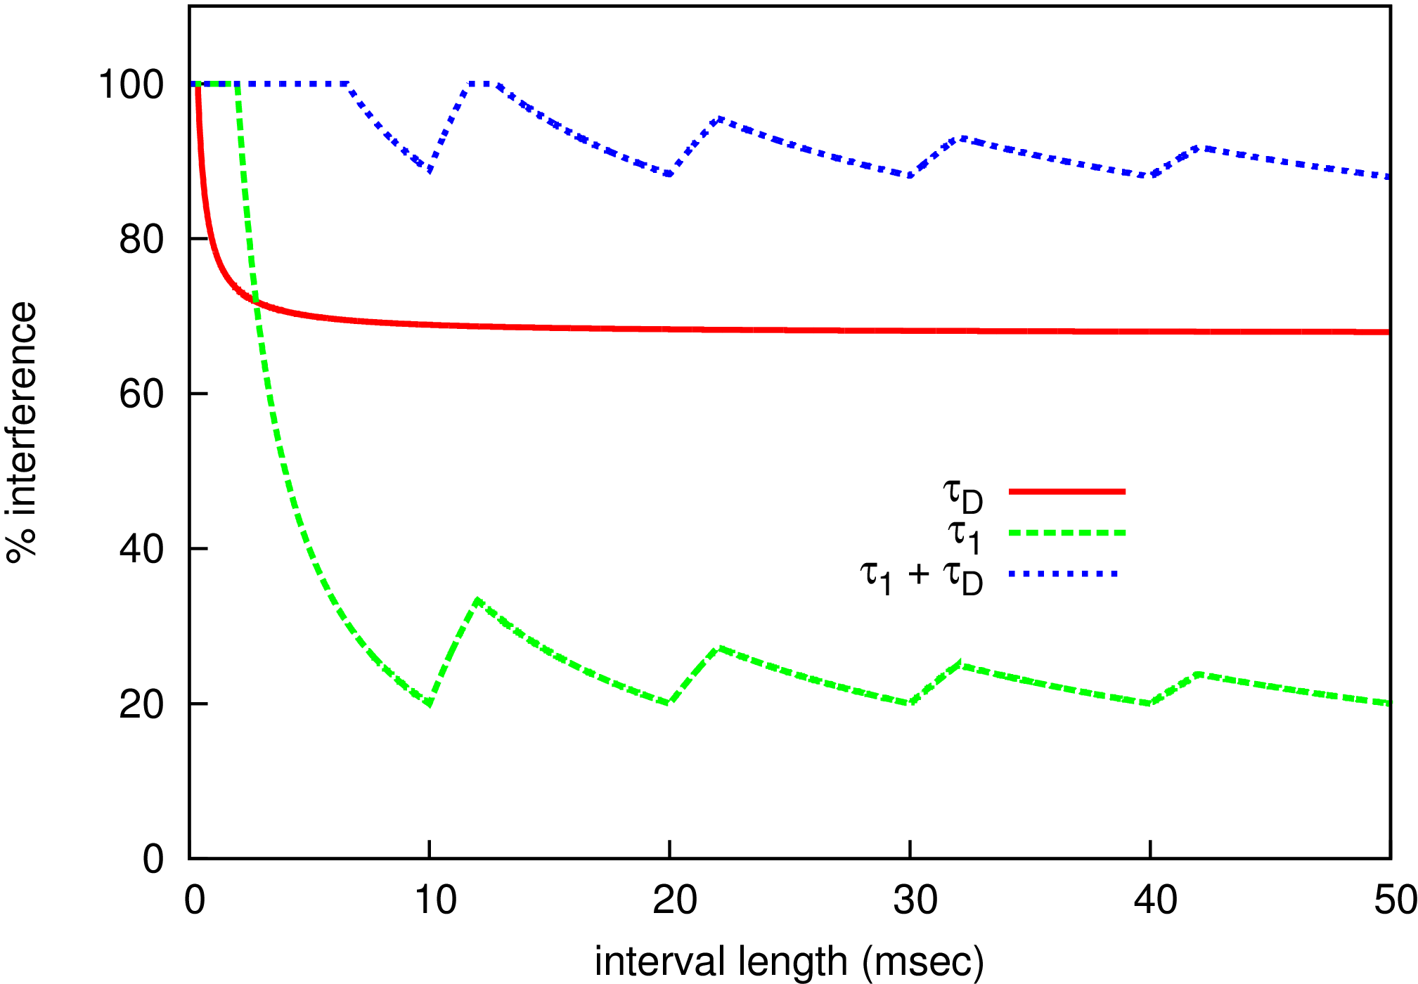
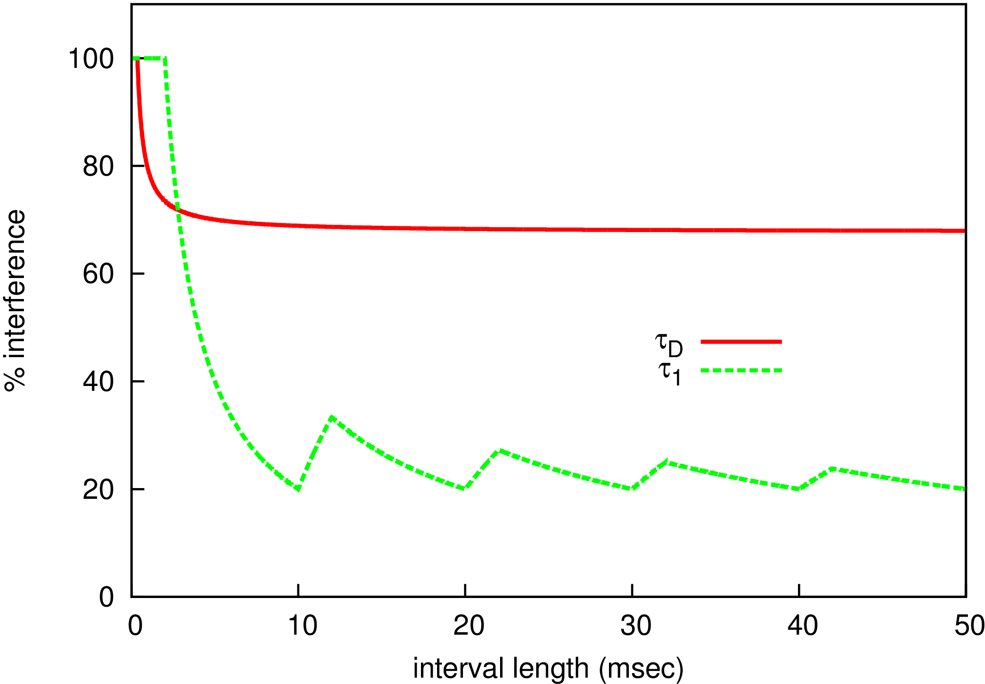
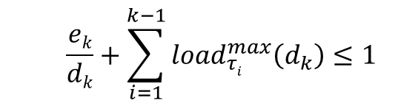
Analyzing
  $$\frac{ek}{dk}+\sum_{i=1}^{k−1}{{load}_{τi}^{max}\left(d_{k}\right)≤1}$$
Task under
consideration
Interference from
higher priority tasks
τ₁ is a periodic task (WCET =2, Period = 10)
Notes:
If I lower what is the effect of the I/O performance.
From the analysis straightforward to make it fit, but how do we implement this.
Controlling interference to meet the requirements of the system.
Will application fit, if it does not what can we do to make it fit
Green + red
Outline where going with this

Slide 74
Bounding

Slide 75

Adjusting the Interference
May have missed worst-case
CPU time consumed too high
Aperiodic servers
  Force workload into a specific workload model
  Example: Sporadic server
Notes:
May have missed WC in analysis
Reasons why one would want to adjust

Slide 76
Future Research
Combine bounding and accounting
  Accounting
    Charge user of services
    Cannot always charge correct account
  Bound
    Set aside separate account
    If exhausted disable I/O until account is replenished
Notes:
Charging multiple entities

Slide 77
Future Research:
Practicality of Aperiodic Servers
Practical considerations
  Is the implementation correct?
  Overhead
    Context switches
    Latency vs Throughput

Slide 78

Past Research:
Throttling
Non-real time
Real time
OS scheduler

Slide 79
“Amortized” Cost of I/O Operations
WCST(n) << n * WCST(1)
Cost of some ops can be shared amongst requests
  Hard disk seek time
  Parallel access to flash packages
Improved minimum available resource
Notes:
Idea is that if we can perform better scheduling we can achieve higher levels of throughput
Pizza delivery example
- bulk requests with deadlines taken into account

Slide 80
Seek Time Amortization

Slide 81
Seek Time Amortization

Slide 82
Seek Time Amortization

Slide 83
50 Kbyte Requests

Slide 84
Example System
How do we make the system work?
Web services
  Multimedia
  Website
Video surveillance
  Receive video
  Intrusion detection
  Recording
  Playback
Local network
All-in-one
server
Network
Internet
CPU
Notes:
Service order is critical to meet timing constraints
Timing constraints are critical for a properly operating system.
Demonstration for success

