Slide 1
Connecting the RTDS to a Multi-Agent System Testbed Utilizing the GTFPGA
Mark Stanovich, Raveendra Meka,
Mike Sloderbeck
Florida State University

Slide 2
Introduction
Power systems are becoming much more cyber-physical
  Computational resources
  Data communication facilities
Desire to explore distributed control of electrical systems
Existing RTDS infrastructure to simulate electrical system simulation
Need to add computational and data communication facilities
Notes:
Power systems are quickly being much more cyberphysical in nature meaning they are utilizing computational and data communication resources.
One of our goals is to study distributed control of electrical power systems.
Given the availability of our RTDS infrastructure, our plan was to add a number of computational resources connected utilizing readily available Ethernet components.

Slide 3
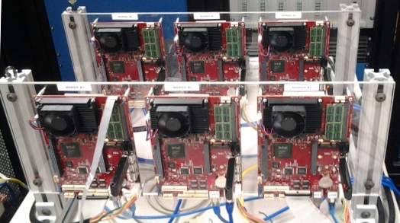
Distributed Controls Testbed
Support a variety of software
  Operating systems
    E.g., Linux, Windows, Vx Works
  Applications and programming languages
    E.g, Matlab, C++, Java, JADE
Data communications
  E.g., TCP/IP
Cost effective
Portable
Versalogic “Mamba” SBCs
(x86 Core 2 Duo processor)
*Designed by Troy Bevis
Notes:
The general requirements specification for the distributed controls testbed was to be able to support a variety of operating systems and application software. The computational units were to have data communications facilities, be cost effective, and also be portable. The initial design was to add a number of general purpose computational units. In this case, a setup was put together consisting of 6 versalogic x86 single board computers. Each board has two Ethernet interfaces allowing readily available communication mechanisms to be leveraged.

Slide 4
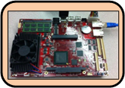

Connecting RTDS to the
Distributed Controls Testbed
Need to exchange signals between computational units and RTDS
  Receive sensor readings
  Send commands
Digital and analog I/O wires
  Tedious for large number of wires
  Signal mapping changes frequently
Notes:
Mapping of wires to computational units can frequently change depending on the particular project.

Slide 5
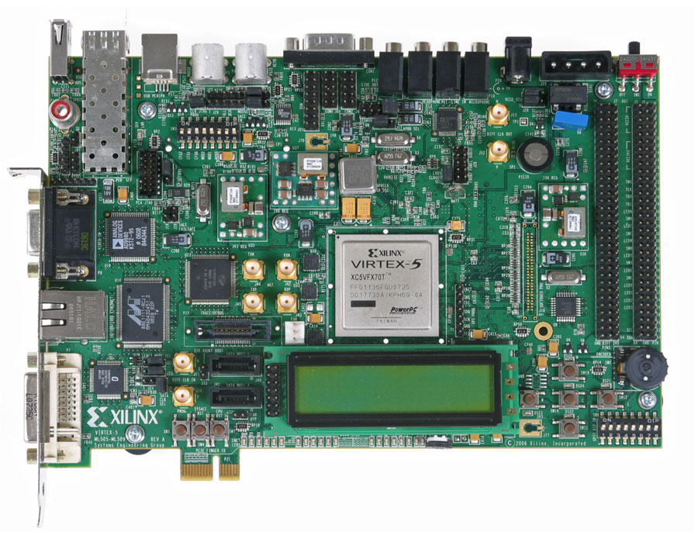
GTFPGA
Embedded PowerPC processor
Xilinx ML507 board
Fiber protocol capability (2 Gbps) to/from RTDS GPC/PB5 cards
Supported in RSCAD libraries for small and large time steps
64 bidirectional 32-bit signals in large time step, available for Ethernet-based communication
Fiber protocol decoding / encoding
Fiber optic
Ethernet
Notes:
RTDS provides the FPGA netlist that interfaces signals to/from RTDS

Slide 6
GTFPGA Flexibility
GTFPGA provides a flexible mechanism to exchange data
Reroute signals in software
  Support multiple experimental setups
  Automatable
    Faster
    Less error prone
Computational units may not have native I/O capabilities

Slide 7
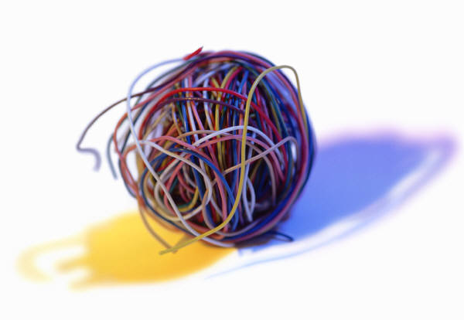
Communications
Mamba #1
Mamba #6

Slide 8
Communications
Mamba #1
Mamba #6
Ethernet
Fiber optic

Slide 9

GTFPGA
Computing Board #1
Computing Board #6
Data is exchanged between FPGA and RTDS every timestep
TCP/IP server
  Exchanges data between computational platforms and FPGA
  Code runs on PowerPC processor
  Multiple computational units can connect
  Port number to identify desired signals mapping
  Low performance
Ethernet
PowerPC
GTFPGA
Fiber optic encoder/decoder
Fiber optic
RTDS
Notes:
Long round trip latencies
Maximum of 7 TCP/IP connections (separate port)

Slide 10
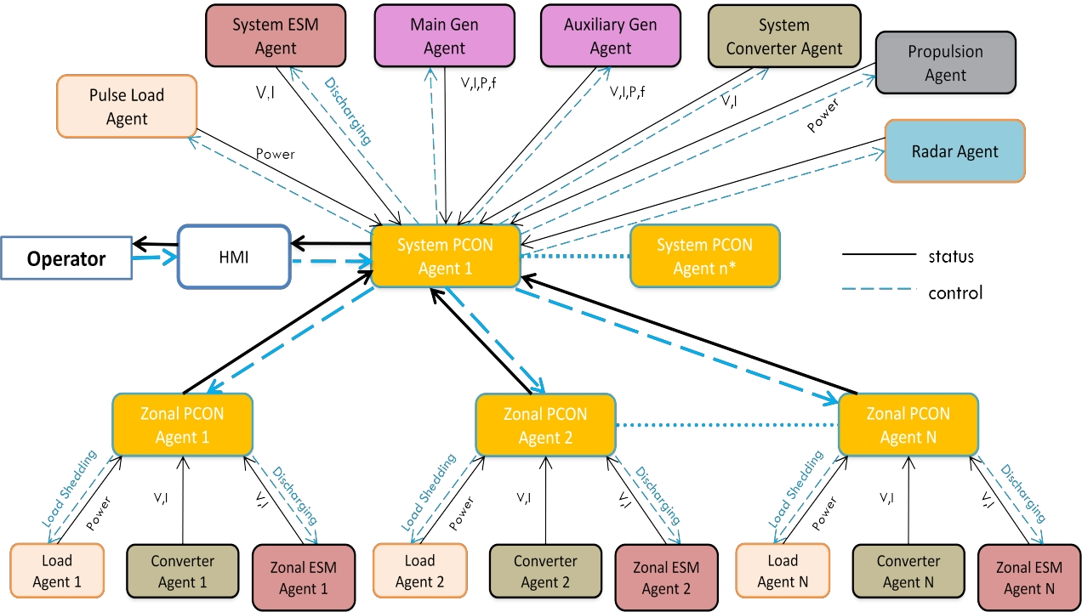
Shipboard Distributed Control
*Work by Qunying Shen
Notes:
example of a cyber-physical system
One example for the use of the distributed controls testbed is to be able to study distributed control for power and energy management on a shipboard power system.
Control scheme is a two-layer hierarchical architecture with supervisory (top-level) control and zonal (bottom-level) decentralized control.
A muti-agent system based framework is used to implement the decentralized control structure.

Slide 11
FREEDM (NSF Center)
Proposed a smart-grid paradigm shift to take advantage of advanced in renewable energy
  Plug and play energy resources and storage devices
  Manage resources and storage through distributed intelligence
  Scalable and secure communication backbone
Distributed Grid Intelligence (DGI)
  Control software for the FREEDM microgrid
  Manage distributed energy resources and storage devices
Solid State Transformer (SST)
  Power electronics based transformer
  Actively change power characteristics such as voltage and frequency levels
  Input or output AC or DC power
  Improve power quality (reactive power compensation and harmonic filtering)

Slide 12
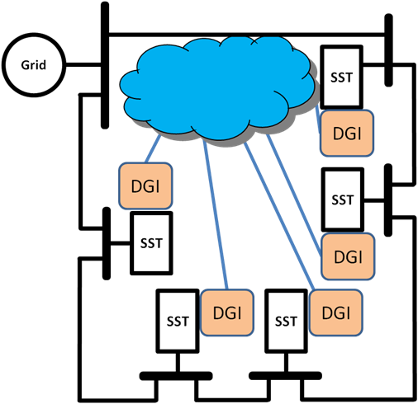
Distributed Grid Intelligence (DGI)
DGI issues power commands
Convergence
  DGIs collaborate to set equal loading on all SSTs
DGI proceeds through a series of phases
  Group Management
  State Collection
  Load Balancing
Data Communications
Notes:
DGI instantiated on the Mamba boards
SST simulated in RTDS
Another example of a cyber-physical system

Slide 13
Power Convergence

Slide 14
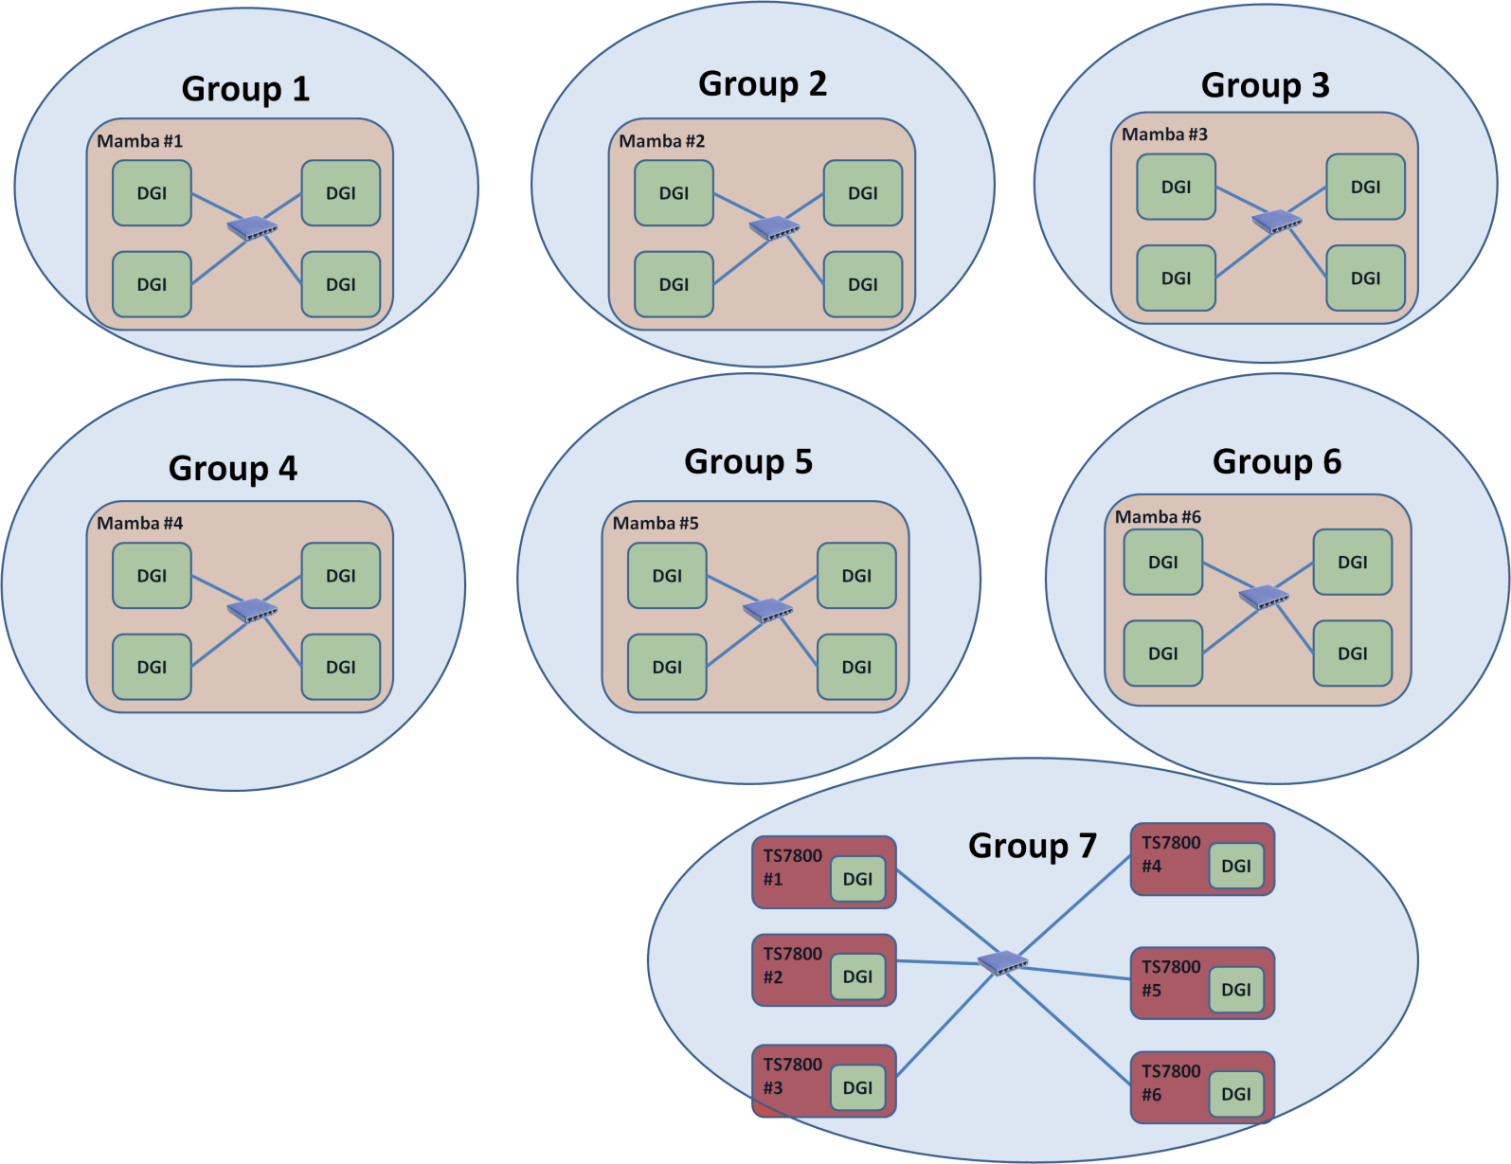
Need for Flexible Communications
Each DGI requires two signals to RTDS
60 total signals
Notes:
Setup 60 connections to the RTDS nearly instantaneously.
No hardware manipulation required
Running actual wires would result in a spaghetti mess with wires strung all over the place.

Slide 15
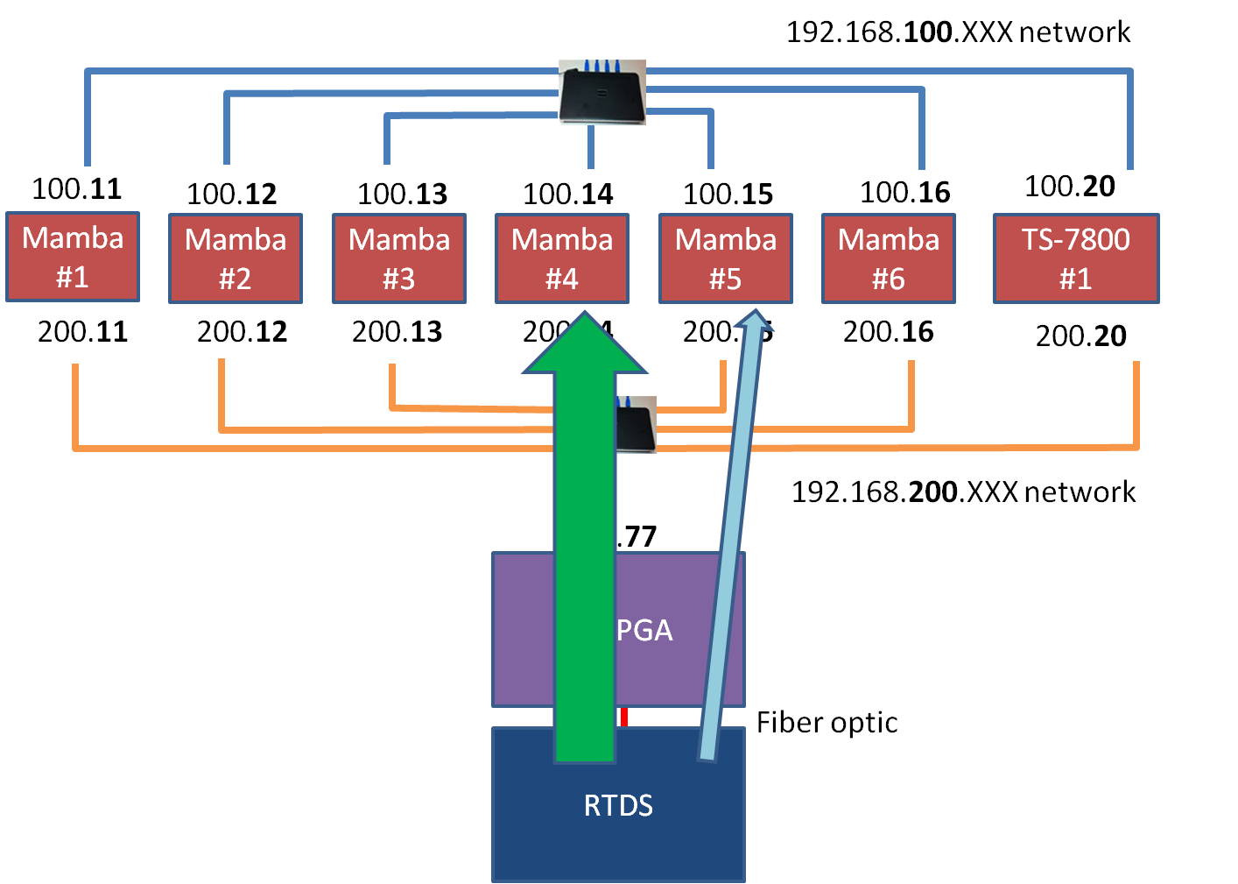

Slide 16
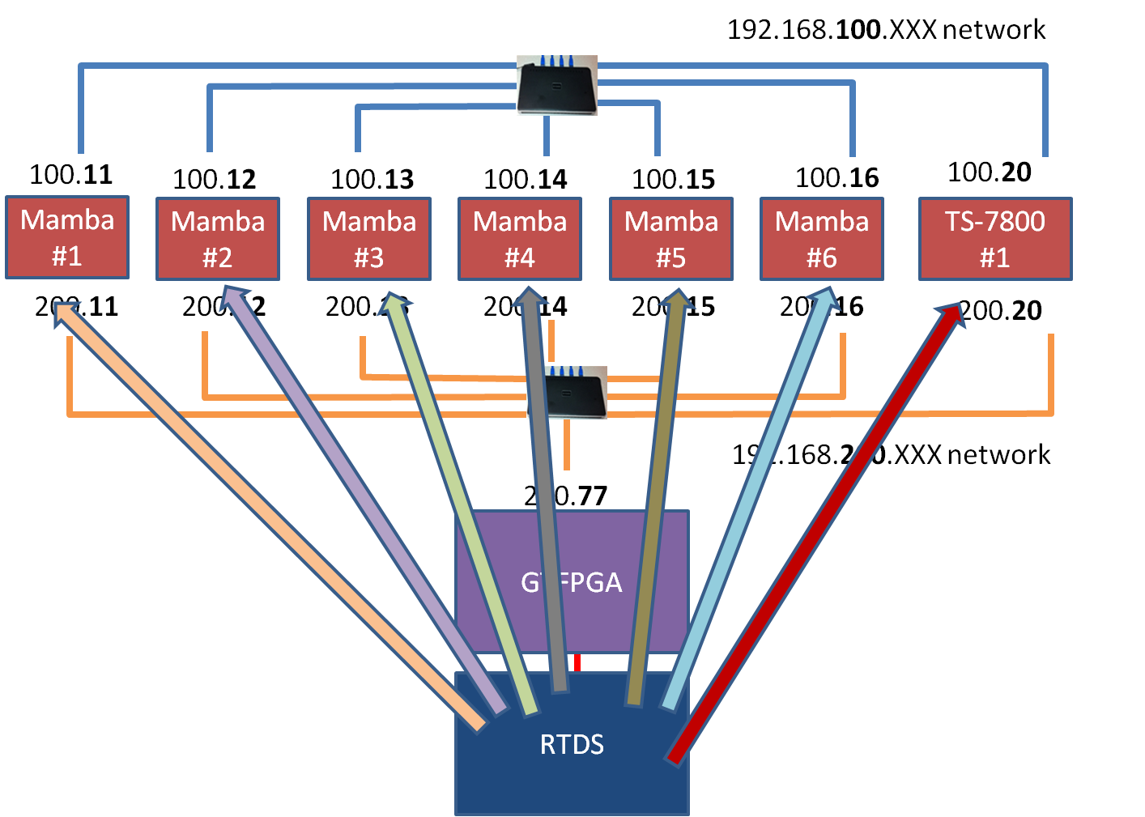

Slide 17

Round Trip Latency
Interference
  Number of competing connections
Send value to RTDS and wait for return to be incremented
  Mamba
  GTFPGA
  RTDS

Slide 18
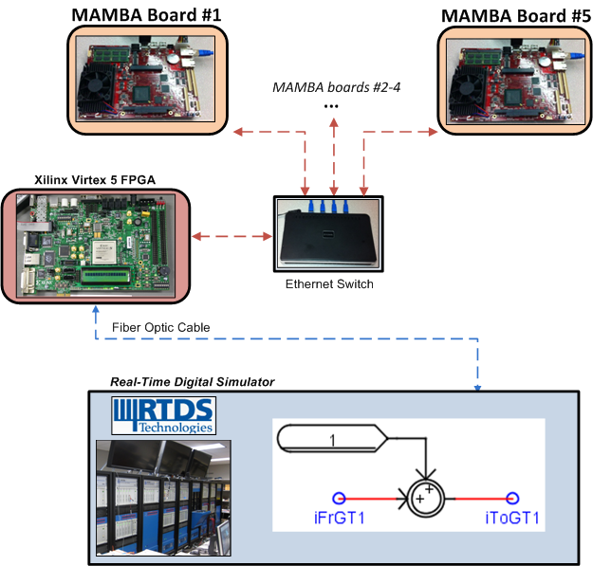
Round Trip Latency

Slide 19
Round Trip Latency
Number of competing connections
Notes:
Sharp peaks
Due to the nature of the experiment, each client sending a packet immediately after receiving a response from the server, it is extremely likely that the number of queued requests when sending a subsequent packet will be the same and therefore, the response times will be similar.
Queue of connections continually waiting to be serviced will likely be the same and assuming a constant amount of time to serve each client request, there will be very little variability in the response time

Slide 20
Various Alternatives
RTDS Interface Module
Embedded
PowerPC processor
Bulk transfer to separate distribution board
  TCP/IP implementation degrades with contention
Use PCIe to exchange data with host PC
  Host PC handles TCP/IP connections
  GTFPGA handles communication with RTDS
Fiber optic
Ethernet
PCIe

Slide 21
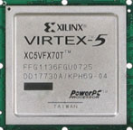
GTFPGA PCIe Communications
Host PC (Linux)
RTDS provides FPGA logic to decode/encode signals
Xilinx provide logic to communicate over PCIe
Write “glue” to put the two together
TCP/IP server
  Port to a Linux implementation
Driver
  Exchange data over PCIe
TCP/IP Server
Driver
Xilinx PCIe Communications
RTDS Optical Fiber Interface Module
Notes:
High learning curve (barrier to entry)
Xilinx dumps a whole lot of information that one must painstainkingly sift through
Xilinx code is very large and not all of it is necessary but must understand to a point in order to properly change and get things to work
Testing is very time consuming. Compile times are very long.

Slide 22

GTFPGA PCIe
Host PC (Linux)
Xilinx Coregen
  Implementation creates an FPGA project that communicates using PCIe protocol
  Reads and writes are directed to FPGA RAM
Add RTDS Interface Module to Coregen’d project
Redirect signals
  Write and read data made available by RTDS interface module
RAM
RAM
Xilinx Board
RTDS Interface
RTDS
Notes:
Start with coregen project and add RTDS code
Pcie much more complex than RTDS implementation

Slide 23
PCIe Host PC Software
User-space driver
  Memory mapped I/O
TCP/IP server
  Each control process utilizes a different port
  Configuration file used to setup RTDS to computational unit mapping
Host PC (Linux)
TCP/IP Server
Driver
Notes:
Routines to communicate with the Xilinx board

Slide 24
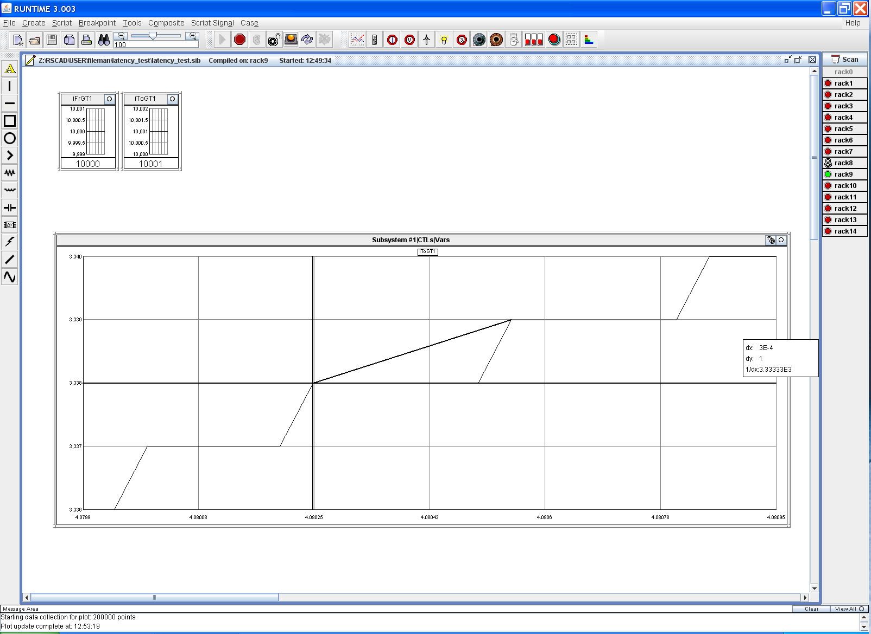
Round Trip Latency
10,000 round trip timings
300 microsecond latency

Slide 25
Round Trip Latency
(Initial Implementation)
Number of competing connections
Notes:
Sharp peaks
Due to the nature of the experiment, each client sending a packet immediately after receiving a response from the server, it is extremely likely that the number of queued requests when sending a subsequent packet will be the same and therefore, the response times will be similar.
Queue of connections continually waiting to be serviced will likely be the same and assuming a constant amount of time to serve each client request, there will be very little variability in the response time

Slide 26
Round Trip Latency
(Vary Competing Connections)
Number of competing connections
(Each connection exchanges 4-bytes)

Slide 27
Round Trip Latency
(Vary Transfer Size)
4-byte Signals Exchanged
Notes:
Previous slide was 1-word only

Slide 28
Future/Continuing Work
Diversify and expand the number of computational units
  Different architecture
  Reduced computational power
DMA rather than memory-mapped I/O
  Each signal potentially results in one PCIe transaction
  Reduce variability due to changes in number of signals exchanged
Co-simulation
  Utilizing GPU facilities
  Pseudo real-time Simulink
    RTDS signaling to “clock” Simulink

Slide 29
Conclusion
GTFPGA offers a very flexible and scalable solution
  Extend communicate with external computational units
Utilizing Ethernet interface directly on the GTFPGA results in large latencies
PCIe interface of GTFPGA can be used to reduce latencies
Utilizing the PCIe interface
  Latencies are significantly reduced
  Larger number of connections are supported
Opportunity to view PCIe implementation on tour

Slide 30


Acknowledgement
This work was partially supported by the National Science Foundation (NSF) under Award Number EEC-0812121 and the Office of Naval Research Contract #N00014-09-C-0144.

Slide 31
Contact Information
Mark Stanovich – stanovich@caps.fsu.edu
Mike Sloderbeck – sloderbeck@caps.fsu.edu
Raveendra Meka – meka@caps.fsu.edu

Slide 32
Future/Continuing Work
Diversify and expand the number of computational units
  Different architecture
  Reduced computational power
Data communications emulation
  Topologies
  Wireless
  Characteristics
    Dropped packets
    Latencies
Notes:
Look at interactions among diverse computational units.
Effects over wide area networks
- routing delays
- different media
Robustness of control software in the presence of non-ideal data communications.

