Slide 1
NETCONSOLE
Network message logging
Eduardo behar

Slide 2
What is it?
Netconsole is a *remote logging service
Linux kernel module
Can be built-in or modularized
*Already on most Linux systems*
Made by Ingo Molnar, Matt Mackall, and Cong Wang

Slide 3
What does it do?
Logs printk/dmesg messages over UDP(User datagram protocol) to another computer
Port 514(default) or 6666
/var/log ->syslog or /netconsole.log
Doesn’t involve userspace(i.e. syslogd with nodes)

Slide 4
What problems do we have?
Kernel panics might be hard to capture
Errors might not be reproducible
Disk logging might not work
Log files can be clueless

Slide 5
How does netconsole help?
When disk logging fails, netconsole does not
ed@Comp ~$ printf Hooray for netconsole!
It is remote, instantaneous
Does not enable interrupts
Makes debugging easier

Slide 6
Installing netconsole-Pre
Determine senders information
Ip address(ex. 192.168.0.1337)
Determine receivers information
Mac address(ex. 13:37:69:00:r2:d2)
Ip address(ex. 192.168.0.69)

Slide 7
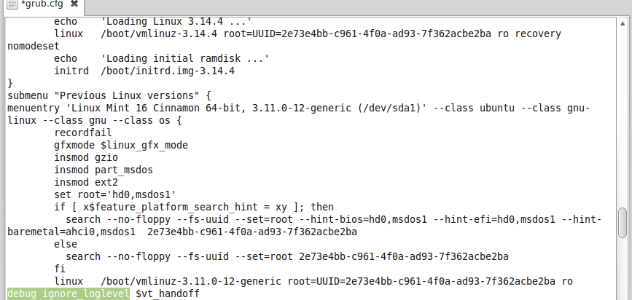
Installing netconsole-Sender
Edit grub.cfg
Replace “quiet splash”
~$ update-grub

Slide 8
Installing netconsole-Sender
Initialize at boot time
netconsole=<LOCAL_PORT>@<SENDER_IP_ADDRESS>/<SENDER_INTERFACE>,<REMOTE_PORT>@<RECEIVER_IP_ADDRESS>/<STEP_1_MAC_ADDRESS>
~$ sudo sh –c ‘echo options netconsole netconsole=6666@192.168.0.1337/eth0,6666@192.168.0.69/13:37:69:00:r2:d2 > /etc/modprobe.d/netconsole.conf'

Slide 9
Installing netconsole-Receiver
Linux - ~$ netcat -l -u 192.168.0.69 6666 | tee ~/netconsole.log
Or ~$ netcat -l -u 6666 | tee ~/netconsole.log
Mac - $ nc -l -u 192.168.0.69 6666 | tee ~/netconsole.log
Or ~$ nc -l -u 6666 | tee ~/netconsole.log
Windows
Download and unpack netcat(say on Desktop)
cd C:\Users\I_am_a_Pc_derp\Desktop\Netcat
nc -u -l -p 6666 192.168.0.69 > netconsole.txt

Slide 10
Removing netconsole
Revert Grub back to Original config
~$ sudo mv /etc/default/grub.backup /etc/default/grub
~$ sudo update-grub
Remove Netconsole itself
~$ sudo sed -i '/^netconsole/d' /etc/modules
~$ sudo rm -f /etc/modprobe.d/netconsole.conf

Slide 11
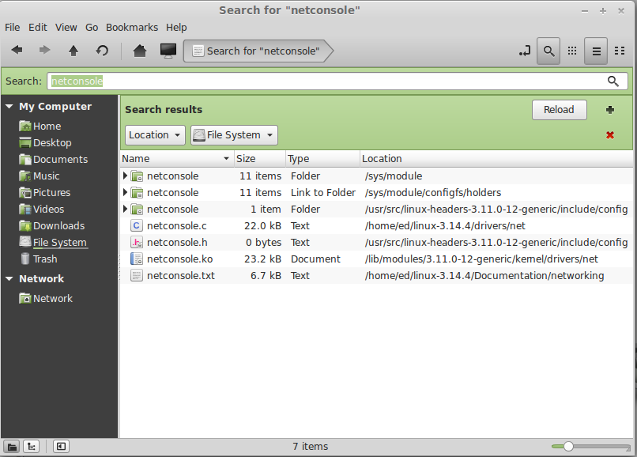
demo
Installed on system/modularized

Slide 12
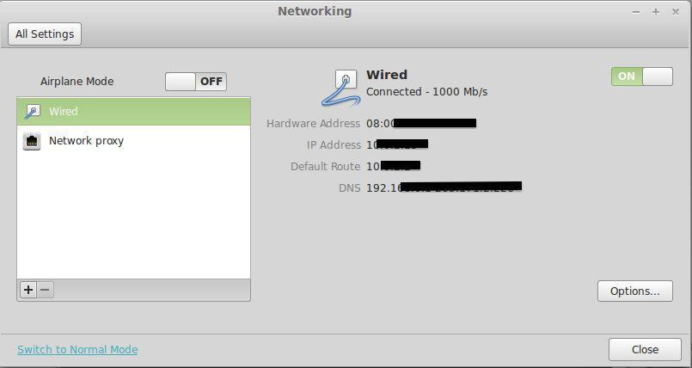
Demo
Sender relative information

Slide 13
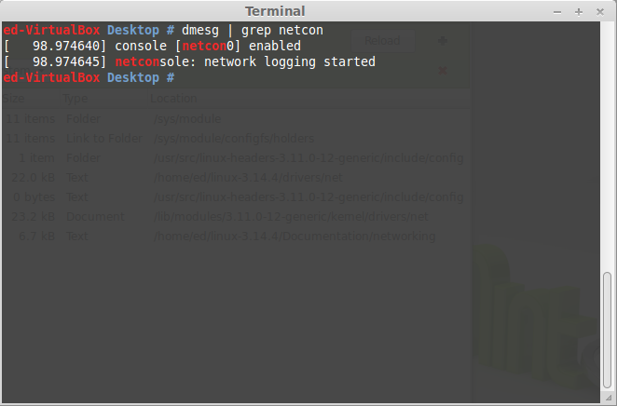
demo
Service started

Slide 14
references
https://wiki.ubuntu.com
https://wiki.archlinux.org
http://www.cyberciti.biz
https://www.kernel.org
Source readme files in netconsole directory

