Slide 1
Eclipse
Kevin Daniels

Slide 2
Overview
Integrated Development Environment (IDE)
Usually used to develop applications in various programming languages (C, C++. Java, JavaScript, Perl, Python, etc.)
Also used for Android Development and PHP Development

Slide 3
Uses for Kernel Development
Using Eclipse CDT (C/C++ Development Tooling)
Code editor with syntax highlighting
Visual debugging tools
Details about errors/warnings
Standard make build
Setting/changing build commands/directories
Disable automatic building (every time you change something it doesn’t require you to rebuild the whole kernel)
And more!

Slide 4
Setting up Eclipse
Download Eclipse CDT from www.eclipse.org/cdt
Eclipse requires Java (install Java)
Extract and then ‘cd’ to containing directory and type: ./eclipse
Create new C Project, uncheck the “Use default work space” and select it to the location of your kernel’s directory
Go to Window -> Preferences -> General -> Workspace -> and disable option “Build automatically”

Slide 5
Turning Off Auto Build

Slide 6
Indexing In Eclipse
Indexing makes navigating through your code much more efficient and helps you and Eclipse interpret code correctly.
Cons:
Usually does not work out of the box for large projects like Linux kernels.
It can be very tedious to configure all the correct paths for Eclipse to look through for header files and other includes.
Once set up it can still take some time for Eclipse to locate everything and be in sync.
Changing certain headers can not only lead to lengthy rebuilds of the project, but indexing as well.

Slide 7
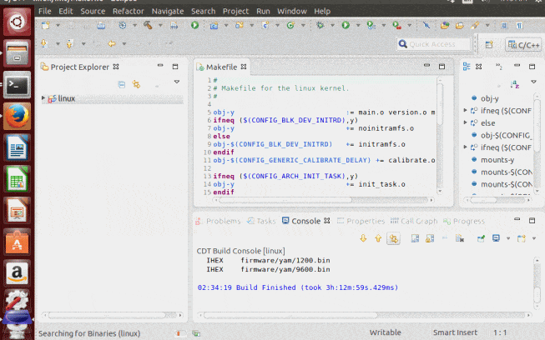
Adding a Path for Indexing
Click on the Project folder
Go to Project -> Properties -> C/C++ General -> Preprocessor Include Paths, Macros...
Under Languages click GNU C, then select CDT User Settings Entries then Add…
Left dropdown: Preprocessor Macros File
Right dropdown: Project Path
Put the path in the File text field

Slide 8
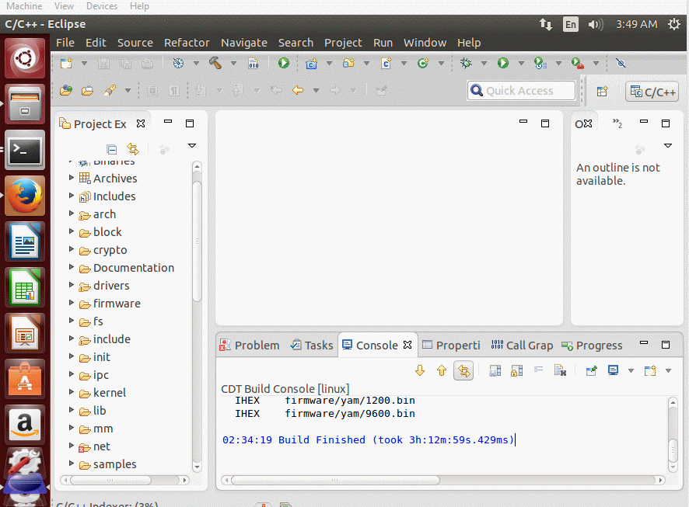
Removing Indexing
A lot easier…

Slide 9
Setting up the Kernel for Eclipse

Slide 10
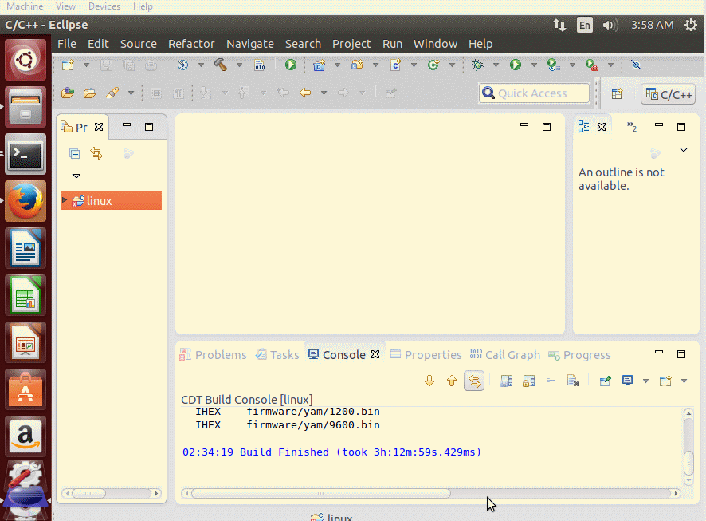
Basic usage
Project Explorer: Helps you navigate the kernel/project and select files

Slide 11
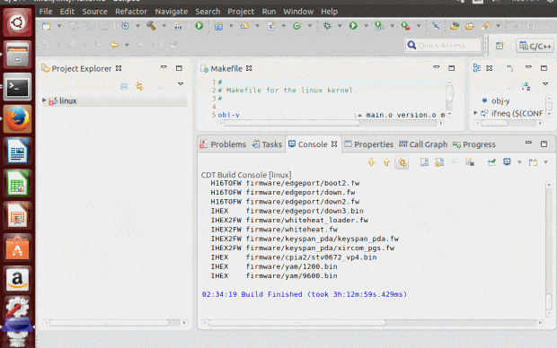
Basic Usage
Console: Displays output, just like it would in terminal
Problems: shows errors, warnings, and info with their location and allows for sorting

Slide 12
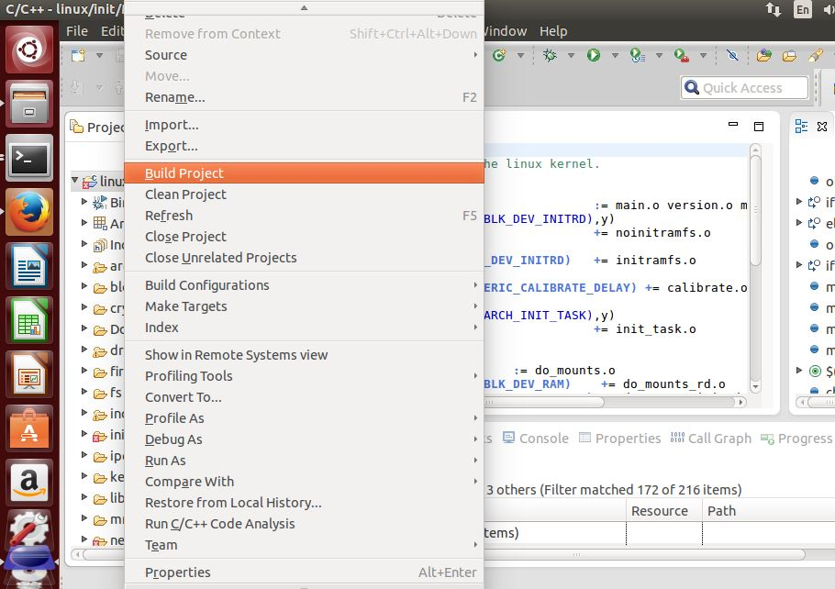
Basic Usage
How to build your kernel: Right click project folder, select Build

Slide 13
Demo – Debugging a Kernel
Build kernel in Eclipse
Use emulator to run kernel (QEMU – open source emulator that can book Linux kernel directly)
Set up debug configurations (see next slide)
Launch kernel with QEMU: qemu-system-x86_64 -no-kvm -s -S -kernel /home/kevin/downloads/linux-3.14.5/arch/x86/boot/bzImage
-S stops the kernel at startup
-s is shorthand for -gdb tcp::1234 (see next slide)

Slide 14
Debug Configurations

Slide 15
Debug Configurations (typed)
Right click the Project folder, select Debug As… then Debug Configurations
Double Click on “C/C++ Attach to Application”
Browse to the vmlinux in the Application field
Click on Debugger tab, select gdbserver on the top dropdown
Click the Connections tab, select TCP for Type

Slide 16
Debugging
Click the button and select your configuration
After the debugger loads, press F6 to step through the kernel or F8 to run it without breaks

Slide 17
Resources
http://www.eclipse.org/cdt/
http://eclipsebook.in/c-cpp-development/tweaking-cdt/c-cpp-indexing/
http://www.sw-at.com/blog/2011/02/11/linux-kernel-development-and-debugging-using-eclipse-cdt/
http://wiki.eclipse.org/HowTo_use_the_CDT_to_navigate_Linux_kernel_source
http://www.opensourceforu.com/2011/02/kernel-development-debugging-using-eclipse/

