Slide 1
fTrace
Kernel debugging

Slide 2
What is fTrace
Internal tracer that was included in 2.6
traces the internal operations of the kernel
traces all functions within the kernel
choose to trace specific functions
traces stack usage
system latency

Slide 3
How to Setup and Use
typically mounted with
mount -t debugfs nodev /debug
to see which tracers are available on your system
cat /debug/tracing/available_tracers
blk mmiotrace function_graph wakeup_rt wakeup function nop
Tracing is enabled by writing to
/debug/tracing/current_tracer

Slide 4
How to Setup and Use
Enable function tracing with
echo function >/debug/tracing/current_tracer
tracing is enabled with
echo 1 >/debug/tracing/tracing_on
to trace the kernel in the context of a particular function
echo $$ > /debug/tracing/set_ftrace_pid

Slide 5
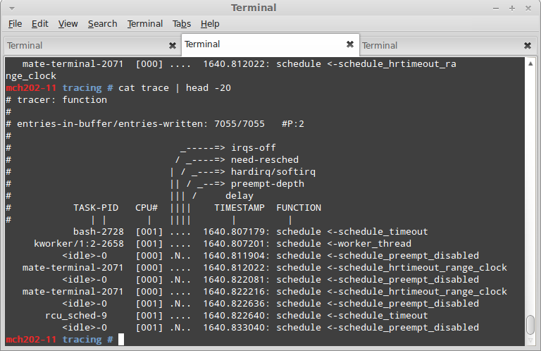
Tracing Functions

Slide 6
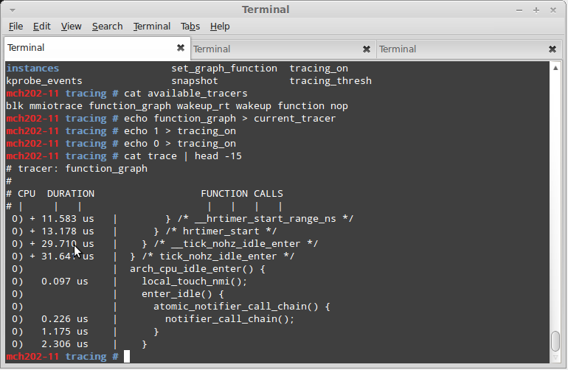
Graphing Functions

Slide 7
References
http://elinux.org/Ftrace
http://lwn.net/Articles/322666/
http://www.opensourceforu.com/2010/12/kernel-tracing-with-ftrace-part-2/

